Slide 1

Rhenium-SCT - Treatment Option for Non-Melanoma Skin Cancer
EDUCATIONAL WEBINAR
Speaker: A/Prof Sid Baxi, Gold Coast
Acknowledgement: Prof Paolo Castellucci / Dr Mohsen Fasad et al, Department of Nuclear Medicine, University of Bologna, Bologna Italy
Notes:
^{ONC3785}

Slide 2
Disclosures
OncoBeta
GenesisCare

Slide 3
Agenda
Science
Literature
Procedure
Report on interim outcomes

Slide 4
Another option in our artillery! (Adapted from NCCN Guidelines)
Therapy | Recurrence BCC | Recurrence SCC | Indication | Contra-indication | Drawback
Electodessication & curettage | 3-9% | 4-8% | Low risk tumors | High-risk locations, high-risk histologic subtypes, haired areas, deep lesions | No histologic margin assessment possible
Excision with postoperative margin assessment | 2% | 2-8% | Low risk tumors, high-risk tumors with wider margins | Skin grafting, tissue rearrangement, expected functional or cosmetic impairment | 4mm/6mm margin required (BCC/SCC respectively) for low risk; wider (~1cm) margins for high-risk
Mohs Surgery | 1% | 3% | High-risk tumors, positive margins after surgery with post-operative margin assessment | Expected functional or cosmetic impairment | Recurrence after skin grafting or tissue rearrangement results in increased risk
Radiation therapy | 5-10% | 5-10% | Inoperable; Cosmetic & functional reasons; patient preference; post-op indications | Genetics ; connective tissue diseases; relative contra-indications (age, location) | 5-35 fractions depending on need; histologic margins assessment not possible
Imiquimod / 5-FU | 15% | 16% | Low risk tumors with contraindicated surgery and radiation | NA | No histologic margin assessment possible
Cryosurgery | 0-13% | n. a. | Low risk tumors with contraindicated surgery and radiation | NA | No histologic margin assessment possible
Photodynamic therapy | 10-30% | n. a. | Low risk tumors with contraindicated surgery and radiation | NA | No histologic margin assessment possible, painful
Vismodegib | over 50% | n. a. | Recurrent BCC patients after unsuccessful surgery and radiation | Pregnancy, nursing, child wish | Adverse events ~30% (muscle spasms, taste / weight loss, alopecia, fatigue), life-long daily consume, no histologic margin assessment possible
Notes:
We will need to state wither on the slide or verbally that this is not a direct comparison table and is a adaptation: Reference: 1. Bichakjian CK, et al. Basal Cell Skin Cancer, Version 1.2016, NCCN Clinical Practice Guidelines in Oncology. J Natl Compr Canc Netw. 2016;14(5):574-97. doi: 10.6004/jnccn.2016.0065

Slide 5

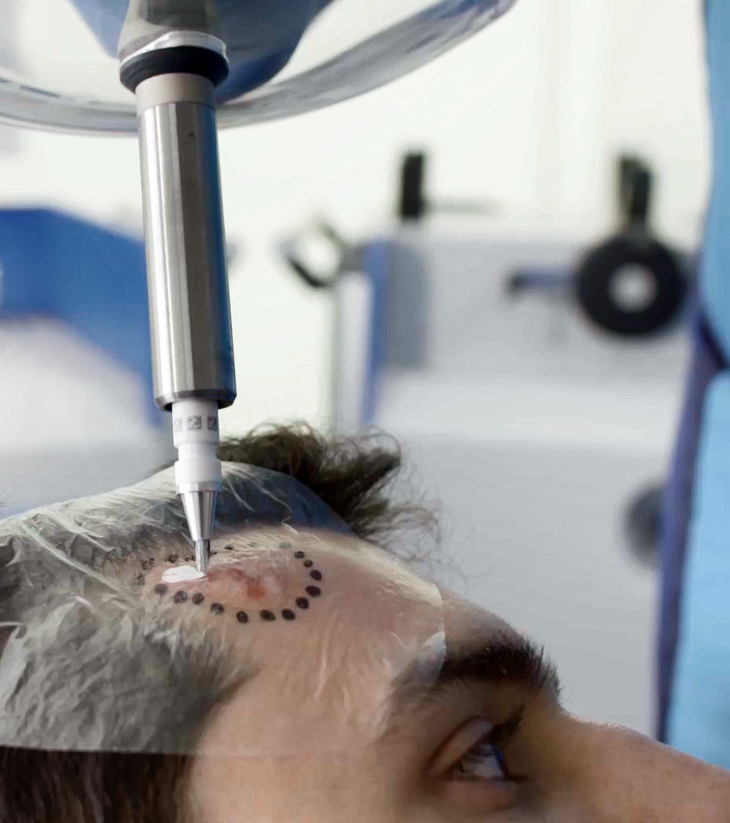

What is Rhenium SCT®?
The Rhenium-SCT® is a resin/paste utilising the beta emitter radioisotope Rhenium-188 for the treatment of Non-Melanoma Skin Cancer.
Mechanism of action:
local direct cell-killing effect of radiation
Creates a immunological response via inflammation
KEY FEATURES
Painless
Non invasive
Personalised
Single session
Aesthetic
Bringing back Quality of Life
Notes:
Please update to look more visually appealing.

Slide 6
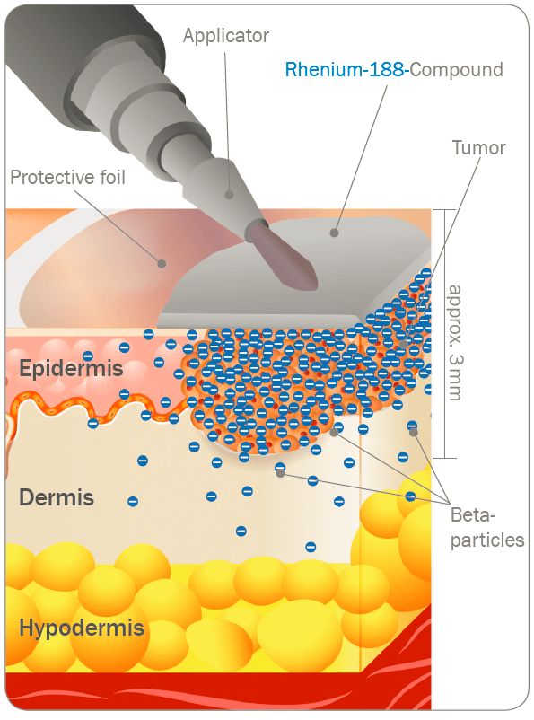
Rationale for the use of ¹⁸⁸Re therapy
¹⁸⁸ Rhenium
Synthesised isotope
Decay
85%: 𝛽- (2,12 MeV)
15%: 𝛾 (155 KeV)
Daughter: 188 Os
Half life 17 hours
Energy 𝛽- (2,12 MeV) delivery profile of ¹⁸⁸Renium (in the skin):
About 75% energy delivered in the first 1mm
About 90% in the first 2mm
About 95% in the first 3 mm
Notes:
Limitation - lesions thicker than 3.0mm cannot be treated with a single application of 188Re SCT
Advantage - relatively high effective dose of Re-188 can be administered to the surface, without deeper involvement of the sub-dermal structures allowing for optimal recovery of the subsequent dermatitis that occurs

Slide 7
INDICATIONS:
BCC / SCC and IEC
Lesions <3mm in thickness
Radial size is not a contra-indication but a consideration
Cautions:
Peri-ocular / peri-oral
Clinical or radiological PNI
Standard radiation therapy cautions – pregnancy / radiation sensitivity syndrome or sensitizing medications

Slide 8
TGA approved Not Medicare funded currently

Slide 9
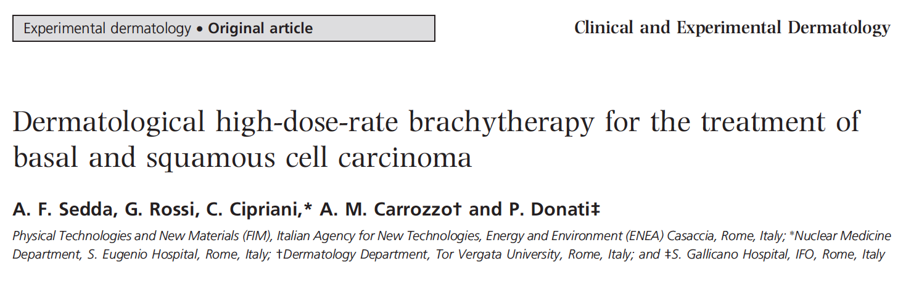
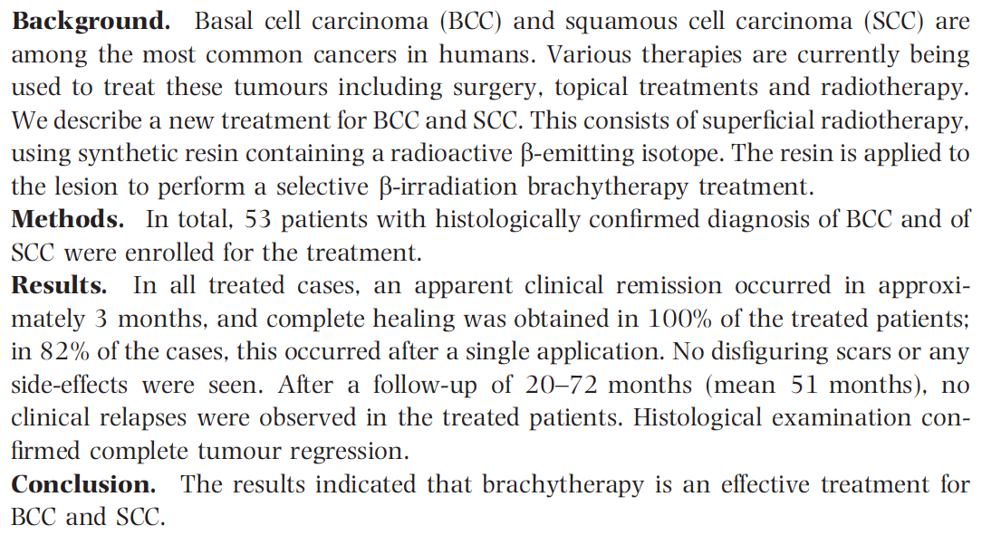
Skin Cancer Therapy using ¹⁸⁸Re is not a “new” technique

Slide 10
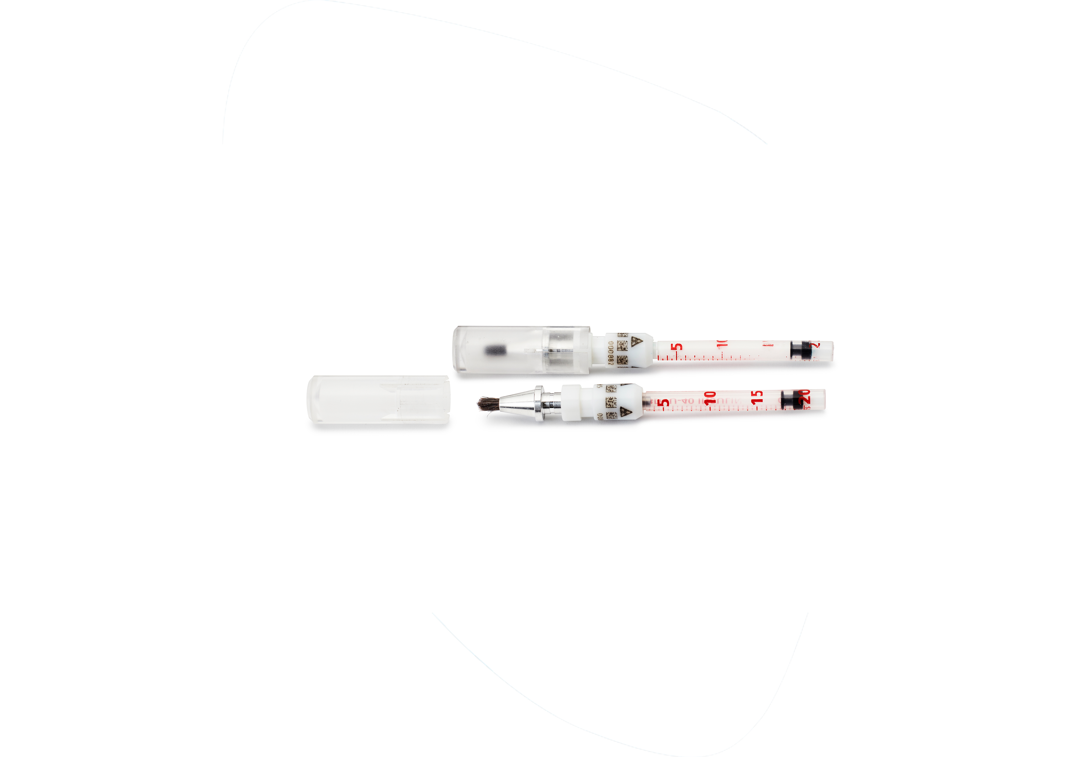
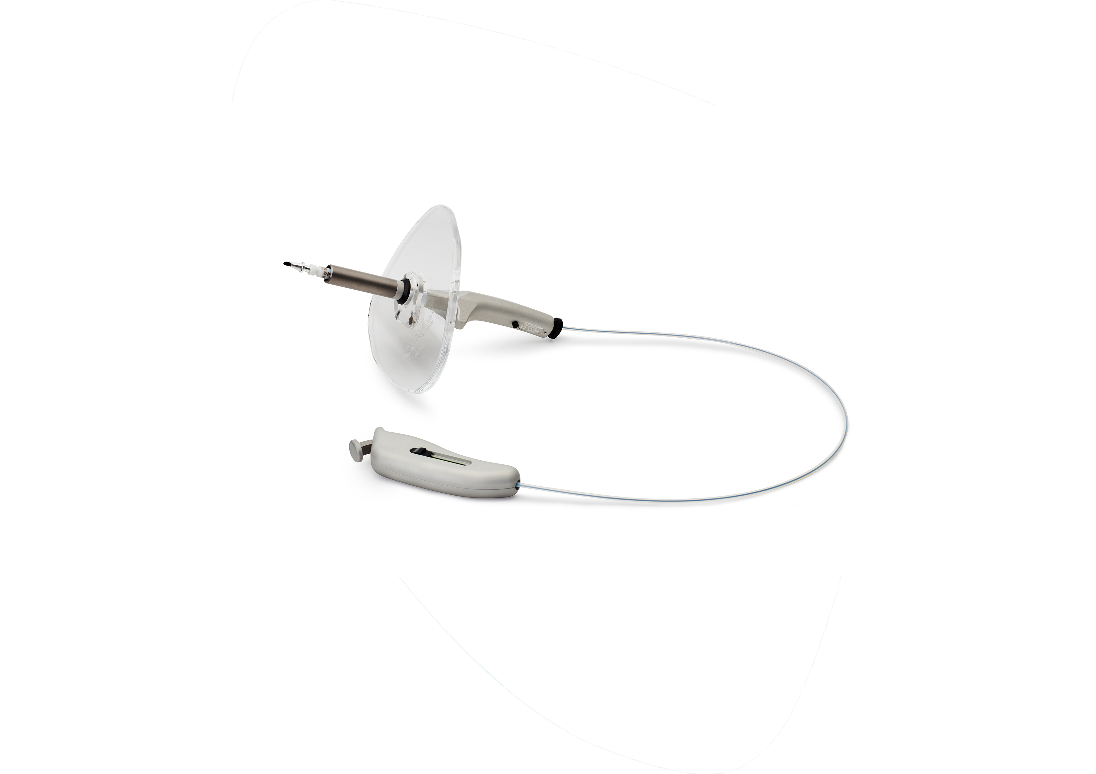
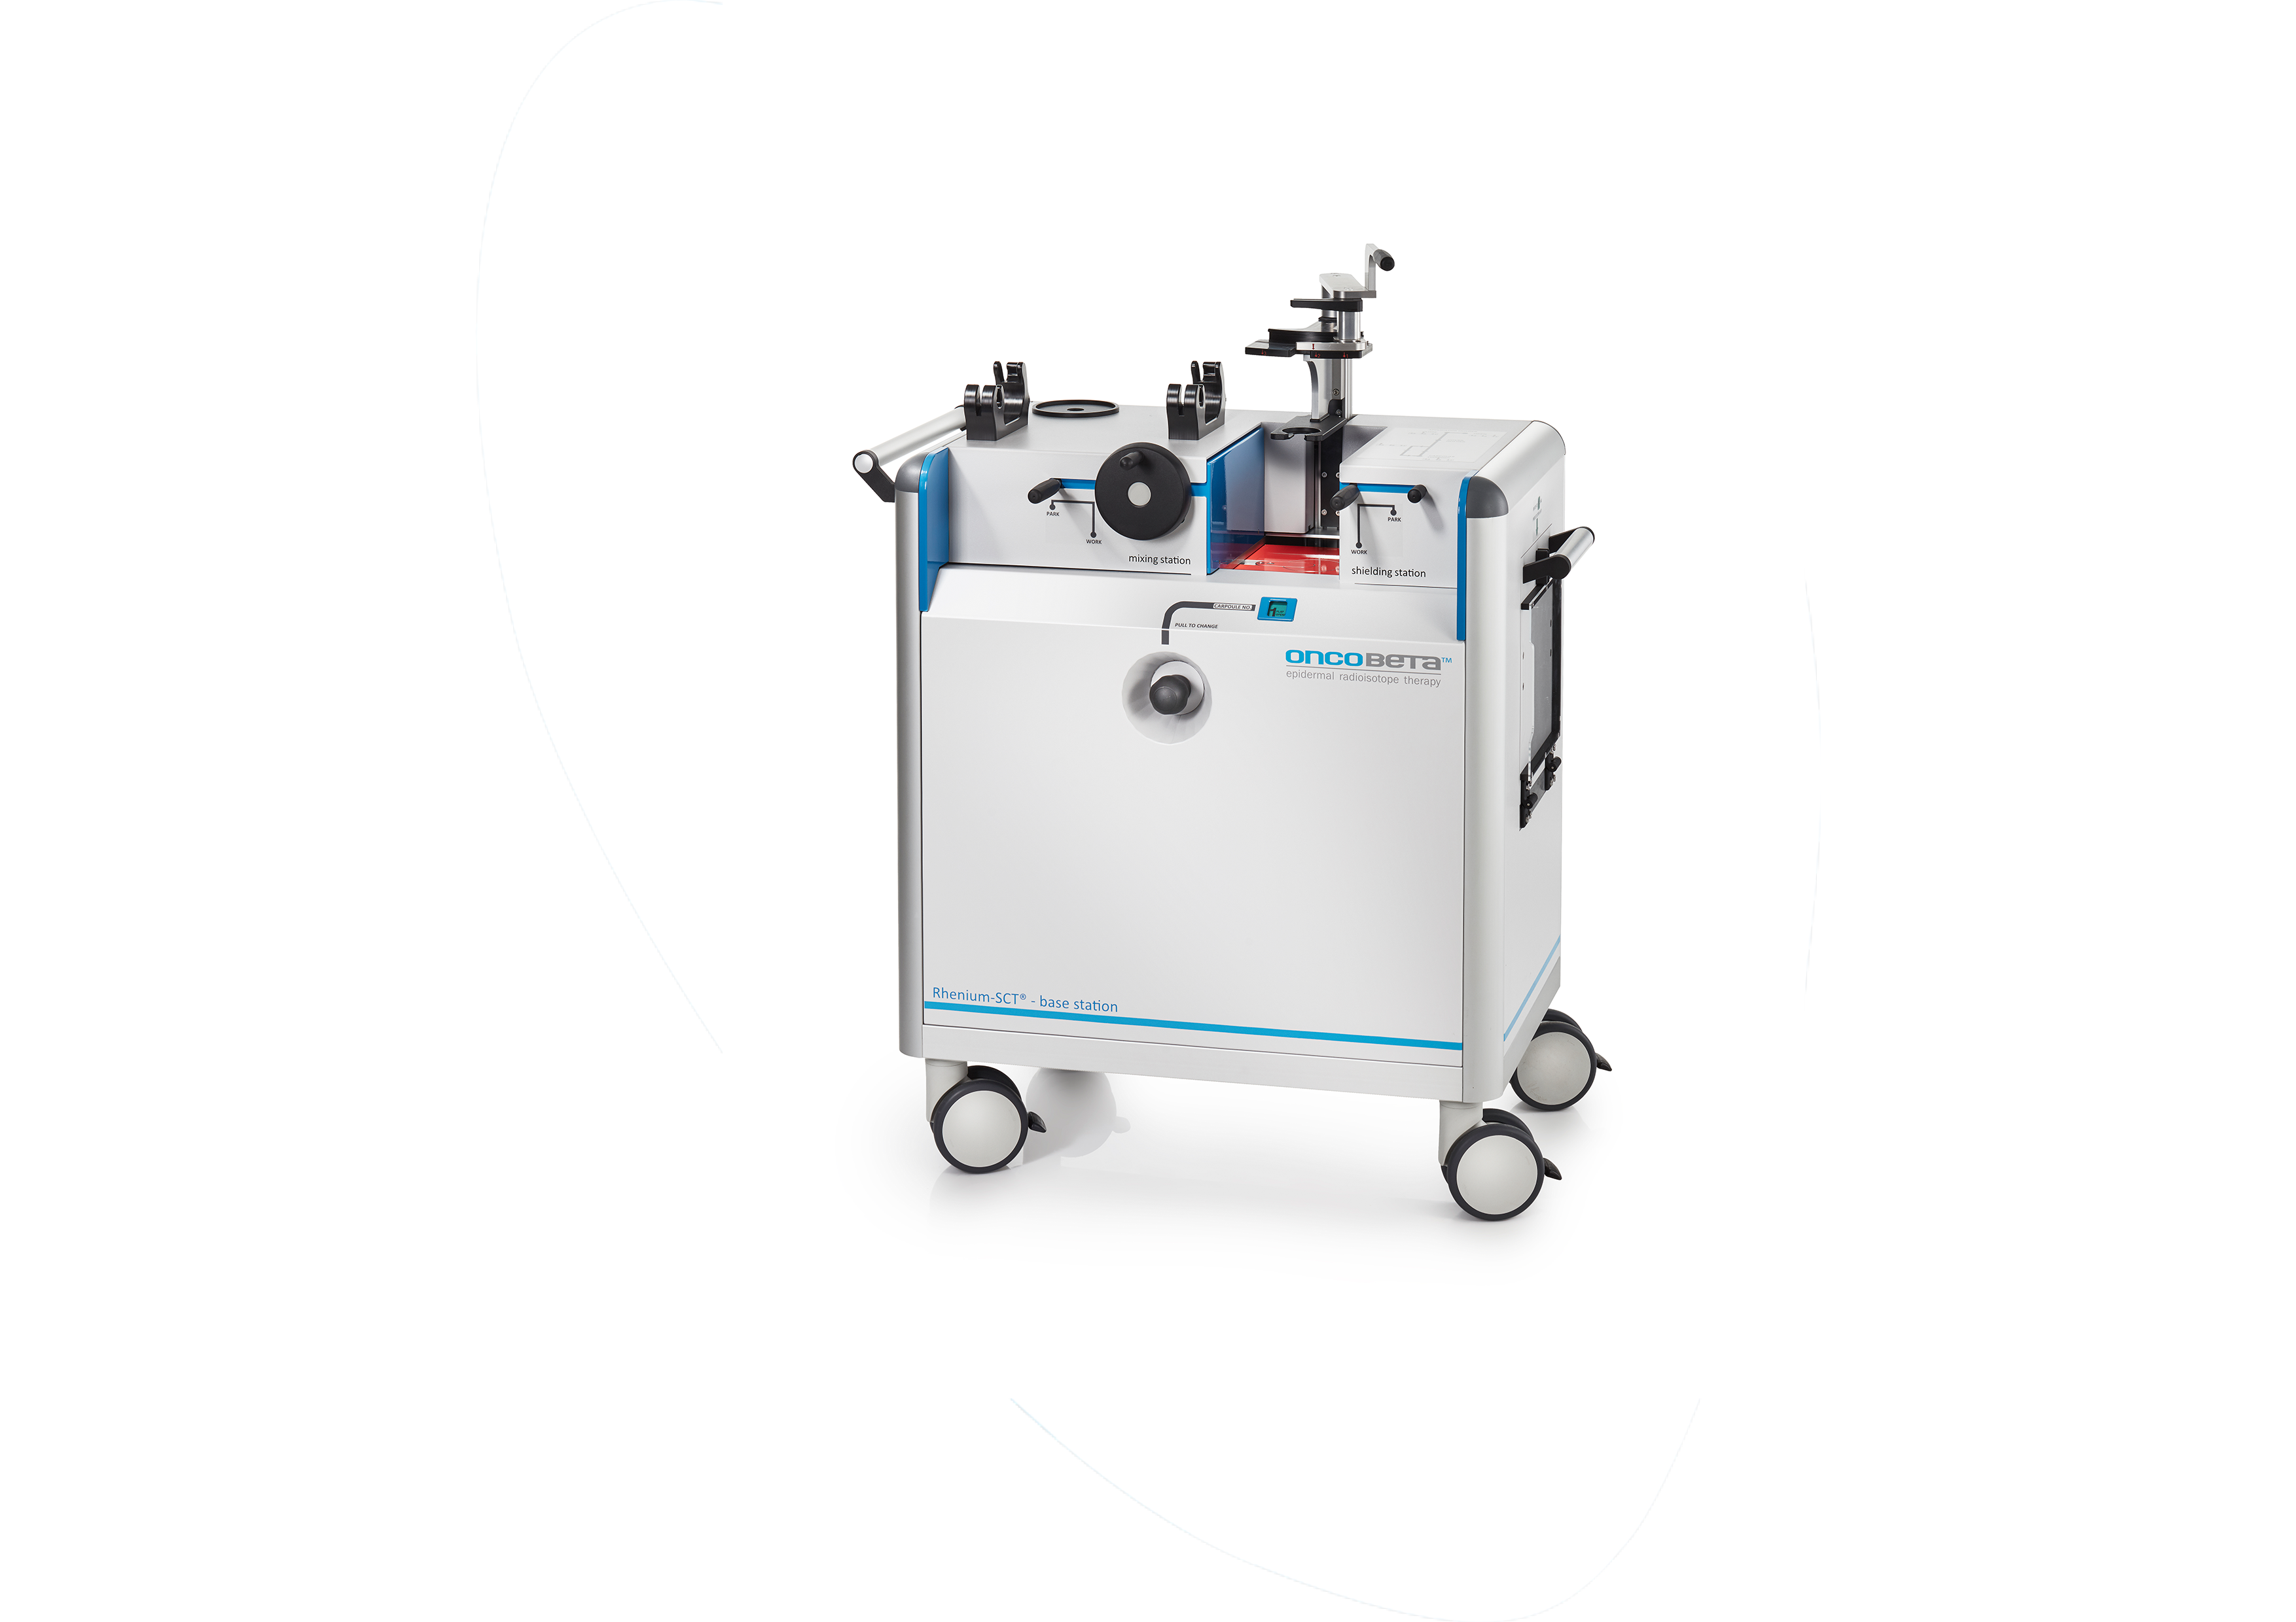
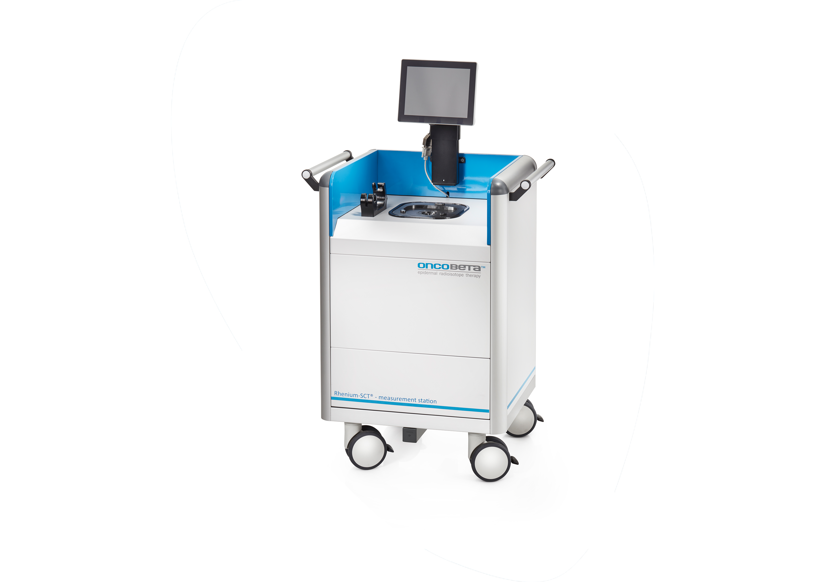
Rhenium-SCT®: Application System
Rhenium-SCT Carpoule is TGA registered for the treatment of NMSC
Carpoule
Applicator
Base Station
Measurement Station

Slide 11
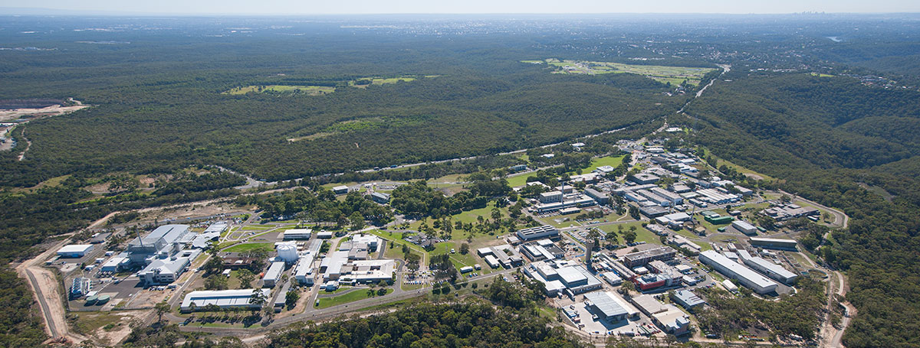

ANSTO Lucas Heights Campus and OPAL reactor
Sydney Airport
OPAL
Production
28km

Slide 12
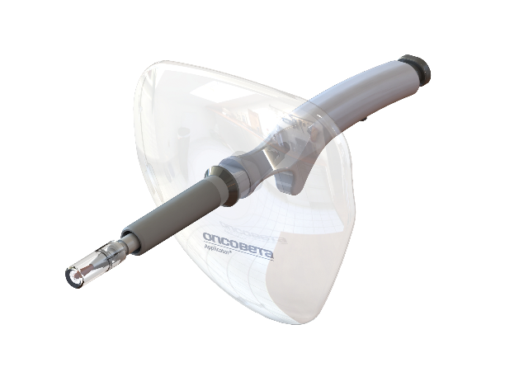

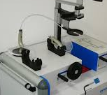
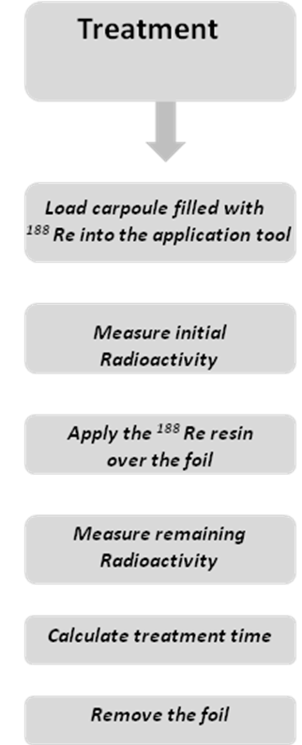
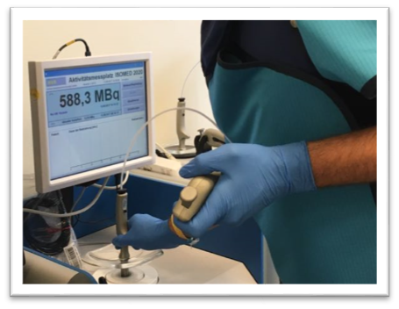
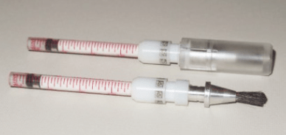
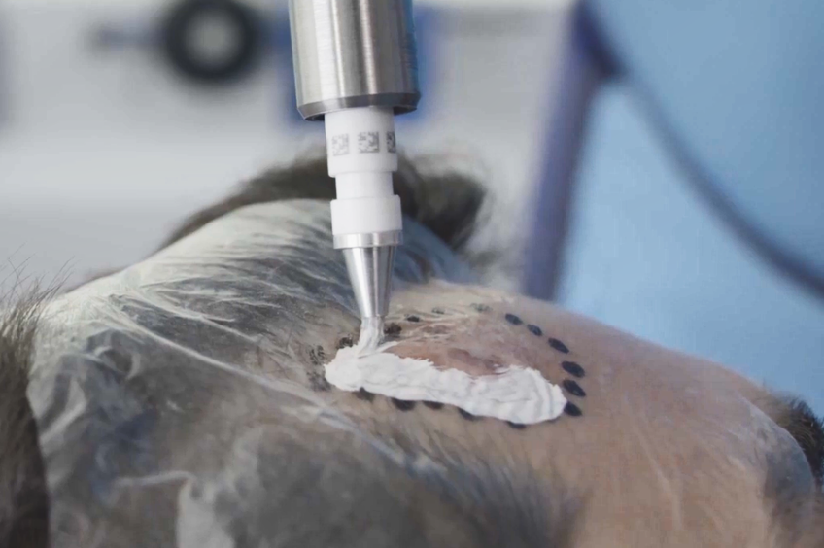
Approx. 10 minutes
+
treatment time
Application tool
Rhenium carpoule

Slide 13
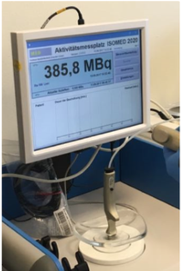
Before
After
203 MBq of ¹⁸⁸Re administered TIME 0 !!
Notes:
To determine "paste on time"
Lesion’s surface area
Lesion’s depth
MBq administered

Slide 14
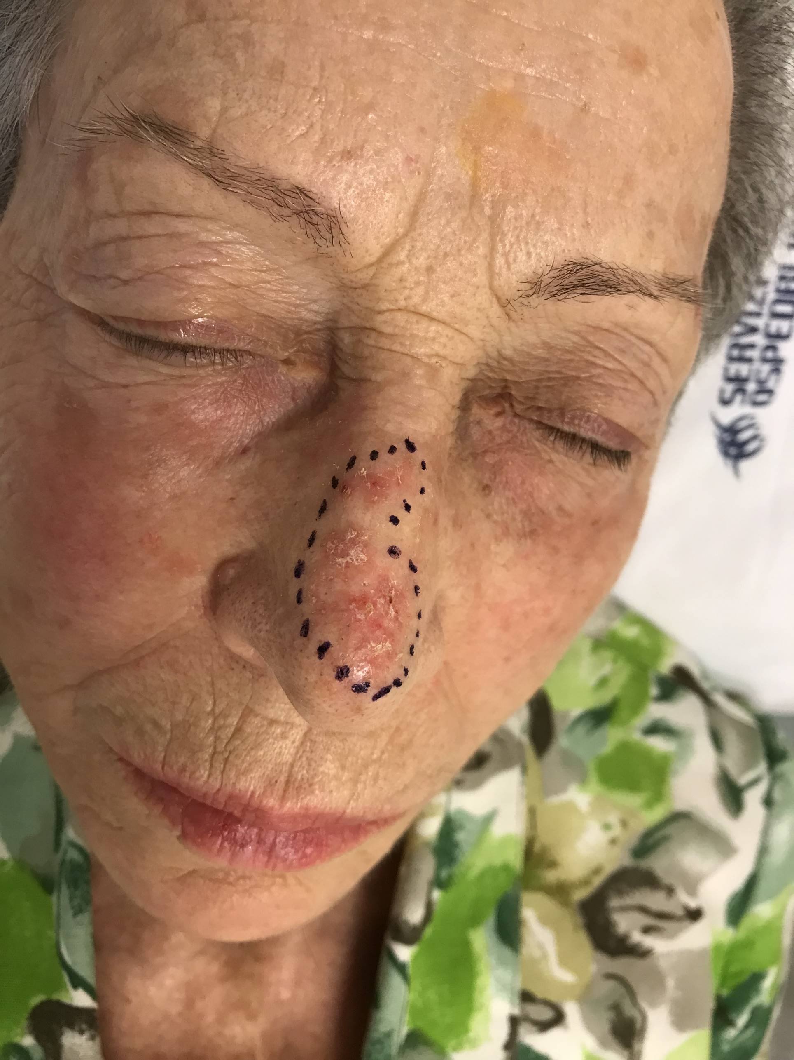
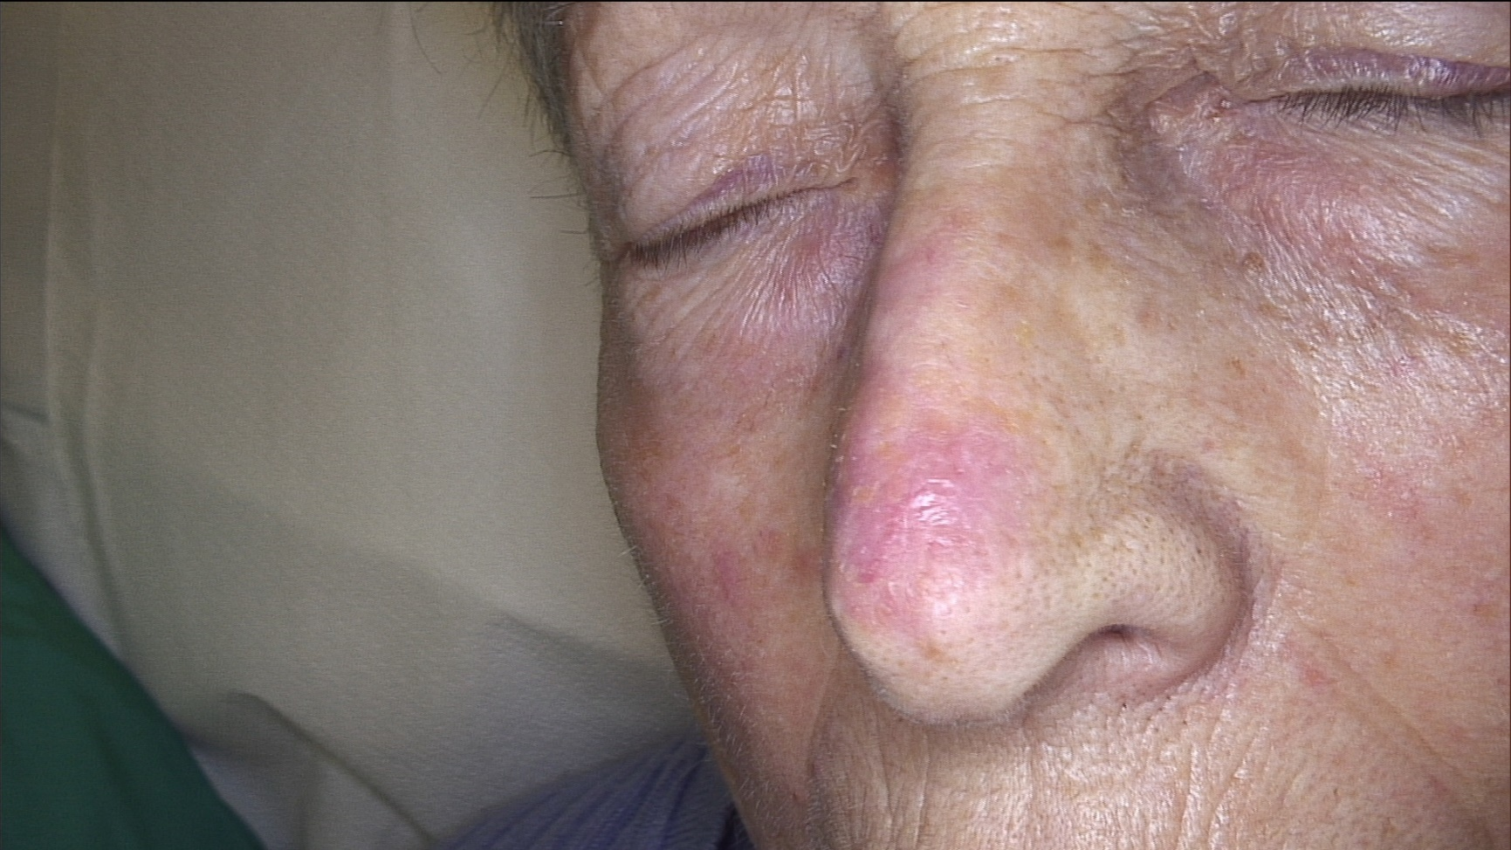
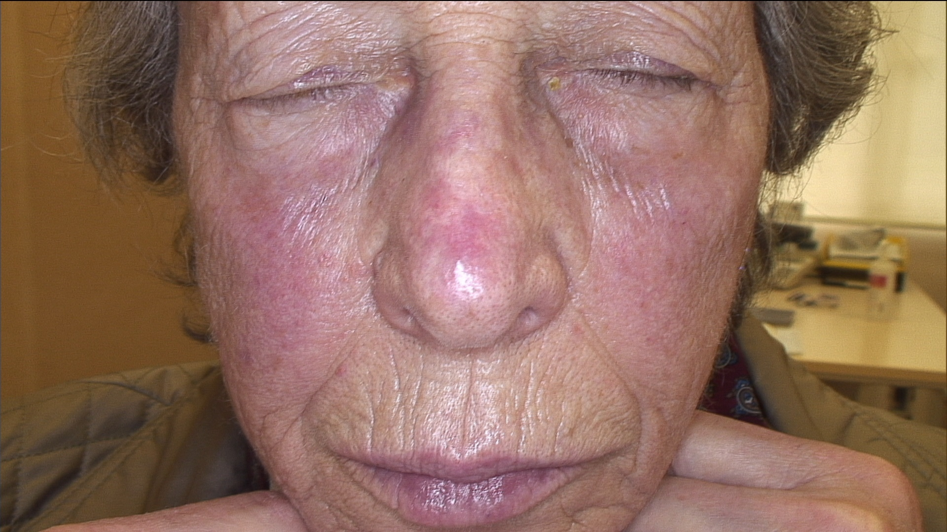
Treatment time 66 minutes
BEFORE
5 Weeks tox G1
6 months
SCC
8 cm2
Invasion 1.7 mm

Slide 15
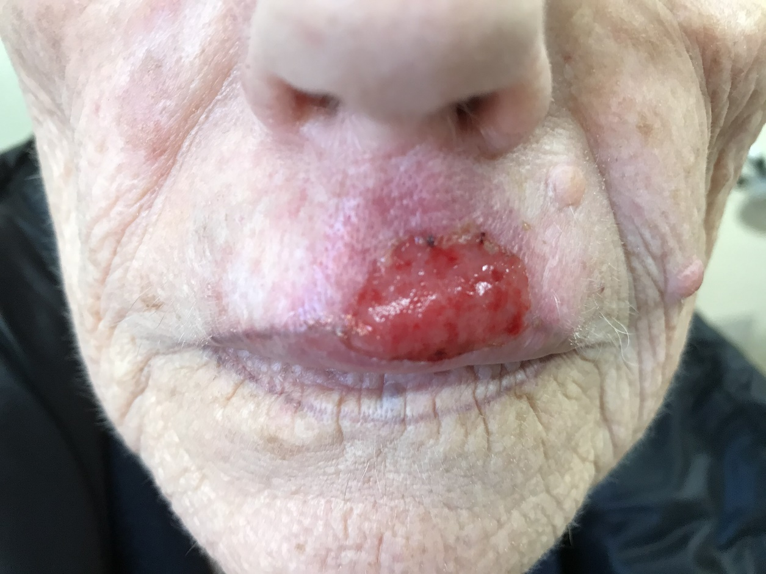
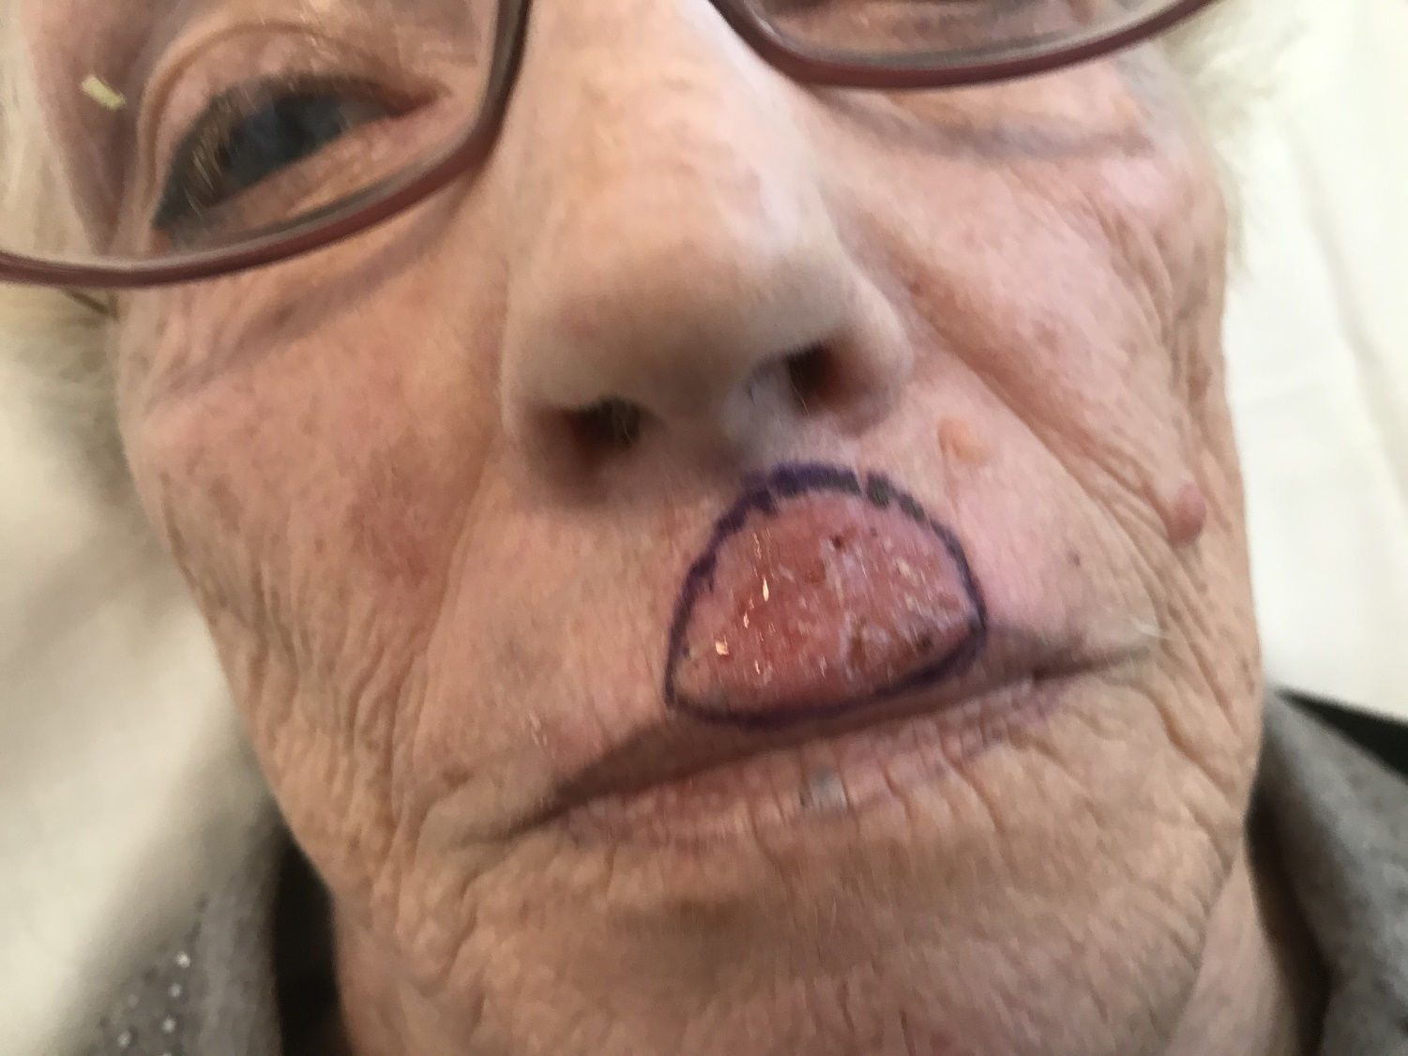
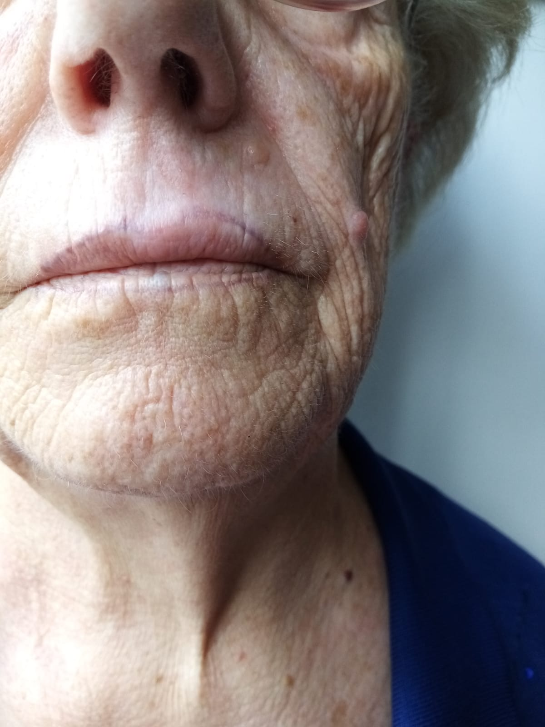
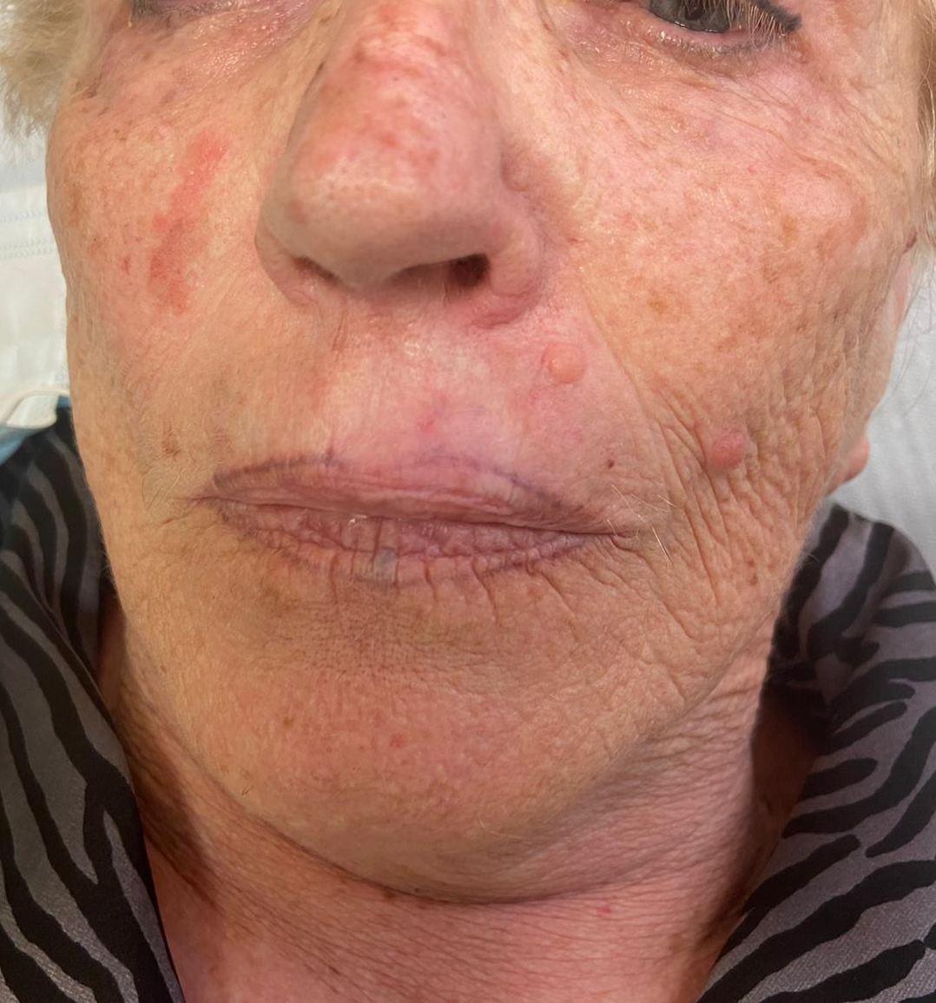
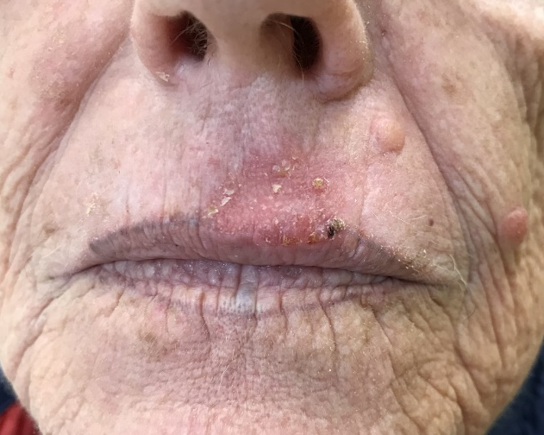
SCC
4.5 cm2
Thickness 1.7 mm
3 Weeks Toxicity G3
Treatment time 45 minutes
3 Months excellent Cosmetic
12 Months good/excellent Cosmetic
The lip – tatoo is visible again
One year later faint de-pigmentation

Slide 16
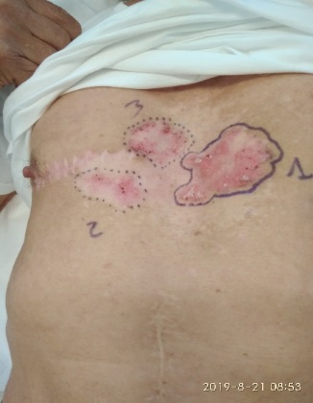
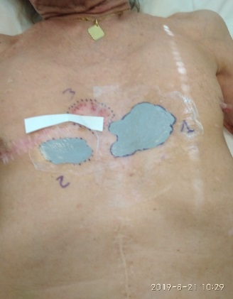
BCC relapse
Surface 28 cm2 ( 1) + 10 cm2 (2)
invasion 1.6 mm for both
Depigmentation for previous RT
Scar for previous surgery
Lesion 1: Adimistered 841 MBq
Superficial adsorbed dose 141Gy;
Mean dose 44 Gy;
Target dose 19Gy; received from the deepest point of lesion invasion 1,6mm)
Treatment time 114 minutes

Slide 17
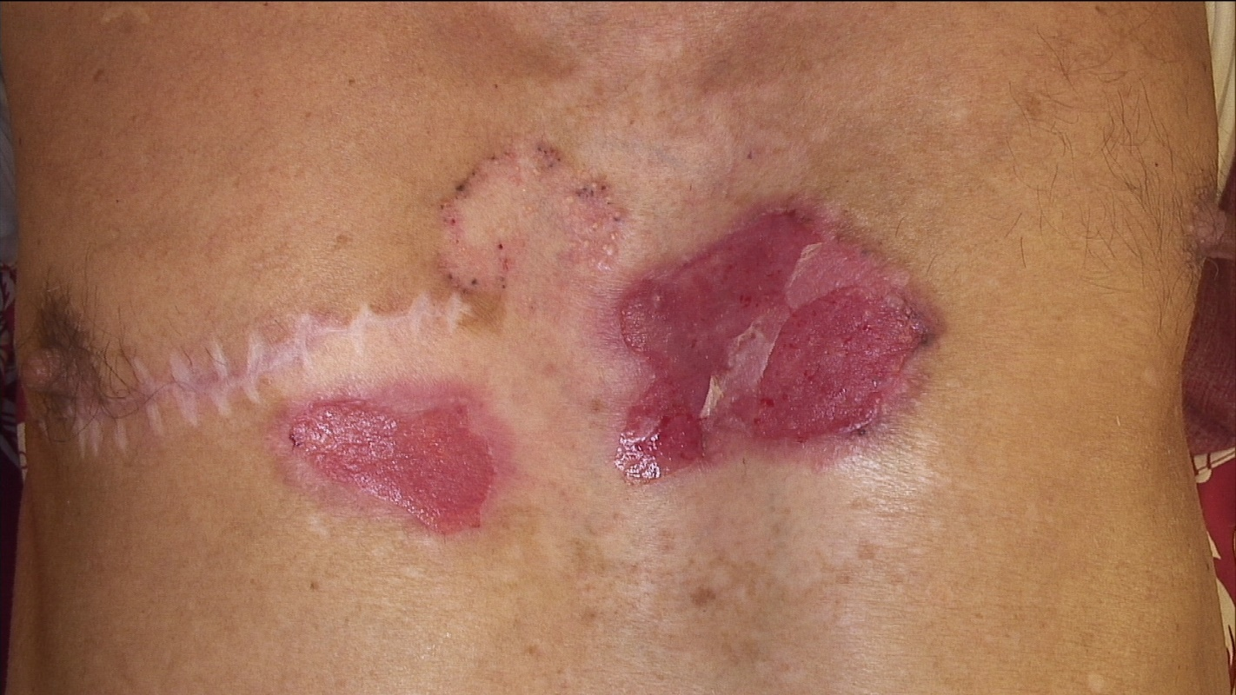
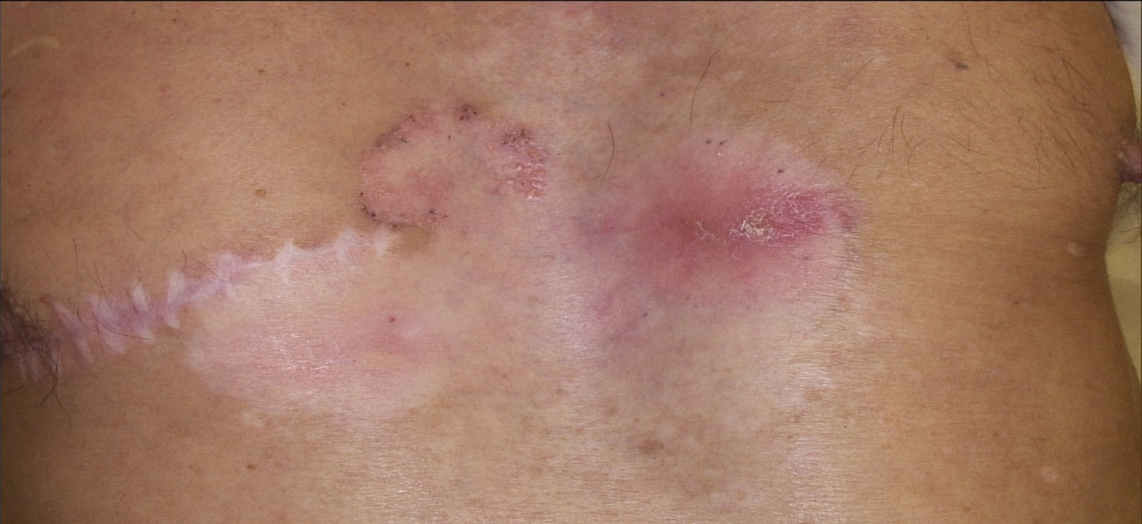
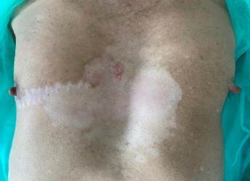
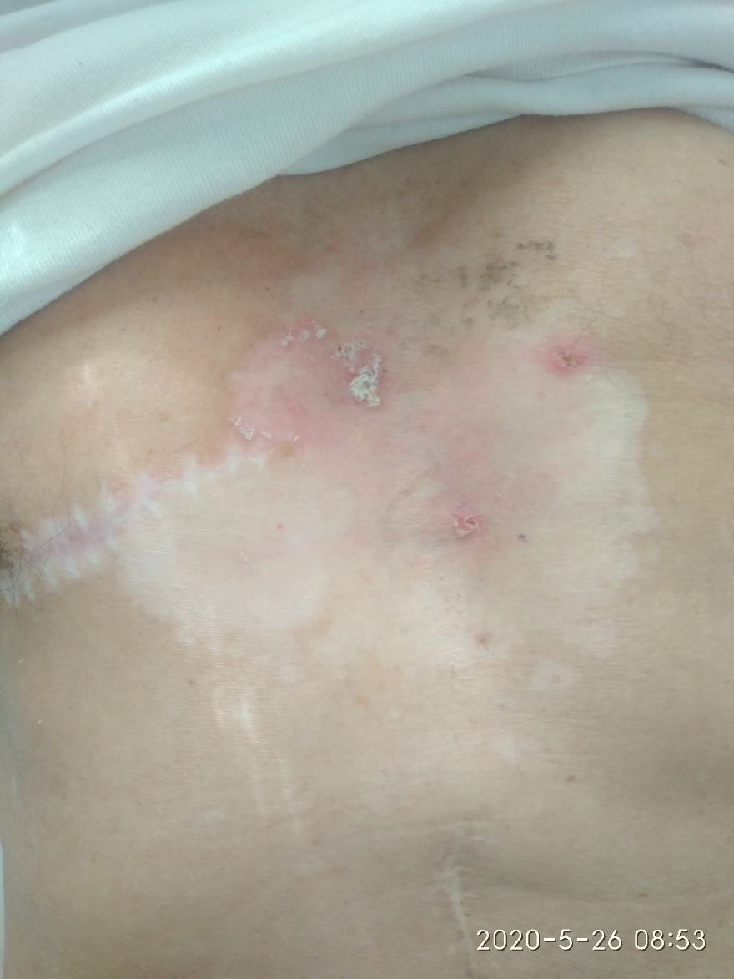
4 Weeks Toxicity G3
8 weeks
3 months
6 months Good Cosmetic results
Biopsy sites
(negative)
Before Rhenium-SCT®

Slide 18
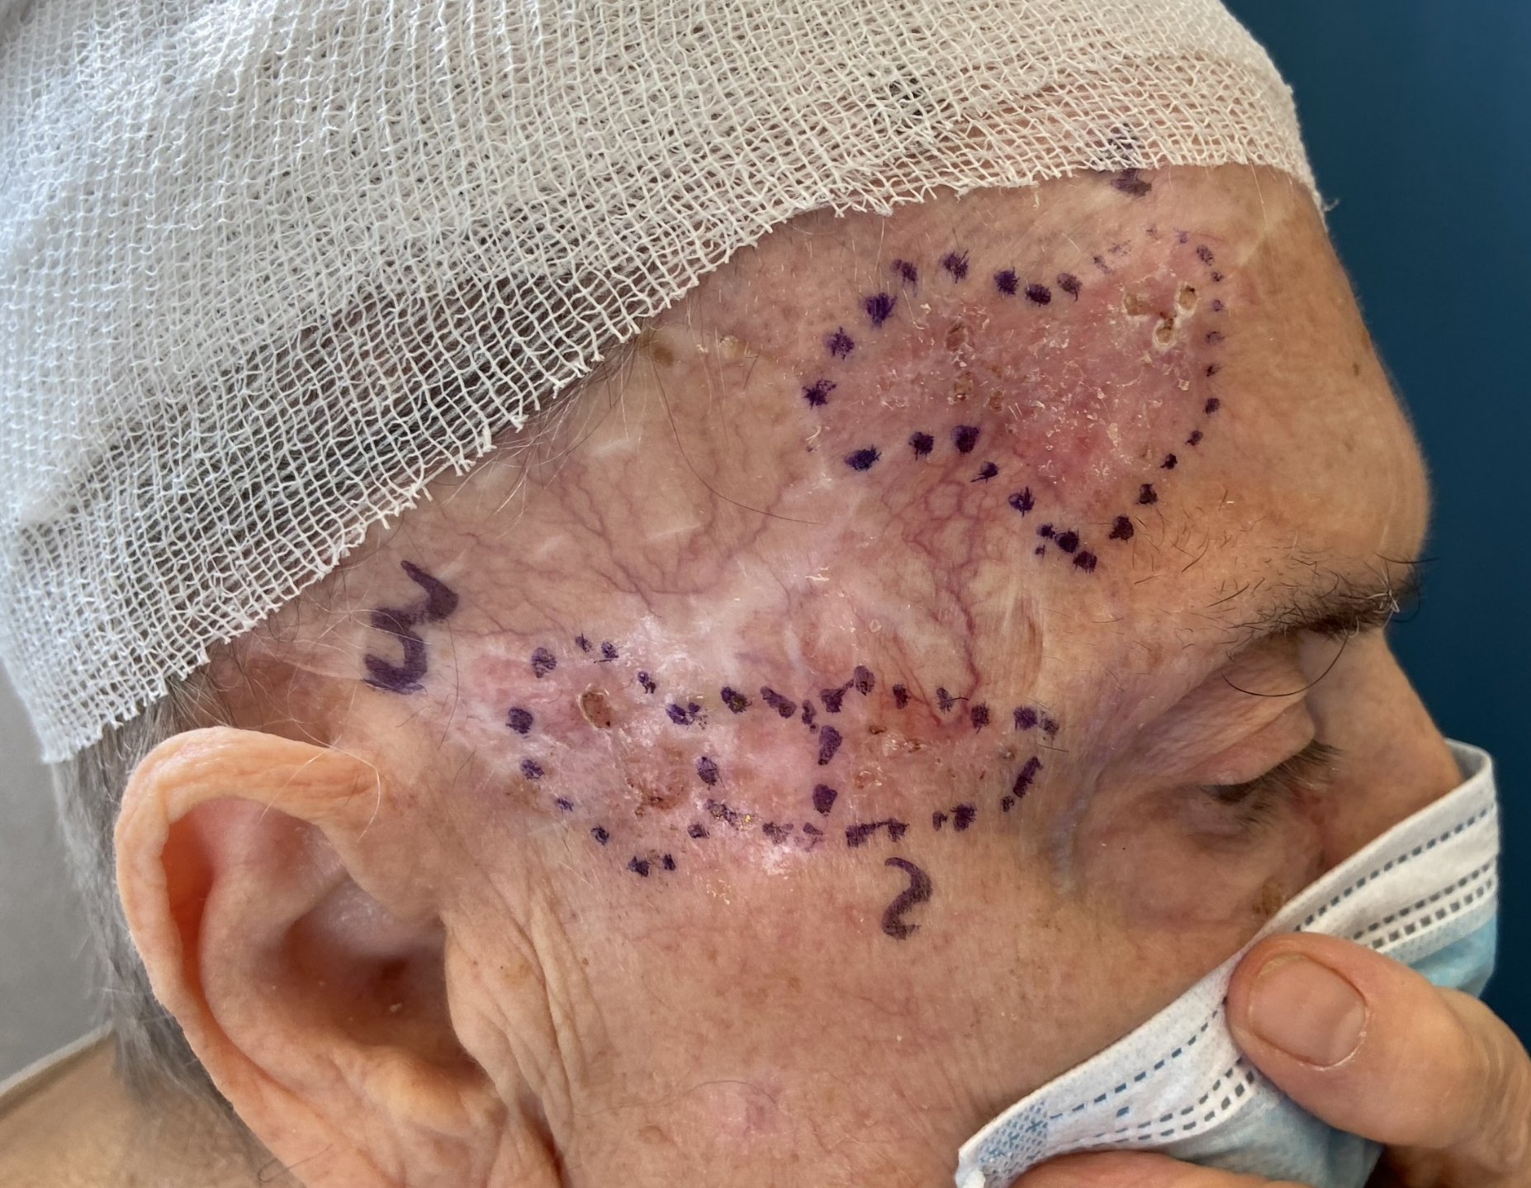
SCC
19 cm2 Surface Area
1.1mm depth neoplastic invasion
Administered 358 MBq
Superficial absorbed Dose (at 0,0001mm depth) 111 Gy
Mean absorbed Dose by the volume of the lesion 37 Gy
Target absorbed dose at 1,0mm of neoplastic invasion 20 Gy
Treatment time 120 minutes

Slide 19
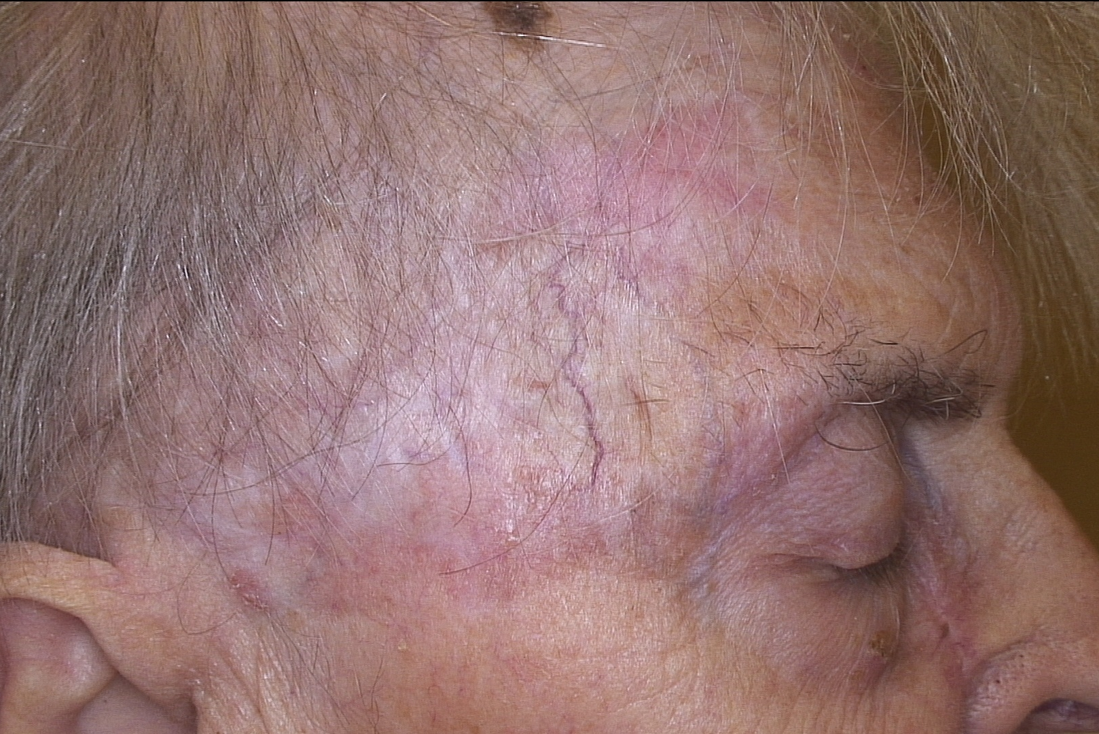
12 weeks
Good Cosmetic
SCC
19 cm2 Surface Area
1.1mm depth neoplastic invasion
Administered 358 MBq
Superficial absorbed Dose (at 0,0001mm depth) 111 Gy
Mean absorbed Dose by the volume of the lesion 37 Gy
Target absorbed dose at 1,0mm of neoplastic invasion 20 Gy
Treatment time 120 minutes

Slide 20
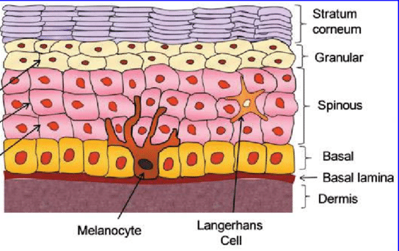
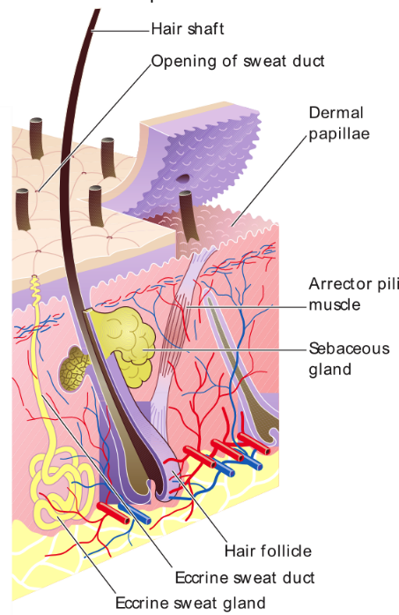
SIDE EFFECTS TO CONSIDER – ALOPECIA / HYPO-PIGMENTATION
…Hair loss and dryness of the skin can be present at different grades
Melanocytes are present in the deepest part of the Epidermis (2mm) Depigmentation of the treated areas is almost always present (at different grades)
Notes:
Adverse events
- Hair loss
- Dryness
- Depigmentation

Slide 21
Phase IV, multi-centre international, open label, single arm study
Efficacy of Personalised Irradiation with Rhenium-SCT- for the treatment of non-melanoma skin cancer
Please review the Product and User information before use. This can be accessed at www.oncobeta.com. Indication: Rhenium-188 paste for the treatment of skin cancer lesions and skin tumours. OncoBeta® GmbH, Schleißheimer Str. 91, 85748 Garching near Munich, GERMANY. SHOW4108. Date of preparation: May 2023
Notes:
^{ONC3785}

Slide 22


Recruitment
Approx. 190 patients
Geography
Australia, Austria, Germany, United Kingdom, South Africa
Timings
Recruitment commenced 2022
12 month study
24 month follow-up
Endpoints
Efficacy
Safety
PROMS

Slide 23

Interim Analysis Review
7 May 2023

Slide 24
Subject Characteristics
182 records provided for interim analysis
BCC
SCC
BCC/ SCC
-
144 (79.1%)
32 (17.6%)
4 (2.2%)
2 (1.1%)
At the time of the interim data analysis:
81 had at least one post-baseline tumour assessment by modified visual RECIST criteria
70 were noted with at least one post-baseline SCI QoL assessment
149 were noted with a response on the Day 14 treatment comfort assessment
Notes:
There were a total of 182 subjects records provided for the interim analysis. Of these, 144 were BCC (79.1%), 32 were SCC (17.6%), and 4 were both BCC and SCC (2.2%). Two subjects did not have information on skin cancer type, both screen failures.
At the time of the interim data cut, 81 subjects had at least one post-baseline tumour assessment performed with modified visual RECIST criteria. Seventy subjects were noted with at least one post-baseline SCI QoL assessment, and 149 subjects were noted with a response on the Day 14 treatment comfort assessment.

Slide 25
Demography of Subjects
Median
age 72 years
Characteristic | Category | Summary | Overall (N=182) | BCC only (N=144) | SCC only (N=32) | Both BCC and SCC (N=4)
Age (years) |  | N | 177 | 142 | 31 | 4
 |  | Mean (SD) | 70.6 (12.76) | 69.9 (13.03) | 73.5 (11.72) | 74.8 (8.30)
 |  | Median | 72.0 | 71.0 | 76.0 | 73.5
 |  | Min, Max | 27, 95 | 27, 95 | 50, 95 | 66, 86
Age group | <40 | n (%) | 3 ( 1.7%) | 3 ( 2.1%) | 0 ( 0.0%) | 0 ( 0.0%)
 | 40-49 | n (%) | 5 ( 2.8%) | 5 ( 3.5%) | 0 ( 0.0%) | 0 ( 0.0%)
 | 50-59 | n (%) | 28 ( 15.8%) | 23 ( 16.2%) | 5 ( 16.1%) | 0 ( 0.0%)
 | 60-69 | n (%) | 41 ( 23.2%) | 34 ( 23.9%) | 6 ( 19.4%) | 1 ( 25.0%)
 | 70+ | n (%) | 100 ( 56.5%) | 77 ( 54.2%) | 20 ( 64.5%) | 3 ( 75.0%)
Gender | Male | n (%) | 95 ( 53.7%) | 73 ( 51.4%) | 20 ( 64.5%) | 2 ( 50.0%)
 | Female | n (%) | 82 ( 46.3%) | 69 ( 48.6%) | 11 ( 35.5%) | 2 ( 50.0%)
FitzPatrick skin type | I | n (%) | 39 ( 23.6%) | 32 ( 24.6%) | 6 ( 19.4%) | 1 ( 25.0%)
 | II | n (%) | 100 ( 60.6%) | 79 ( 60.8%) | 19 ( 61.3%) | 2 ( 50.0%)
 | III | n (%) | 25 ( 15.2%) | 19 ( 14.6%) | 5 ( 16.1%) | 1 ( 25.0%)
 | IV | n (%) | 0 ( 0.0%) | 0 ( 0.0%) | 0 ( 0.0%) | 0 ( 0.0%)
 | V | n (%) | 0 ( 0.0%) | 0 ( 0.0%) | 0 ( 0.0%) | 0 ( 0.0%)
 | VI | n (%) | 1 ( 0.6%) | 0 ( 0.0%) | 1 ( 3.2%) | 0 ( 0.0%)
Range 27-95 years
56.5% were 70+ years
53.7%
were Male
Source: Table 14.1.3
Notes: Percentages are based on the number of subjects in the FAS with non-missing responses
Two subjects in the FAS did not have the type of skin cancer (BCC/SCC) recorded. These subjects were both screen failures.
Notes:
Demography
The demographic characteristics of subjects in the study are summarised in Table 14.1.3. An extract of the table is presented below. The median age of subjects was 72 years, with a range of 27 years to 95 years. Over half of subjects (56.5%) were aged 70 years or higher, and 53.7% of subjects were male. Ethnicity was recorded for 177 subjects, of whom 175 were white, and two were black/African American.

Slide 26
Location of Treated Tumour
Tumour location | N (%)
Nose | 57 (23.4%)
Other facial location | 38 (15.6%)
Other location | 31 (12.7%)
External ear | 15 (6.1%)
Back | 14 (5.7%)
Cheek | 14 (5.7%)
Forehead | 14 (5.7%)
Lower limbs | 13 (5.3%)
Scalp | 11 (4.5%)
Hand | 9 (3.7%)
Neck | 8 (3.3%)
Shoulder | 8 (3.3%)
Inner ear | 4 (1.6%)
Upper limbs | 4 (1.6%)
Knee | 2 (0.8%)
Foot | 1 (0.4%)
Perioral | 1 (0.4%)
125
34
17
Single lesion (71.0%)
Two lesions (19.30%)
Three lesion (9.7%)
Note: Subjects could have more than one treated tumour
Notes:
Of the 176 subjects with information in the tumour_details dataset, 125 had a single lesion recorded (71.0%), 34 had two lesions (19.3%), and 17 had three lesions (9.7%).

Slide 27
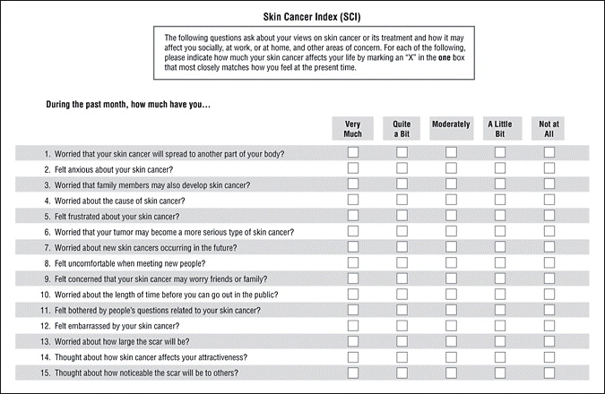
Interim Analysis of Quality of Life
PROs using the Skin Cancer Index (SCI) were completed by subjects at baseline and during study follow-up.
This interim analysis uses data from baseline and 6-month follow-up to evaluate the change in quality of life as measured by the SCI.
Following from the reference, three subscales were derived from the SCI, namely:
Emotion subscale – items Q1 to Q7
Social subscale – items Q8 to Q12
Appearance subscale – items Q9 to Q15
Notes:
PROs using the Skin Cancer Index (SCI) were completed by subjects at baseline and during study follow-up. This interim analysis uses data from baseline and 6-month follow-up to evaluate the change in quality of life as measured by the SCI.
The data provided for the interim analysis included some cases where subjects provided multiple responses to the SCI at baseline. In these cases, the first SCI on the date of the baseline assessment, as provided in the interim analysis data cut, was used as the baseline assessment for comparison with the 6-month assessment.
The SAP includes derivation of two subscales based on a 14 item version of the SCI. The SCI used in the study is a 15 item version (Rhee, et al., 2006). Following from the reference, three subscales were derived from the SCI, namely:
Emotion subscale – items Q1 to Q7
Social subscale – items Q8 to Q12
Appearance subscale – items Q9 to Q15

Slide 28
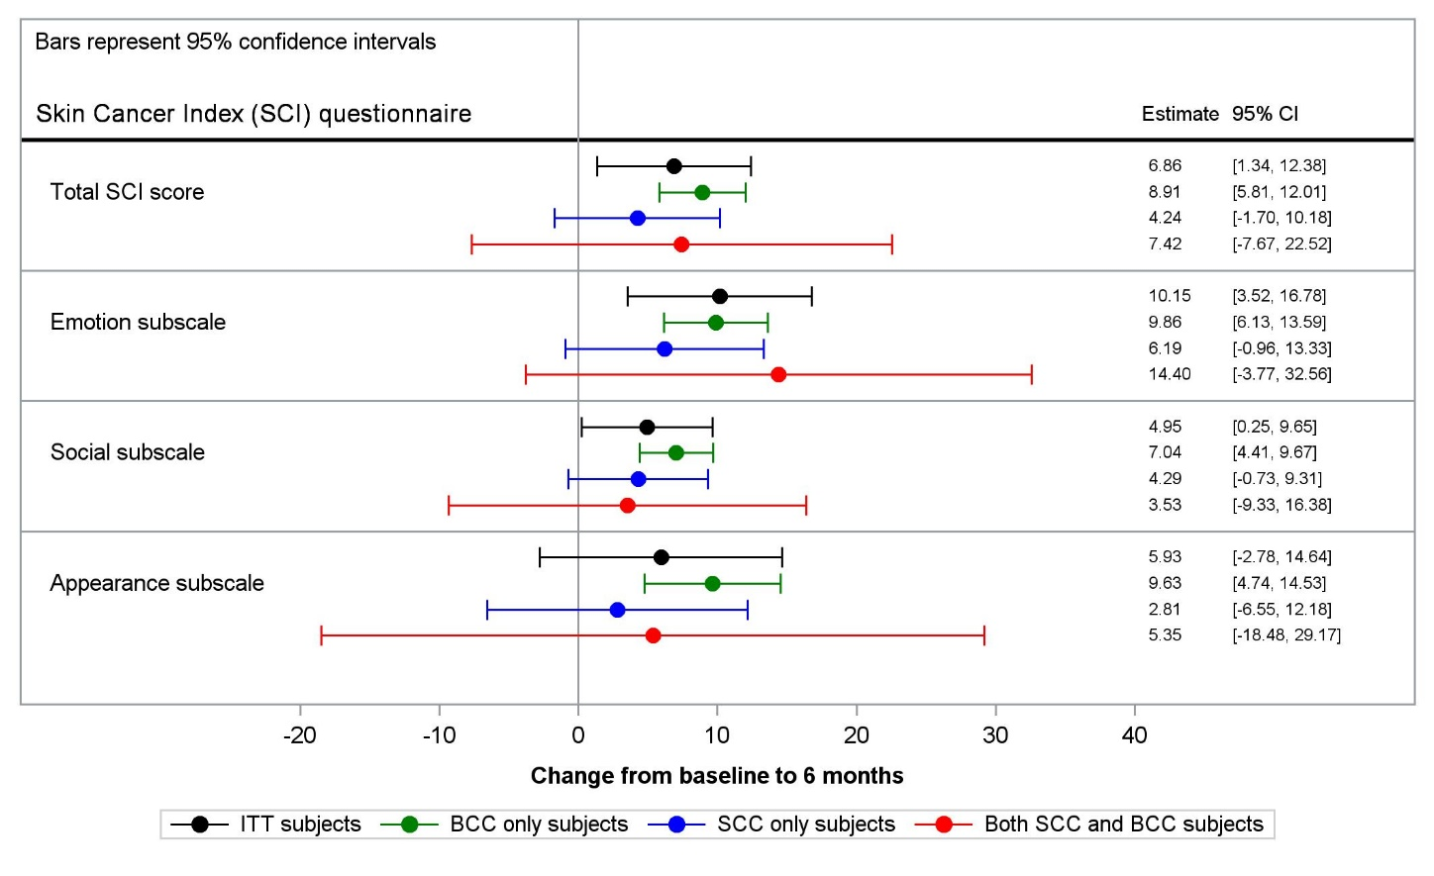
Interim Analysis of Quality of Life
Estimated change from baseline to 6-month follow-up for SCI subscales, adjusted for baseline subscale scores.
Notes: Estimates and confidence intervals shown in the figure are repeated in Appendix 1
Notes:
This questionnaire was completed within 14 days following the treatment visit. For the interim analysis, if the subject answered YES to either question 1 or 2, meaning they had pain present before the treatment, then they were not asked any further questions. Subjects that answered NO to questions 1 and 2, meaning they had not experienced pain prior to treatment, were asked further questions to understand if they experienced any treatment related discomfort. In total, 126 patients completed the treatment related questions and of those 100% reported NO treatment pain or discomfort.

Slide 29
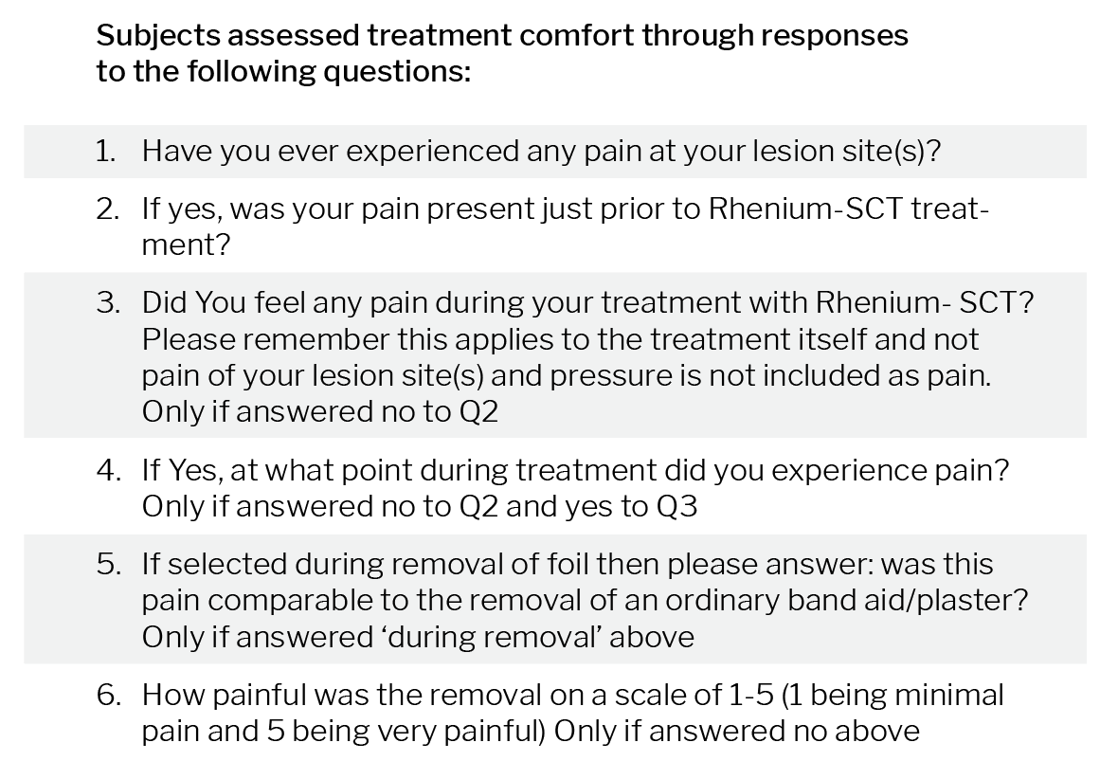
Comfort of Treatment
In total, 126 patients completed the treatment related questions and of those 100% reported NO treatment pain or discomfort.

Slide 30
RECIST assessment at 6 months
CR
Category | Summary | All Tumours | BCC Tumours | SCC Tumours
Complete response | n/N (%) | 103/106 ( 97.2%) | 81/83 ( 97.6%) | 22/23 ( 95.7%)
Partial response | n/N (%) | 3/106 ( 2.8%) | 2/83 ( 2.4%) | 1/23 ( 4.3%)
Progressive disease | n/N (%) | 0/106 ( 0.0%) | 0/83 ( 0.0%) | 0/23 ( 0.0%)
Stable disease | n/N (%) | 0/106 ( 0.0%) | 0/83 ( 0.0%) | 0/23 ( 0.0%)
Overall, 103 of 106 tumours assessed at 6-months were classified as complete response (CR)
Notes:
RECIST assessment at 6 months
The interim analysis data cut also provided modified visual RECIST responses for subjects that had attended through to 6 months. A distribution of the responses, which are based on the number of tumours treated rather than the number of subjects in the ITT, is shown in Table 14.2.1.1, and repeated below. Subjects with both BCC and SCC tumours are counted in both columns for these tumour types.
Overall, 103 of 106 tumours assessed at 6-months were classified as complete response (CR), with the remaining 3 classified as partial response (PR). There were seven tumours included in the tumour assessment dataset where no evaluation was provided. From baseline records, there are 101 tumours which were treated that do not yet have a 6-month follow-up.

Slide 31
Adverse Events
There were 40 AE reported in 29 subjects (15.9% of subjects reporting at least one AE).
Grading of AE was mild for 25 events and moderate for 13 events; 2 events did not have a grading provided at this time.
Relationship to IP was noted as probable for 22 events, possible for 7 events, unrelated for 6 events, and was missing for 5 events.
2 patients have had prolonged healing of treatment site, longer than 6 months, however both have healed.
One of the 2 patients had this prolonged healing reported as a SAE, patient history to understand possible underlying conditions has been requested and is still pending. Patient has healed in the meantime.
There have been no adverse events leading to study withdrawal.
Notes:
There were 40 AE reported in 29 subjects (15.9% of subjects reporting at least one AE). Grading of AE was mild for 25 events and moderate for 13 events; 2 events did not have a grading provided at this time. Relationship to IP was noted as probable for 22 events, possible for 7 events, unrelated for 6 events, and was missing for 5 events. A single event was noted as serious, and this event (which had a fatal outcome) also lead to withdrawal from the study.
Death was unrelated so can be deleted from this report

Slide 33
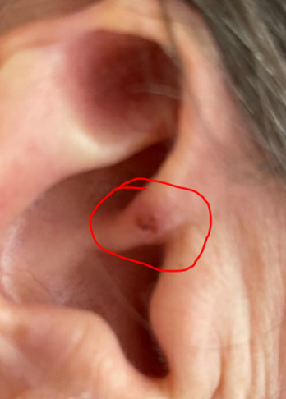
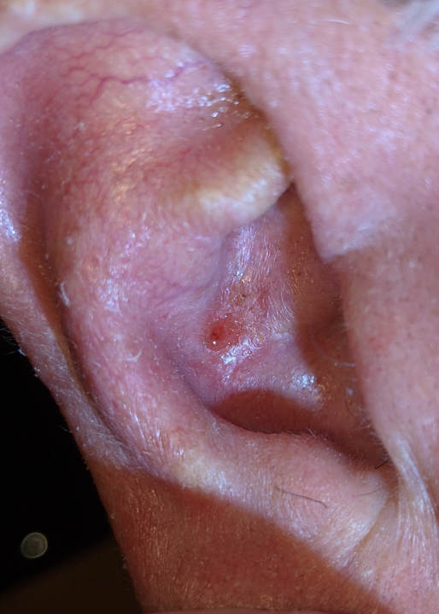
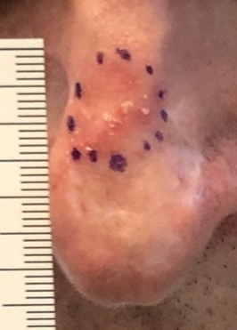
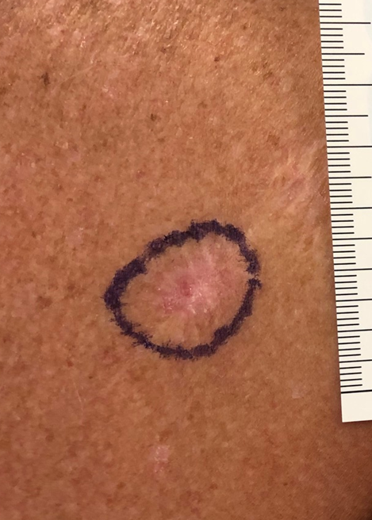
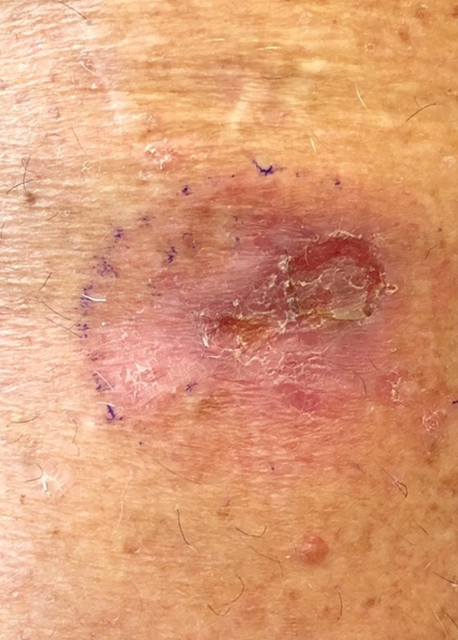
My Experience N=25
Notes:
Ipi – CTLA4 checkpoint blockade inhibitor
Nivo- PD-L1 – PDL pathway inhibitor

Slide 34
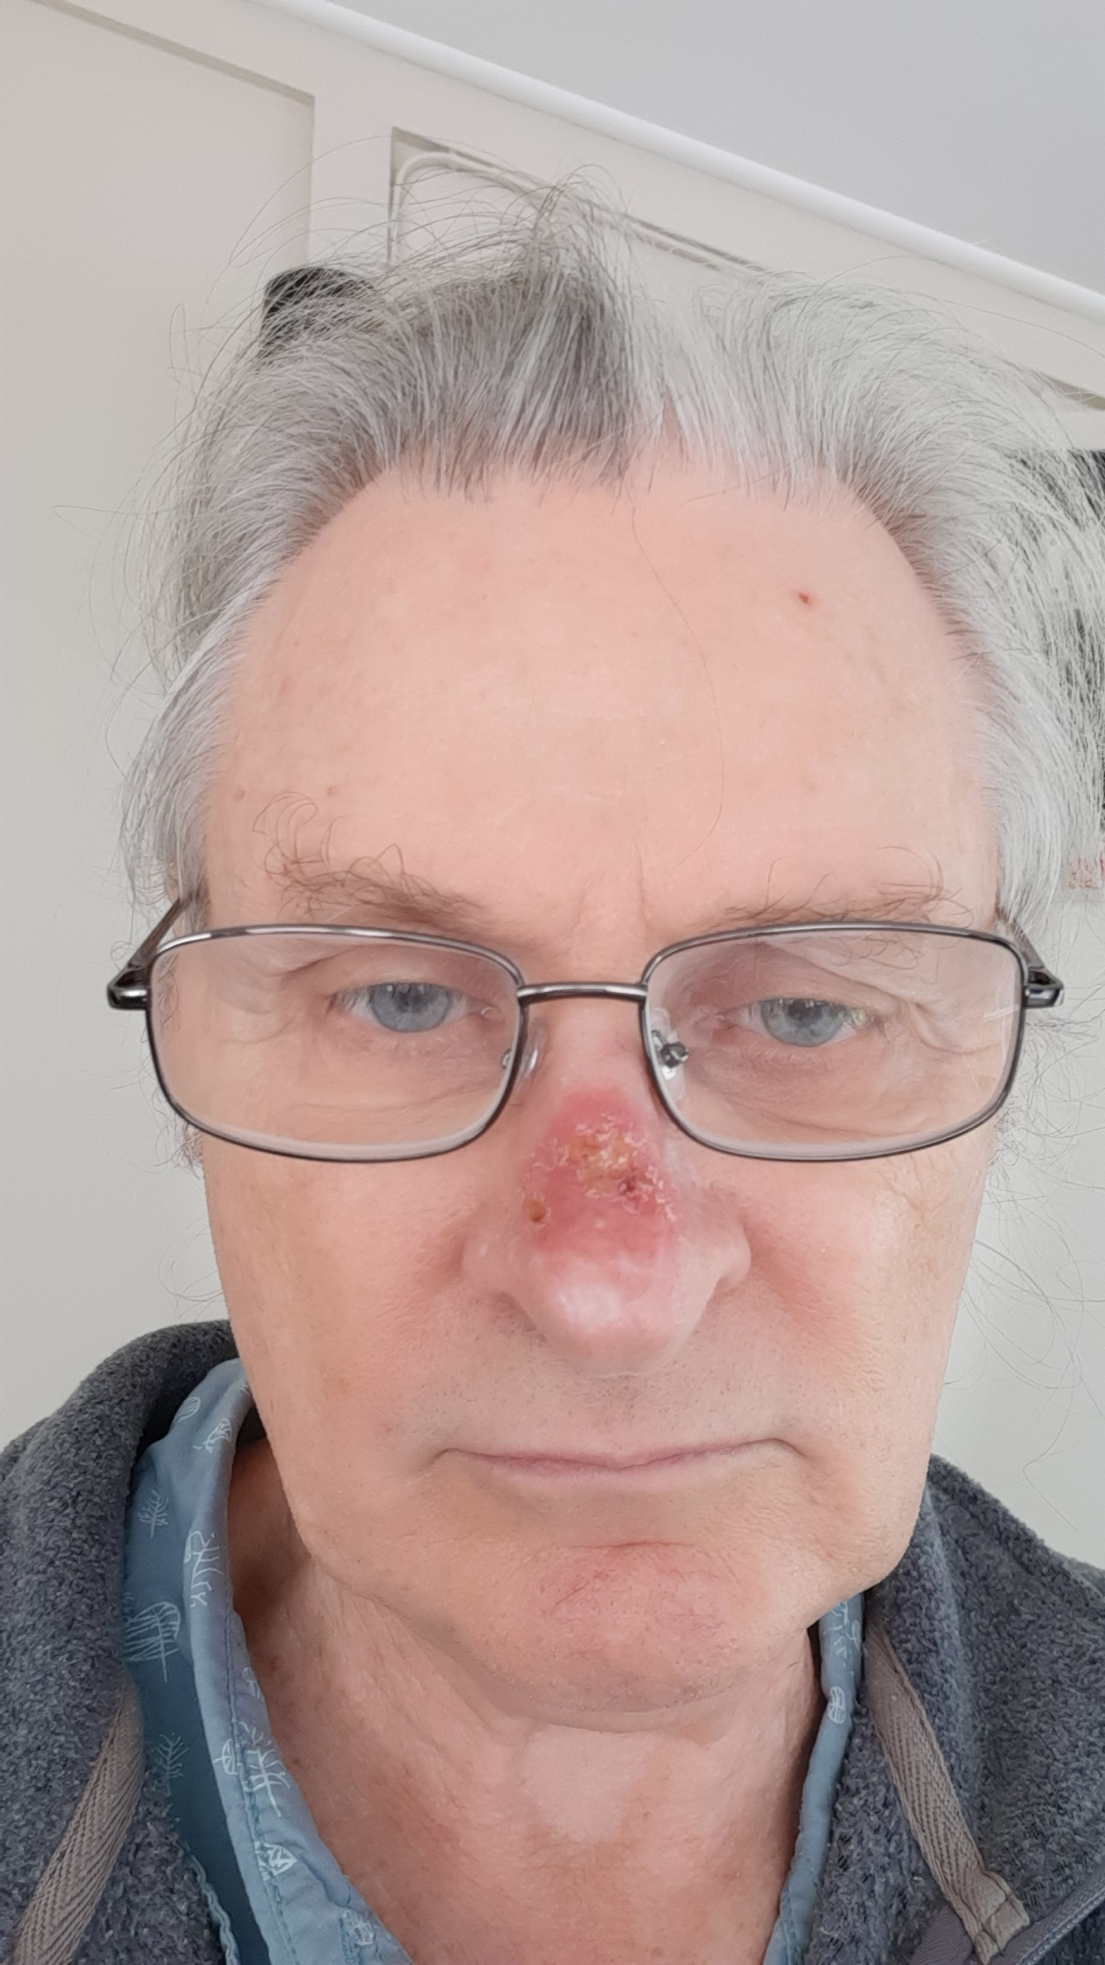
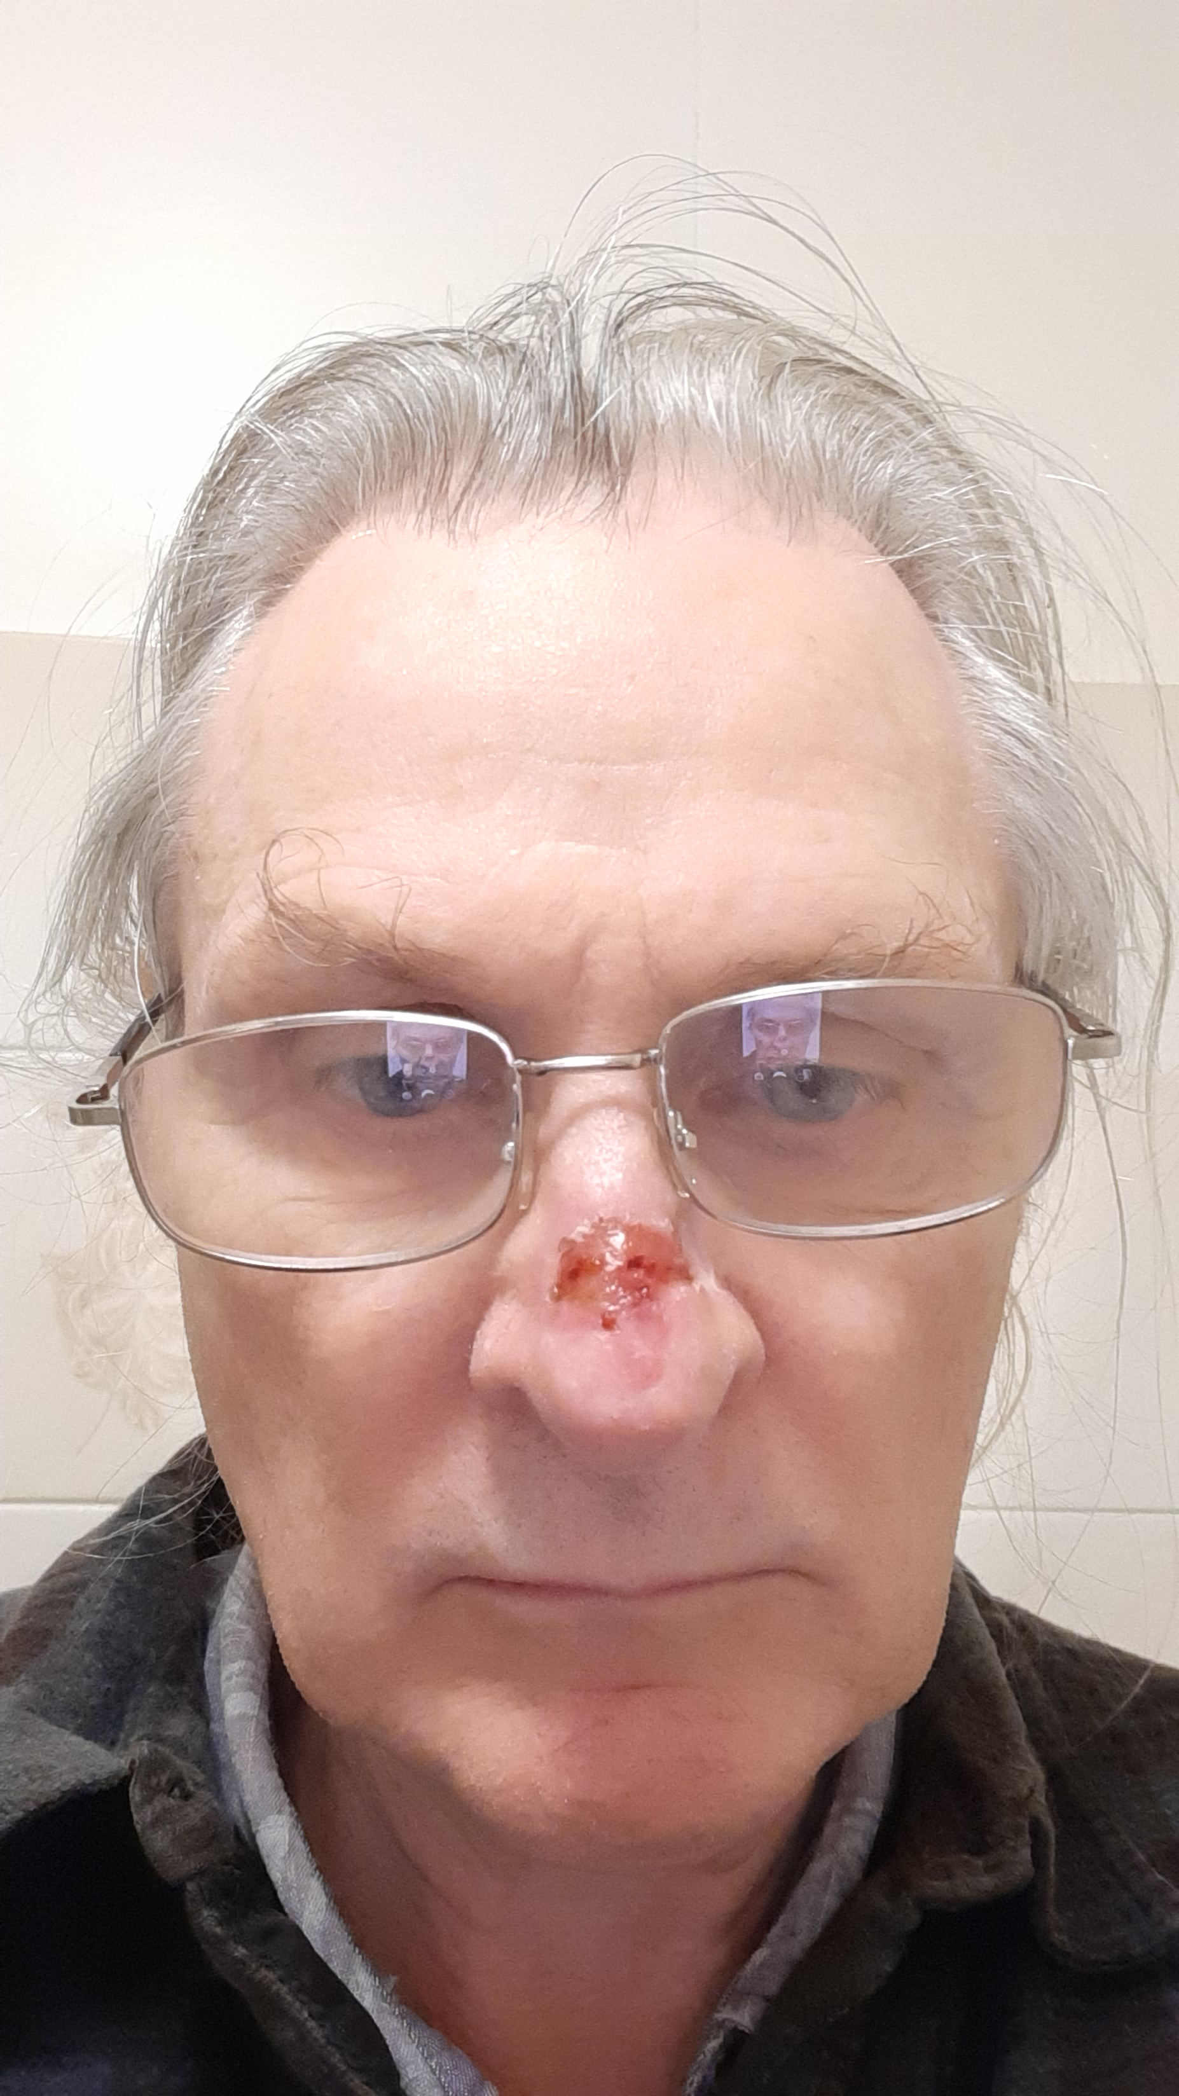
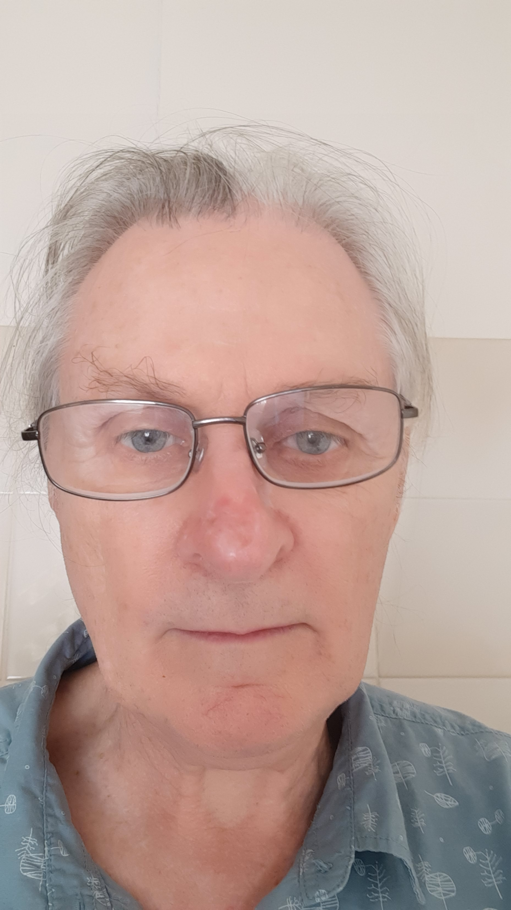
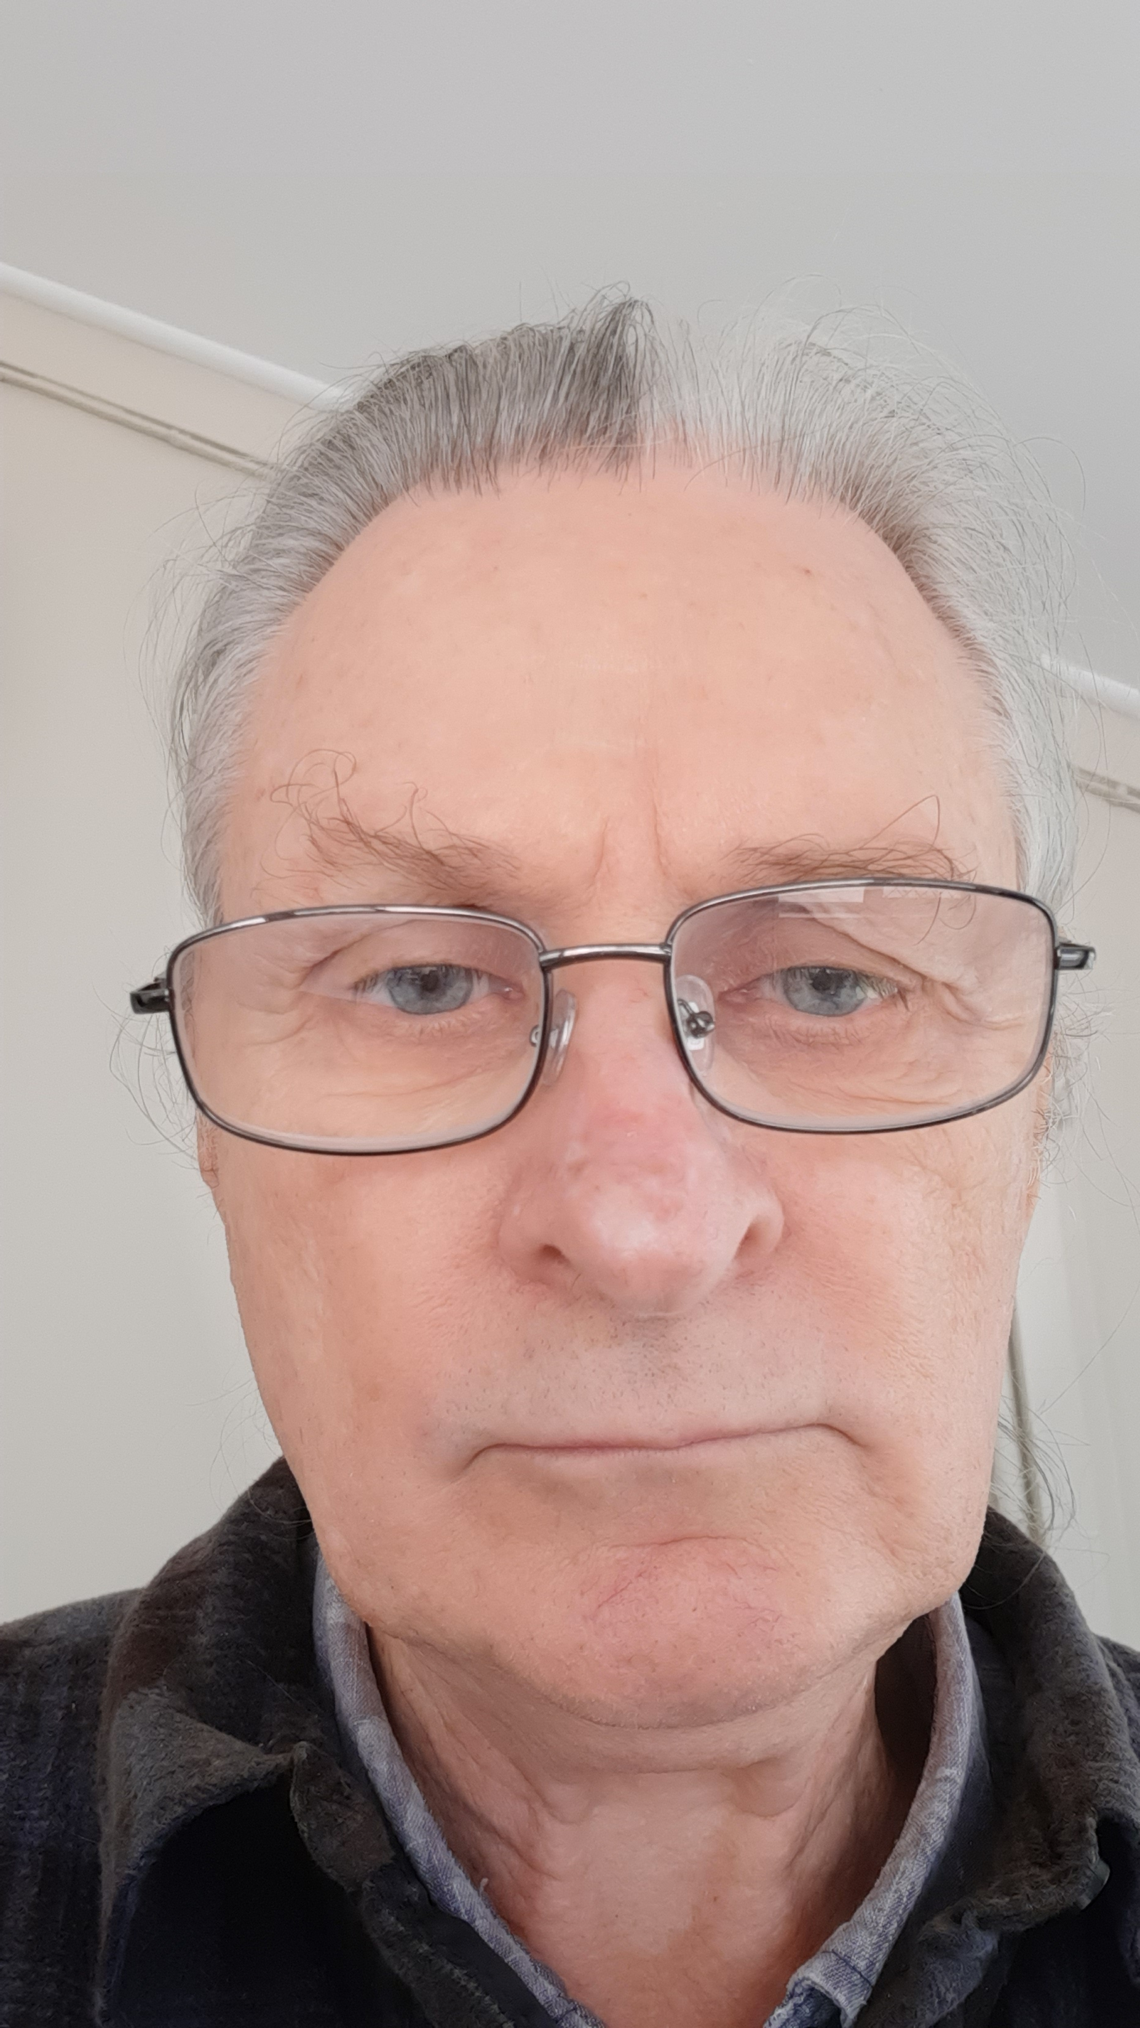
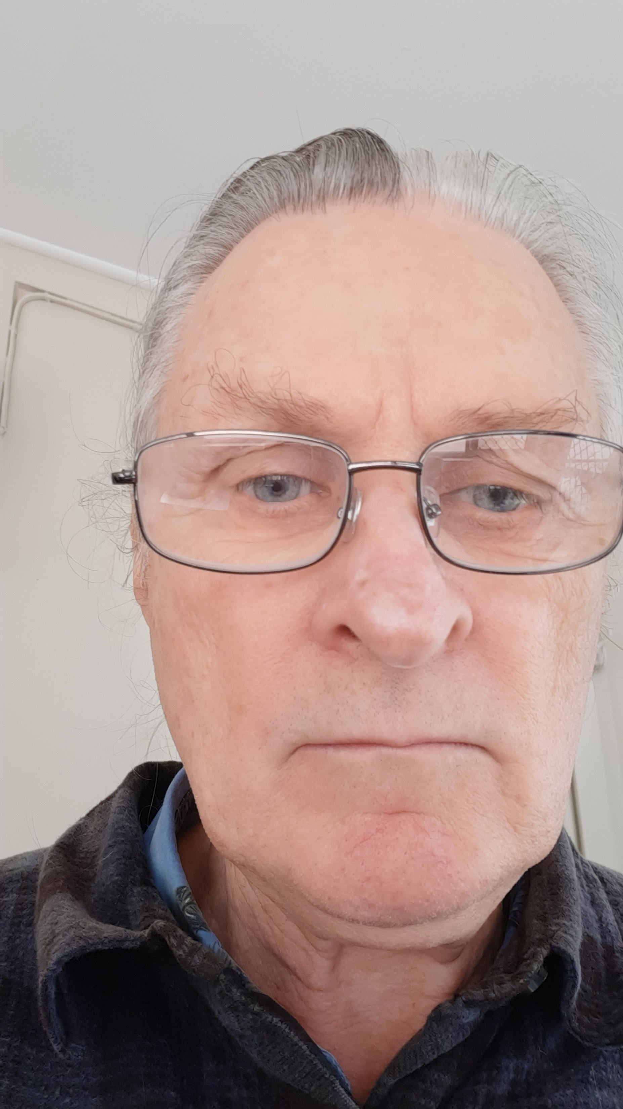
TYPICAL TIMELINE
Week:
0 2 4 6 8 12
Notes:
Ipi – CTLA4 checkpoint blockade inhibitor
Nivo- PD-L1 – PDL pathway inhibitor

Slide 35
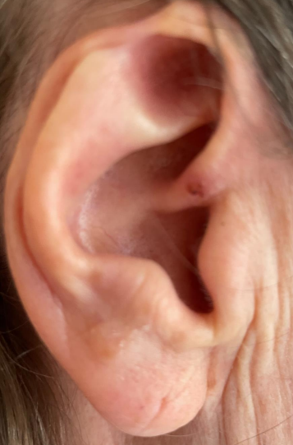
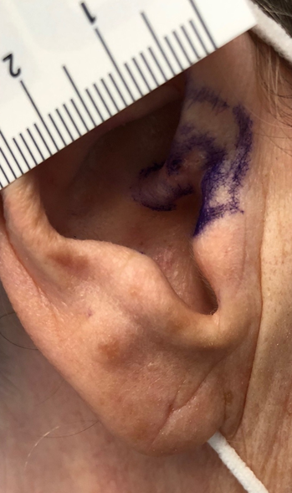
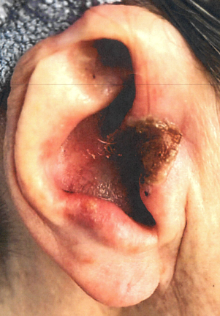




TYPICAL TIMELINE
Week:
0 4 6 8 12 24
Notes:
Ipi – CTLA4 checkpoint blockade inhibitor
Nivo- PD-L1 – PDL pathway inhibitor

Slide 36


TYPICAL TIMELINE
Months:
6 12
Notes:
Ipi – CTLA4 checkpoint blockade inhibitor
Nivo- PD-L1 – PDL pathway inhibitor

Slide 37





ADVERSE EFFECT ON STUDY
Month:
0 1 3 3+ 12

Slide 38

FAQs:
How is Rhenium different from conventional radiation
Is it possible to operate in a area treated by Rhenium-SCT
Is re-treatment by conventional radiotherapy or Rhenium-SC T possible?
Why not fractionate it to make it safer?
Are the late effects different from conventional radiotherapy (?second malignancy risk)
Cost?

Slide 39

Thank you Questions….

Slide 40
Conclusions – From a clinical perspective
Single session (690min), non-invasive procedure
Indicated for BCC / SCC / IEC that are <3mm in size
Size is not a limitation apart from the amount of paste that has to be used and relatively use of
Most useful for locations with difficult surgical options or unattractive cosmetic outcomes risk – Ear / Noses / Peri-oral / Penile
After care is simple skin care principles and can be undertaken back with the referrer and their clinic nurse
Referral in for treatment and patient returns to the referrer for ongoing skin cancer care – the patient remains yours
Right treatment for the right patient at the right time
in their cancer care journey

Slide 41
Conclusions – From a treatment program perspective
Partnership of clinical champion with a procedural champion:
Clinical skill:
Your skill is lesion delineation to direct the proceduralist as to where to ‘paint’
Patient needs to see you the day before or morning of the procedure
Patient needs to see you at week 3 and week 6 for after-care for skin care
Procedural skill:
Radiation licenced practitioner (radiation oncologist or nuc medicine physician)
Radiation licenced facility (radiation therapy or nuc medicine department)

