Slide 1







Approaching Hair Loss:
A Guide for GPs
12th November 2024
HealthCert Webinar
Dr Ahmed Kazmi
Specialist Dermatologist & Clinical Senior Lecturer
Notes:
Mention major affiliations
Mention picture of Jason Statham- not all people find hair loss a problem

Slide 2

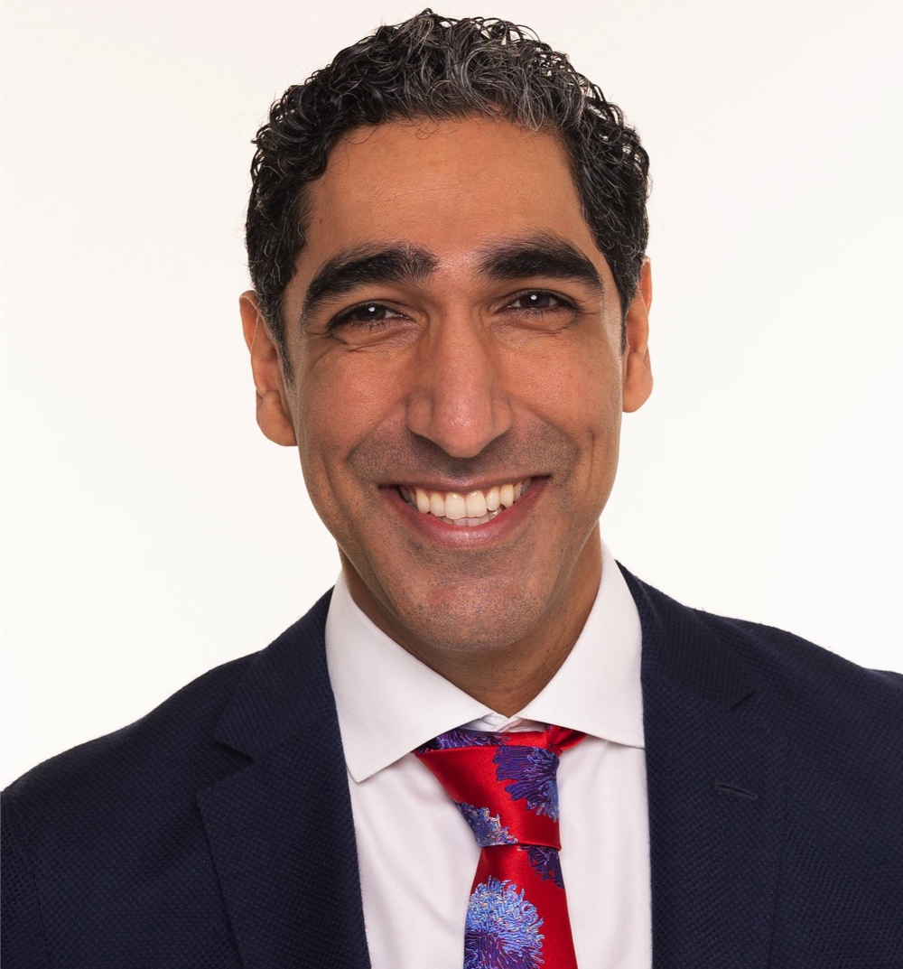
Dr Ahmed Kazmi
MBChB (Hons Str) MRCP (Derm) MRCGP FRACGP FACD
Melbourne based:
  Sinclair Dermatology, East Melbourne
  Fairfield Dermatology, Fairfield
  Hope Dermatology, South Melbourne
Main expertise:
  Hair/scalp disorders (including mesotherapies)
  Medical education
Lots of interests:
  JAKi/Biologics
  Inflammatory/medical dermatology
  Skin of colour/pigmentary disorders
  Genital dermatoses
  Transgender medicine
@drahmedkazmi
Notes:
Introduce myself
Mention mesotherapies
Mention wanting to upskill GPs and give them a role in dermatology clinics
Mention social media specifically- if you use twitter or facebook or Instagram…

Slide 3
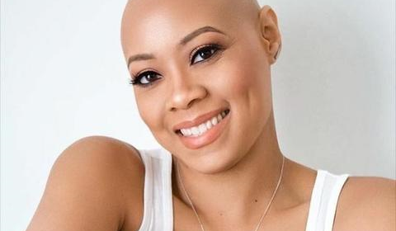
What I can do in 60 minutes…
Feel you have a methodical approach to approaching a hair loss consult
Feel you can better diagnose the common causes of hair loss
Feel you are better able to manage some of the common causes for hair loss
Notes:
Mention picture of woman again

Slide 4
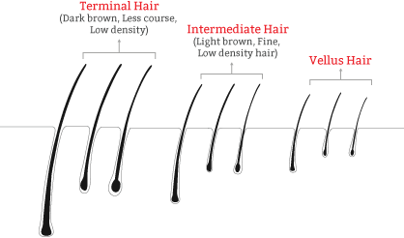
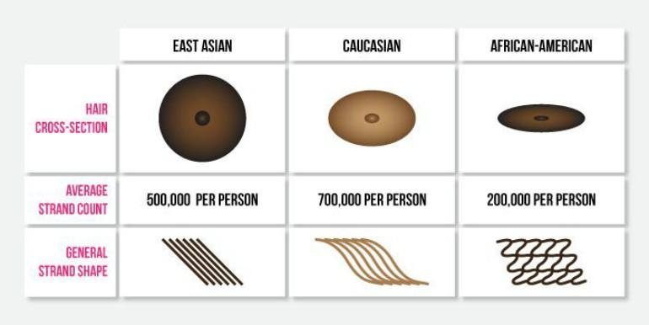
A couple hair facts
Average human has about 5 000 000 hair follicles
Everywhere but palms/soles/mucosal sites
Same for men and women
Average scalp has about 100 000 follicles (not strand count)
Notes:
Terminal hair- thick, pigmented- androgen depened sites and special sites: scalp, eyelashes, eyebrows, beard, axilla, pubic area
Vellus hairs- thin, short, single, less pigmented hairs- cover the whole body other than glabrous skin (palms and soles)
Intermediate hairs- something in between- arms and legs

Slide 5
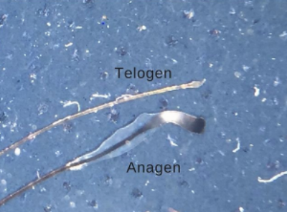
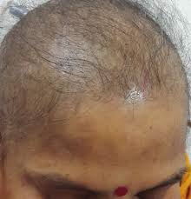
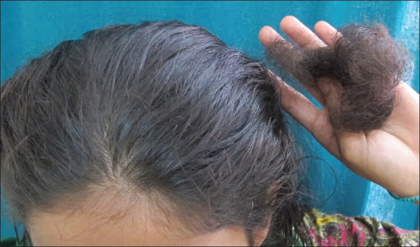
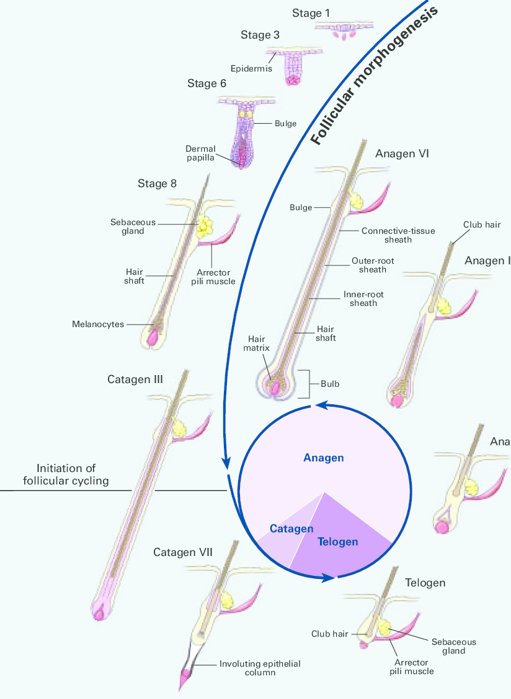
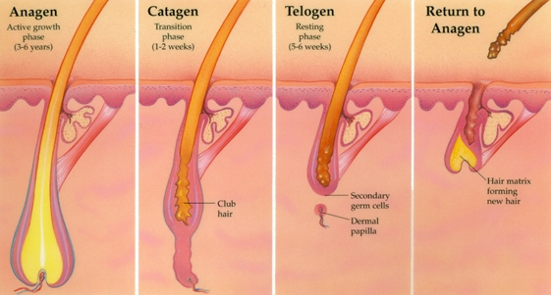
Hair cycle
Telogen effluvium
Anagen effluvium
85%
1%
10-15%
NB: Anagen varies greatly on different body parts, at different ages etc
Notes:
Terminal scalp hair anagen- about 2-6 years- about 85% of scalp hair
Catagen- 2-3 weeks- <1% of scalp hair
Telogen- 3 months – 10-15% of scalp hair
Anagen length varies greatly on the body:
Beard hair- 1-3 months

Slide 6
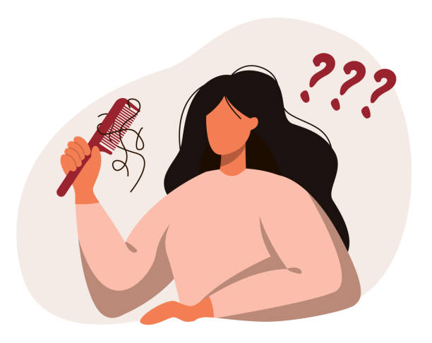
Can you think of any causes of hair loss?

Slide 7
Nonscarring Alopecia vs Scarring Alopecia
Scarring (aka cicatricial) | Nonscarring
Loss of hair follicle (and sebaceous gland) | Hair follicle present (and sebaceous gland)
No potential for regrowth | Usually potential for regrowth
Deposition of scar tissue | No scar tissue
Usually epidermal changes: scale, erythema, dyspigmentation | Usually normal looking scalp
Usually symptomatic- burning, itching, tender | Usually asymptomatic
Rare | Common
Examples: LPP, FFA, DLE, CCCA, Dissecting cellulitis, De Calvans, acne keloidis nuchae, erosive pustular dermatosis, Pseudopelade of Brocq, alopecia mucinosa, acne necrotica, keratosis follicularis spinulosa decalvans, Traction (late), Tinea capitis*, trichotillomania (late), secondary cicatricial alopecia | Examples: Androgenetic alopecia (pattern hair loss), Telogen Effluvium, AA, Anagen effluvium, Traction (Early), tinea capitis*, trichotillomania (early), secondary non-cicatricial alopecias (e.g. syphilis, SLE)
Dr Ahmed Kazmi

Slide 8
Ciccatricial Alopeciaa
Classification of cicatricial alopecias- comprehensive
Primary | Lymphocytic | Lichen planopilaris (LPP) Frontal fibrosing alopecia (FFA) Graham-Little-Piccardi-Lassueur syndrome Discoid lupus erythematosus (DLE) Central centrifugal cicatricial alopecia (CCCA) Pseudopelade of Brocq Alopecia mucinosa Keratosis follicularis spinulosa decalvans
 | Neutrophilic | Folliculitis Decalvans Dissecting cellulitis (perifolliculitis capitis abscedens et suffodiens)
 | Mixed | Acne keloidis nuchae Erosive pustular dermatosis Acne necrotica varioliformis/ Acne necrotica miliaris
 | Nonspecific | Burnt out disease Bad biopsy
Secondary | Exogenous | Traction alopecia (late) Trichotillomania (TTM) Dermatitis artifacta (DA) Scars: surgical, burns, traumatic, persistent chemotherapy induce alopecia
 | Dermatoses | Psoriasis Atopic dermatitis Morphoea Sarcoidosis Necrobiosis lipoidica Immunobullous disease especially pemphigus vulgaris and pemphigus foliaceous
 | Neoplasia & lymphoproliferative | Melanoma, SCC, BCC, merkel cell carcinoma, cutaneous lymphoma, metastatic deposits, atypical fibroxanthoma, Angioma, epidermoid cyst, dermoid cyst, pilar cyst, pilomatrixoma, sebaceous adenoma, hidrocystoma, syringoma, eccrine poroma, lymphangioma, leiomyoma, neurofibroma, lipoma, melanocytic naevi, Langerhans cell histiocytosis
 | Infective | Tinea capitis, VZV, HSV, bacterial e.g. leprosy (not scalp)
Dr Ahmed Kazmi
Notes:
Explain that any classification system has its limitations- some can appear in more than one box, some have multiple names, some diagnoses become extinct or evolve, but has to start somewhere
Also that histologically, if caught early enough, even a cicatricial alopecia can look non scarring, and if biopsied too late, will be none diagnostic

Slide 9
Cicatricial Alopecias- simplified
Primary | Lymphocytic | Lichen planopilaris (LPP) Frontal fibrosing alopecia (FFA) Discoid lupus erythematosus (DLE) Central centrifugal cicatricial alopecia (CCCA)
 | Neutrophilic | Folliculitis Decalvans Dissecting cellulitis
 | Mixed | Acne keloidis nuchae Erosive pustular dermatosis
 | Nonspecific | Burnt out disease Bad biopsy
Secondary | Exogenous | Traction alopecia (late) Trichotillomania (TTM)
 | Dermatoses | Psoriasis Atopic dermatitis Immunobullous disease especially pemphigus vulgaris and pemphigus foliaceous
 | Neoplasia and lymphoproliferative | Melanoma, SCC, BCC, cutaneous lymphoma, metastatic deposits, benign cysts and growths
 | Infective | Tinea capitis, scalp folliculitis
Dr Ahmed Kazmi

Slide 10
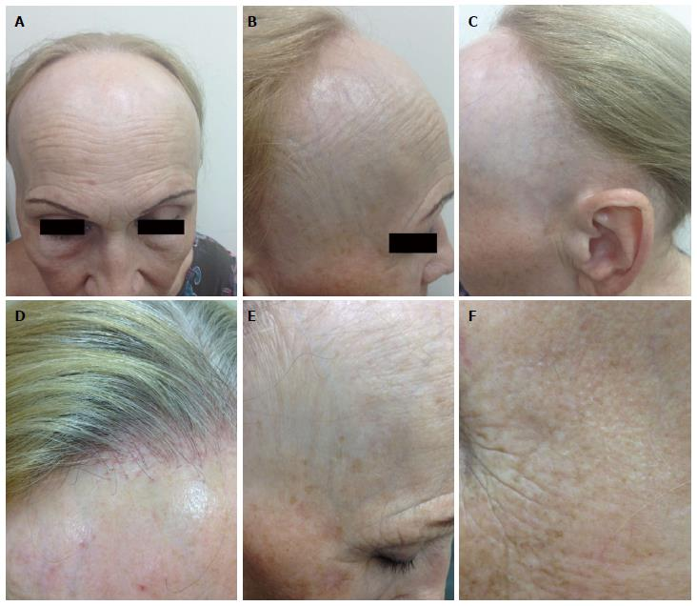
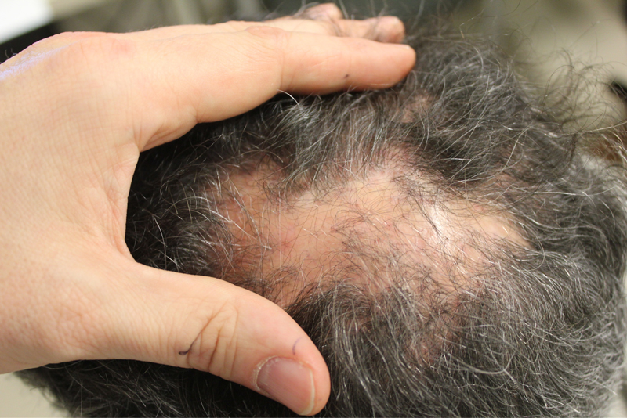
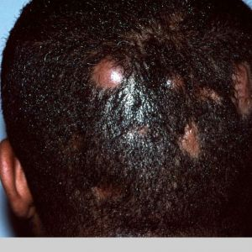
Cicatricial alopecias I see regularly…
FFA
LPP
DC
Notes:
LPP

Slide 11
Classification of non-scarring alopecias
Primary (cutaneous) | Problems with hair cycle | TE/CTE AGA Short anagen syndrome
 | Problems with follicle/scalp skin | AA/AT/AU Tinea Capitis Tranction alopecia (early) Loose anagen syndrome Inflammatory dermatosis e.g. AD, psoriasis
Secondary (to a systemic cause) | Iatrogenic | AE Drug induced shedding
 | Systemic illness | Telogen gravidarum Thyroid dysfunction Starvation, malabsorption Iron or vitamin deficiency Weight loss Acute intercurrent systemic illness e.g. viral illness, covid, pneumonia, acute lupus Chronic illness e.g. liver failure, kidney failure, heart failure, SLE, advanced malignancy
 | Infection | Syphilis
Dr Ahmed Kazmi
Notes:
Explain TE can be considered primary or secondary, and that some systemic diseases enact their hair loss via TE and some by other mechanisms.

Slide 12
Classification of Non-scarring alopecias- Simplified
Primary (cutaneous) | Problems with hair cycle | Telogen effluvium (TE) Androgenetic alopecia (AGA, PHL)
 | Problems with follicle/scalp skin | Alopecia areata (AA) Tinea Capitis Traction alopecia (early) Inflammatory dermatosis e.g. AD, psoriasis
Secondary (to a systemic cause) | Iatrogenic | AE Drug induced shedding
 | Systemic illness | Thyroid dysfunction Malabsorption/ weight loss Iron or vitamin deficiency Acute intercurrent systemic illness Chronic illness
Dr Ahmed Kazmi

Slide 13
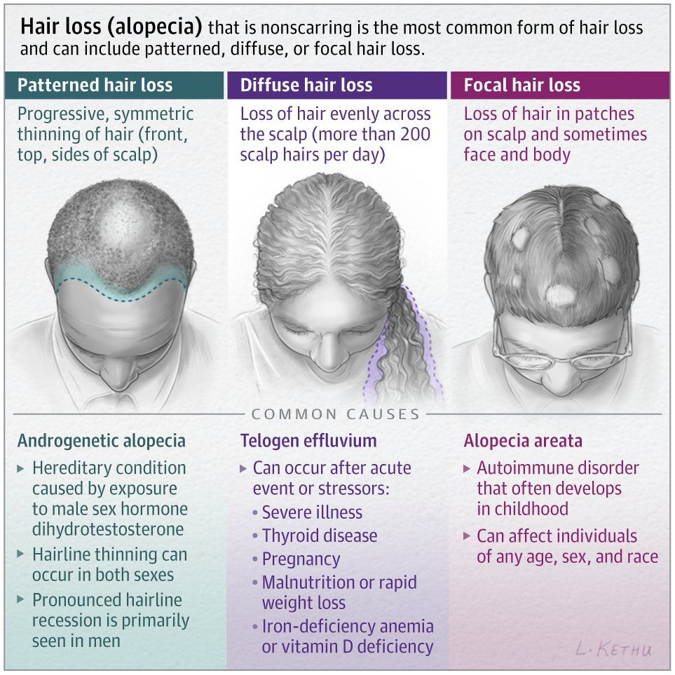
Another way of looking at non-scarring alopecias
Patterned | Diffuse | Focal
AGA MPHL FPHL | TE CTE AE Systemic illness TG | AA Tinea capitis Traction
Dr Ahmed Kazmi

Slide 14

Common Drugs Contributing to Hair Loss
Drug | Comment
Antihypertensives | Mostly betablockers and ACEi
Lipid lowering drugs | Mostly fibrates
Antidepressants | Mostly tricyclics
MSK drugs | Mostly NSAIDs and allopurinol
Anticoagulants | Mostly warfarin and heparin
Retinoids | Isotretinoin, acitretin
Hormones | Testosterone, (COCP)
All chemotherapy
Dr Ahmed Kazmi

Slide 15
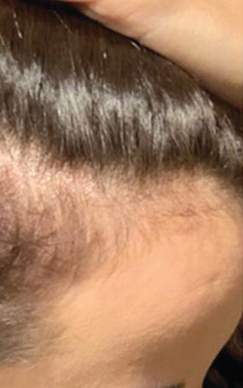
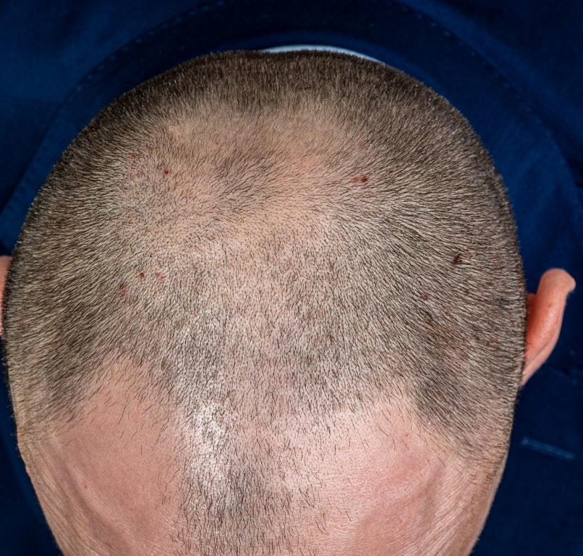
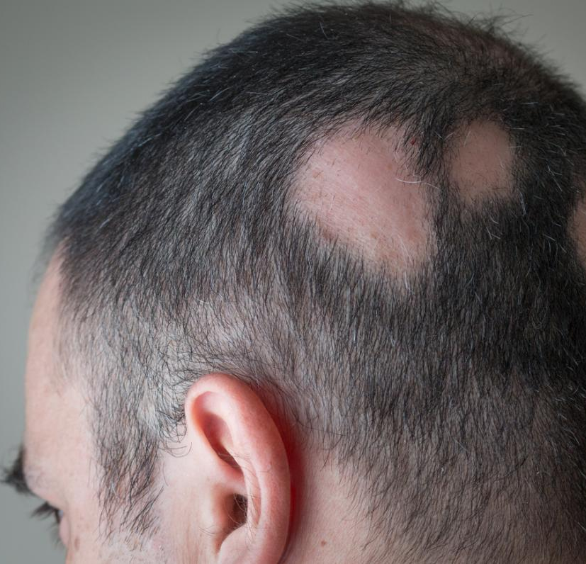
Your bread and butter…
Pattern hair loss
Telogen effluvium
Alopecia Areata
Notes:
If there were three hair loss conditions to get really good at… they would represent about 90% of all hair loss issues your see

Slide 16

Back to basics…
History
Examination

Slide 17
History points
Question | Why
Tell me about your hair loss | Patient usually gives you the answer
How long ago did this all start? | Long history more likely to be pattern loss Acute history more likely to be TE or ciccatricial
Do you have any scalp symptoms? | More common in cicatricial process and seb derm
Do the patches come and go? | If regrowth occurring wont be pattern or ciccatrial
Is any of your other hair affected? | More likely to be FFA or AA
Any problems with your skin, nails, eyes or genitals? | Skin comprises all of these. LP, AA etc
Anyone else in your family affected? | Pattern and AA more likely to be familial, Tinea commonly affects other household members
Anything happened in the last 12 months? Surgery? Stressful events? New medication? Weight loss? Diet? | Working out causes for TE
What is your usual routine for washing and styling? | Identifies contributory practices
How is this affecting you? | Lets me know how hard I need to treat?
Dr Ahmed Kazmi

Slide 18
Examination
Overview
Anterior hair line
Middle parting
Sequentially assess entire scalp
Hair pull
Trichoscopy (hair follicles present or not, inflammation or not, miniaturisation or not)
Eyebrows, eyelashes, beard
If relevant: mouth, nails, skin, lymphadenopathy
Dr Ahmed Kazmi

Slide 19
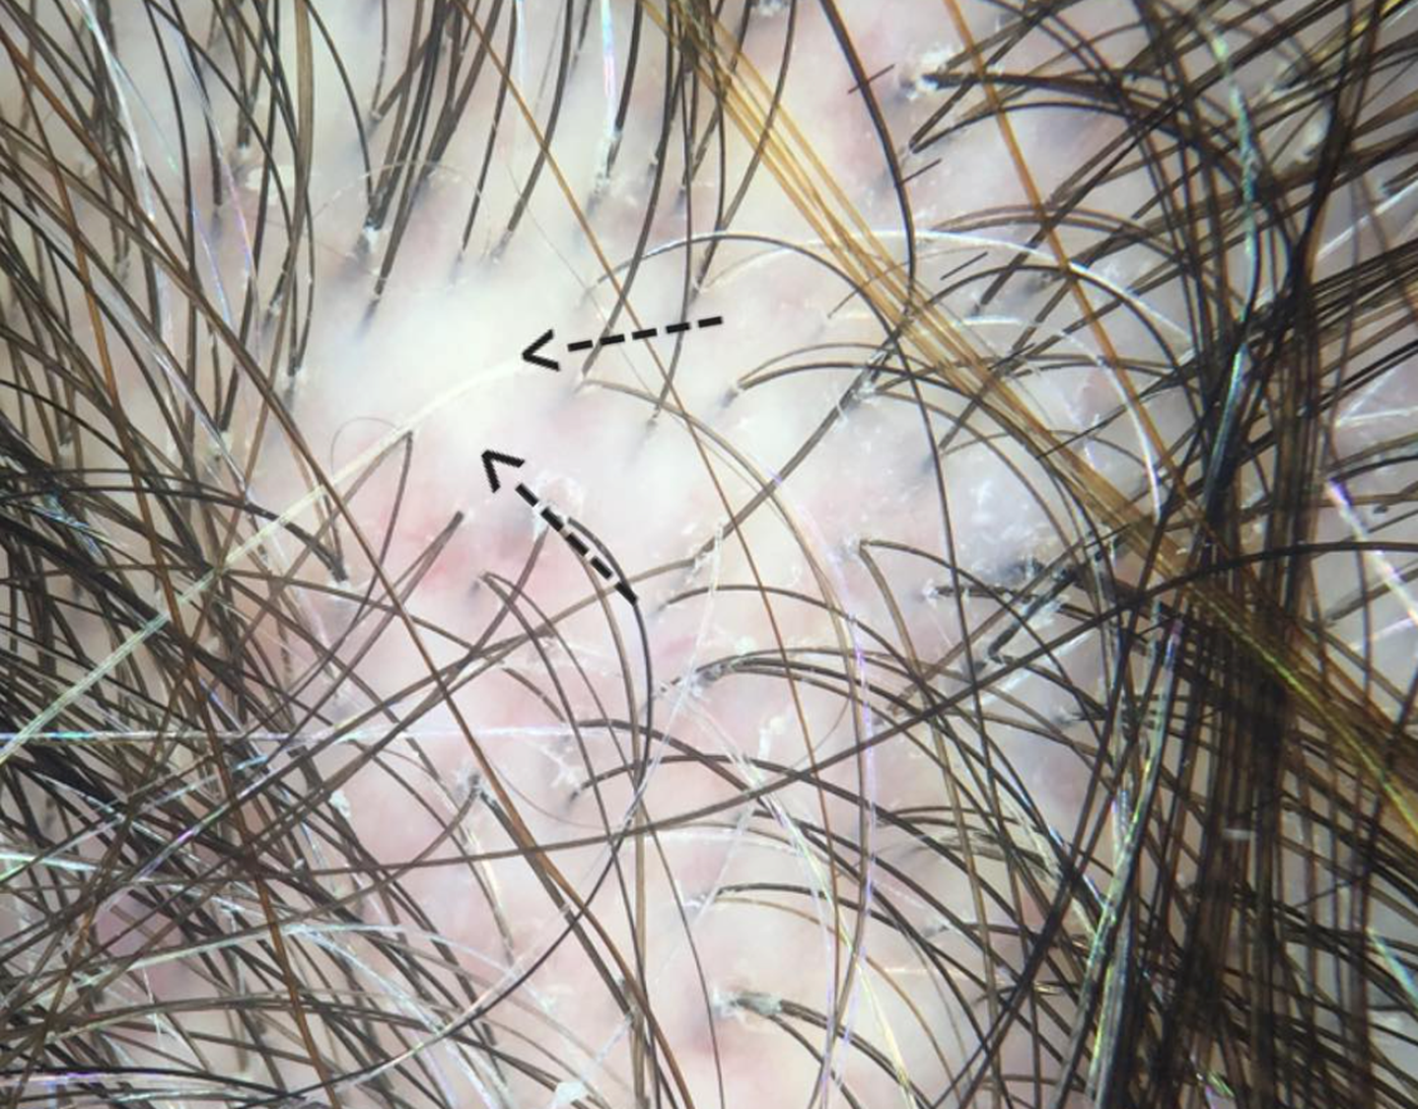
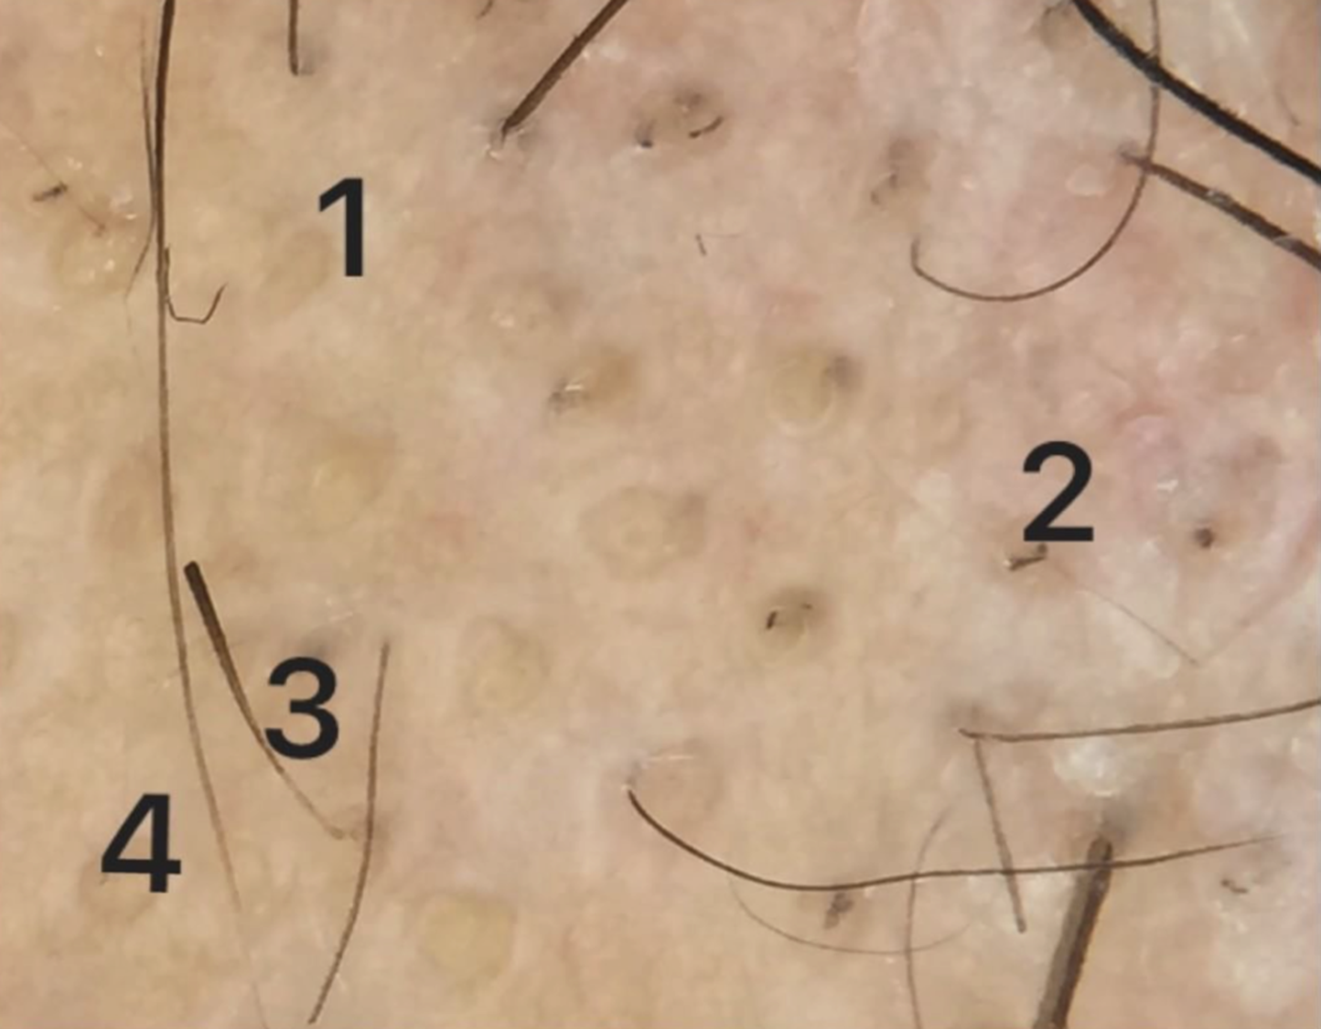
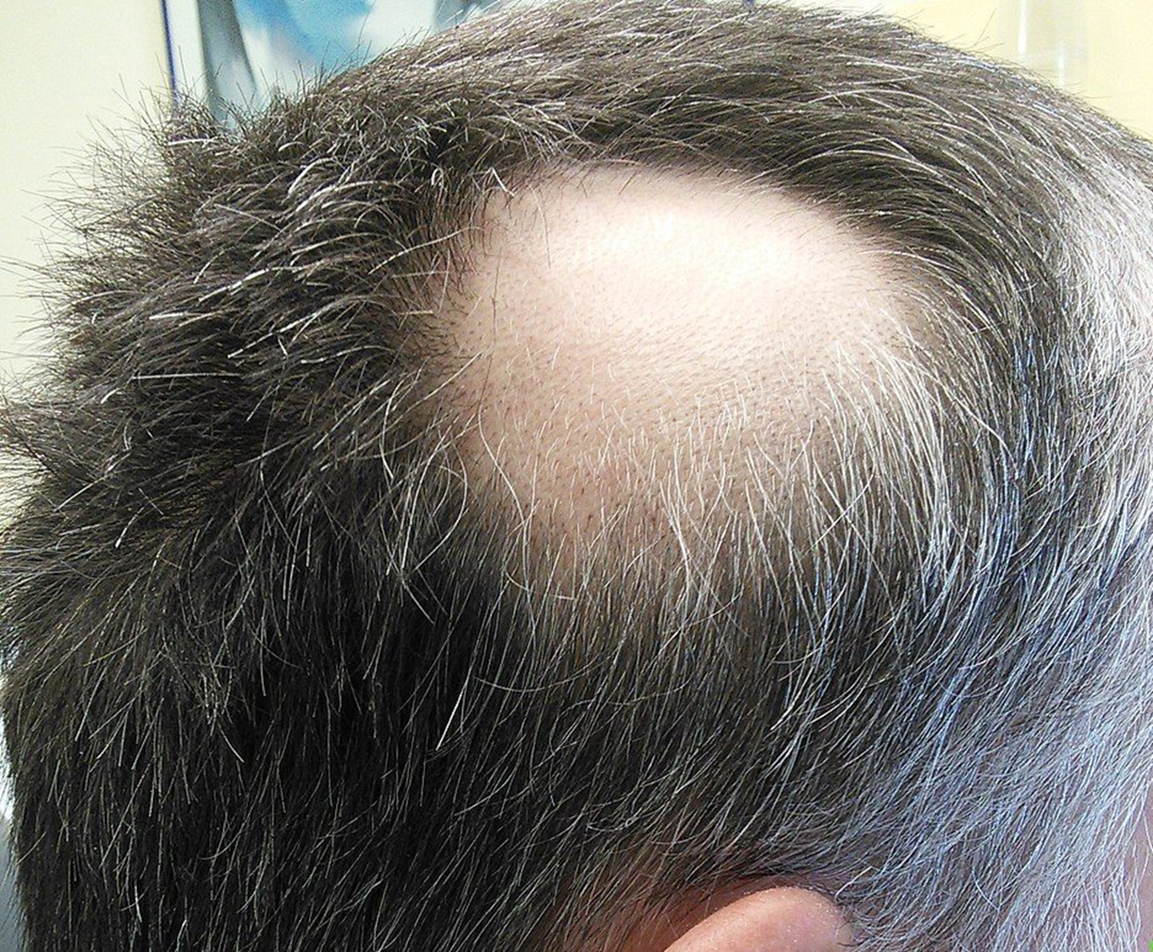
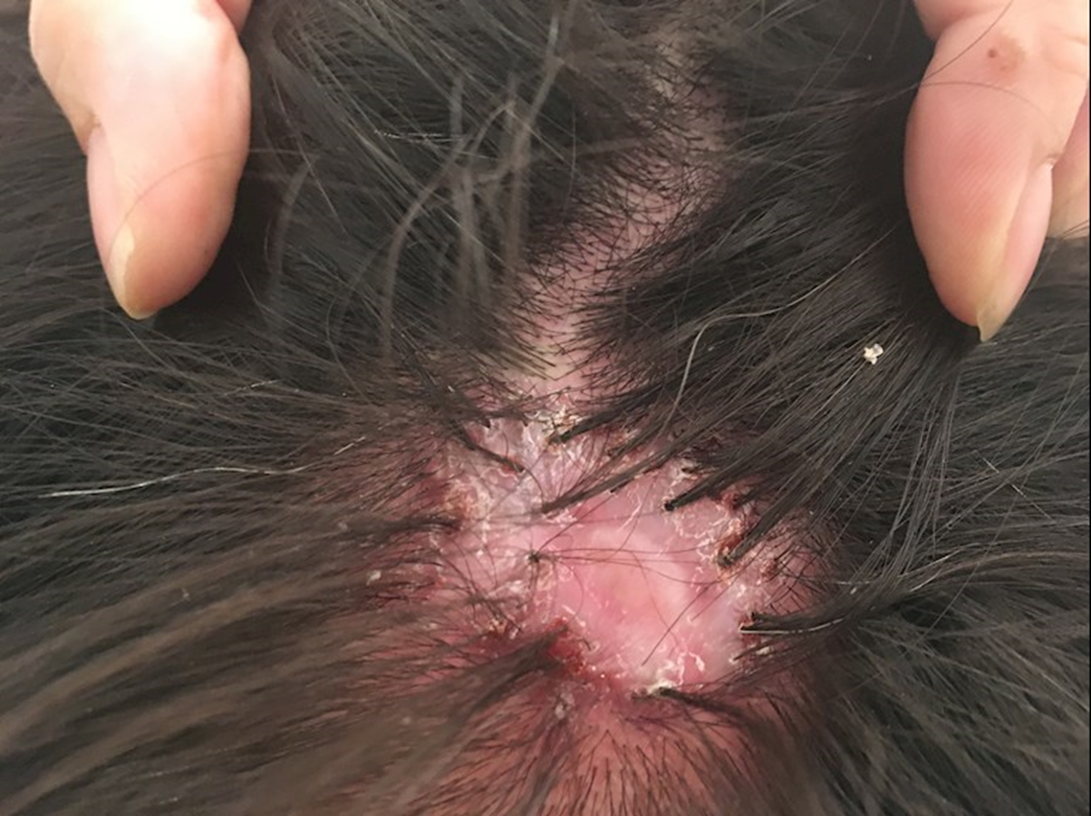
Scarring or non scarring?

Slide 20
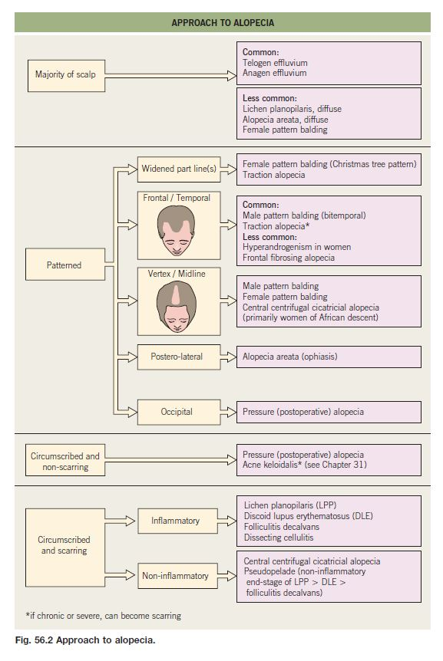
Tying it together
Distribution
Scarring or not
Frequency

Slide 21
Hair work up
If suspecting TE: FBC, UE, LFT, Iron studies, TFT, B12, Folate, Vit D, Zinc + Specifics
If suspecting autoimmune hair loss: as above + ANA, ENA, anti dsDNA, C3, C4, CRP, ESR + specifics (consider pre-systemic work up)
If suspecting DLE: ANA, ENA, anti dsDNA (consider pre-systemic work up)
If suspecting LPP/FFA- none (consider CVS/TFT work up, pre-systemic work up)
If suspecting standard pattern hair loss- none (consider PCOS screen, CVS screen, pre-systemic work up)
If suspecting AA- none (consider TFT/CVS screen/Autoimmune work up, consider pre-systemic work up)
If suspecting tinea capitis: trichogram, mycology culture (consider baseline LFT)
AND PHOTOS!
Dr Ahmed Kazmi

Slide 22
Diagnostic pathway
Pre predictive probability, history, examination, trichoscopy, bloods, biopsy
Scarring or non scarring, inflammatory or not, Diffuse or pattern or patchy
Specific diagnosis
Dr Ahmed Kazmi

Slide 23
5 Step Approach to Hair Loss
Validate
Validate the patient’s experience (avoid gas lighting)
Confirm
Confirm the diagnosis & Explain it
Explain
Explain the options/treatments/signpost
Be
Be holistic
Offer
Offer follow up and/or referral
Dr Ahmed Kazmi

Slide 24
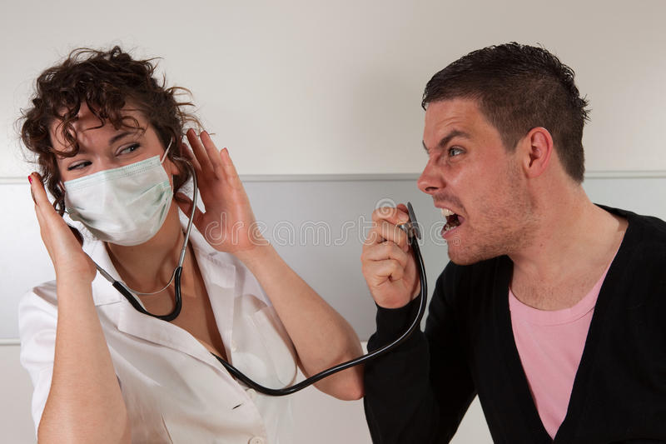

Things people say about their GP
Didn’t believe me
Didn’t explain it to me
Said nothing could be done
Talked me out of having treatment
Made me feel stupid

Slide 25
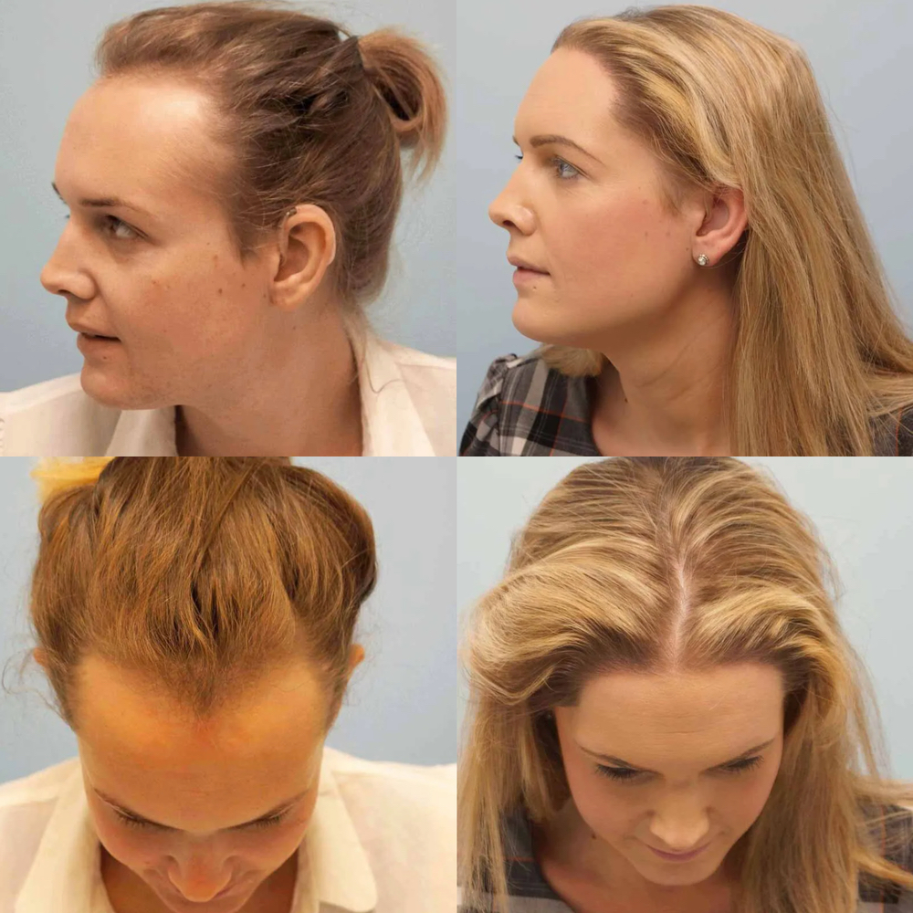


Pattern Hair Loss Overview
Androgenic alopecia (AGA), androgenetic alopecia, pattern hair loss, male pattern hair loss (MPHL), female pattern hair loss (FPHL), common baldness, patten alopecia- all largely synonymous.
Most common form of hair loss
Universal secondary sexual characteristic
30% of 30 year old Caucasian men
50% of Caucasian men have it by 50 years of age
50% of women have it by 80 years of age (bimodal)
?Genetics
Scalp hair has no significant biological function but significant psychosexual and social associations
Huge psychological burden attached: dissatisfaction with appearance, depression, anxiety, low self esteem, obsessions, job problems, marital discord

Slide 26
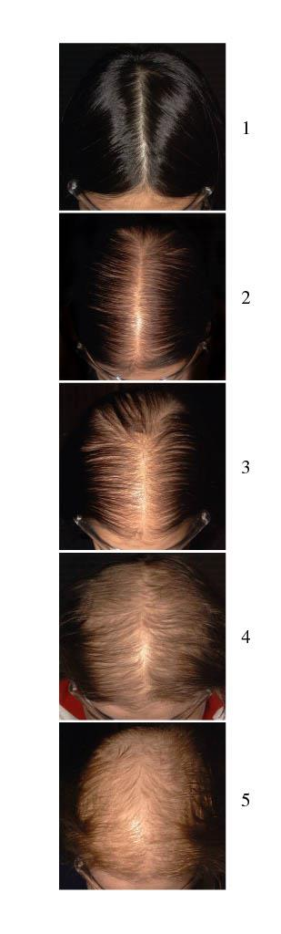
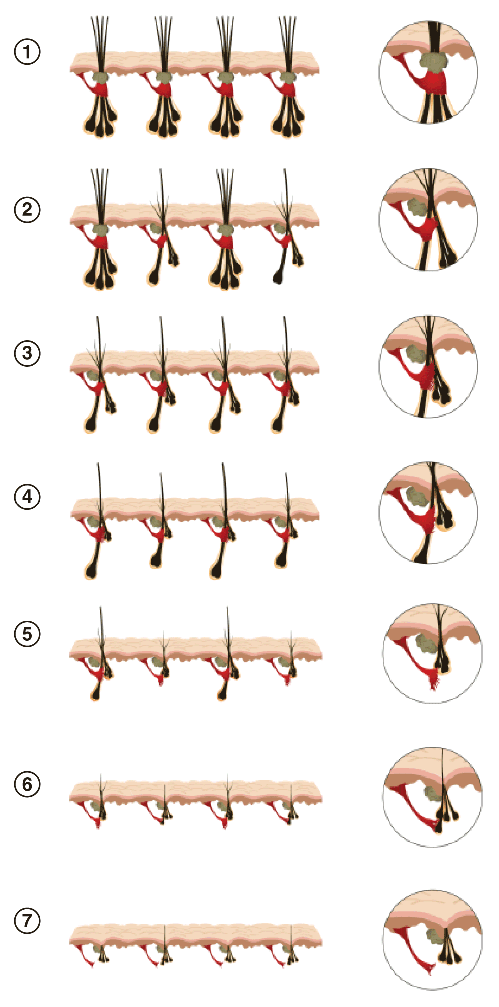
Pattern Hair Loss
Baby peach fuzz
Thick single hairs
Multiple shafts
Single hairs
Baby peach fuzz
FPHL central parting
MPHL temples/mid vertex, crown

Slide 27
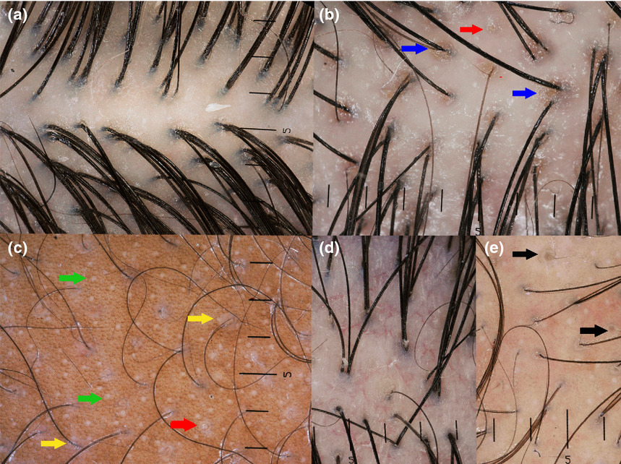
Trichoscopic features
Loss of secondary follicular units
Single follicular units
Greater variability in shaft diameter
Vellus hairs
Minaturised hairs
Empty follicles

Slide 28
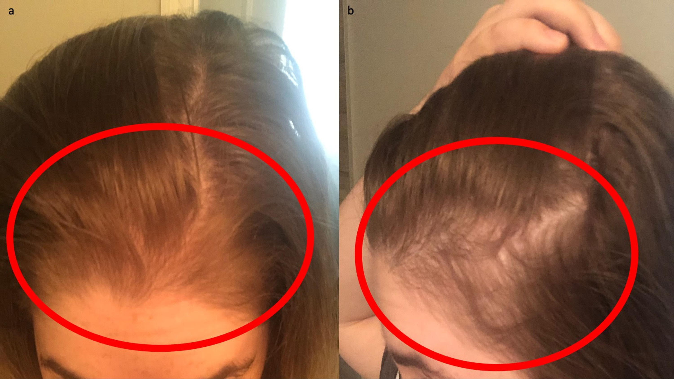
Telogen Effluvium Overview
Non scarring
Diffuse but often temperoparietal scalp affected most
Often 3 months after ’stressful’ event
Problem of proportions
Reversible
1-3 years
Think about cause
Time
Minoxidil
PRP
Vitamins

Slide 29
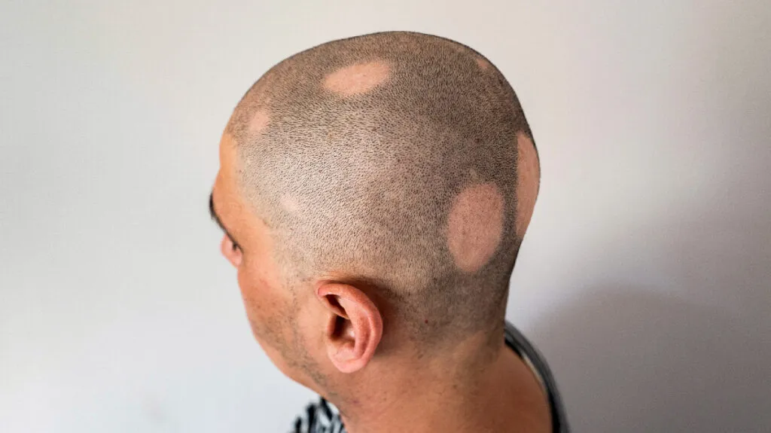
Alopecia Areata Overview
Common condition
1-2% lifetime prevalence
Autoimmune, Genetic
Single patch- About 50-80% resolve within a year
Multiple patches- About 30% resolve within a year
If still there in a year- about 5-10% AT
If still there in a year- about 5% AU
Overall: about 1% AU, 5% AT
Poor prognostic indicators: young age of onset, multiple patches, rapidly progressive, occipital involvement, body hair involvement, more than a year duration, atopic diathesis, other autoimmune burden, family history
Steroids: topical, intradermal, oral
Minoxidil
JAK inhibitors: oral, topical
PRP
Non-steroid topicals

Slide 30
Treatment overview
Conservative management
Camouflage- hair systems, hair fibers, scalp tattoo
Medical management- tablets and topicals and injections
Surgical management- FUT, FUE, Scalp reduction therapy, Hairline lowering
Dr Ahmed Kazmi

Slide 31
Specific Treatments
 | 1st Line | 2nd line | 3rd Line
FPHL | Topical 5% BD Oral minoxidil 0.25mg-2.5mg Consider referral | Spironolactone 50mg-200mg Finasteride 0.25mg-5mg Dutasteride 0.5mg COCP Consider referral | Refer (higher dose minoxidil, antiandrogens such as bicalutamide, flutamide, cyproterone, dutasteride mesotherapy, bicalutamide mesotherapy, PRP, bimatoprost, laser, autologous stem cell therapy, transplant)
MPHL | Topical 5% BD Oral minoxidil 0.25mg-5mg Finasteride 0.25mg-1mg Consider referral | Finasteride 0.25mg-5mg Dutasteride 0.5mg | Refer (higher dose minoxidil, antiandrogens such as spironolactone, dutasteride mesotherapy, bicalutamide mesotherapy, PRP, bimatoprost, laser, autologous stem cell therapy, transplant)
TE | Optimise health & nutrition Exclude/treat contributing factors consider referral | Topical Minoxidil 5% BD Oral minoxidil 0.25mg-2.5mg Consider referral | Refer (higher dose minoxidil, antiandrogens, confirm diagnosis, PRP, laser)
AA | Limited disease- diprosone or novasone lotion nightly Extensive disease- REFER | Consider referral Intralesional steroid Oral steroid Oral minoxidil 0.25mg-2.5mg (Or Topical 5% BD) Topical clobetasol, topical tofacitinib/ruxolitinib/tacrolimus | Refer oral prednisolone oral JAKis topical JAKis PRP sensitisation therapy laser, phototherapy, conventional DMARDs
Cicatricial ALOPECIAS | REFER | REFER | REFER
Dr Ahmed Kazmi
Notes:
Explain they want to be doing licenced evidence based easily defendible treatments, leave the rest to someone else
Include something about lifestyle measures

Slide 32
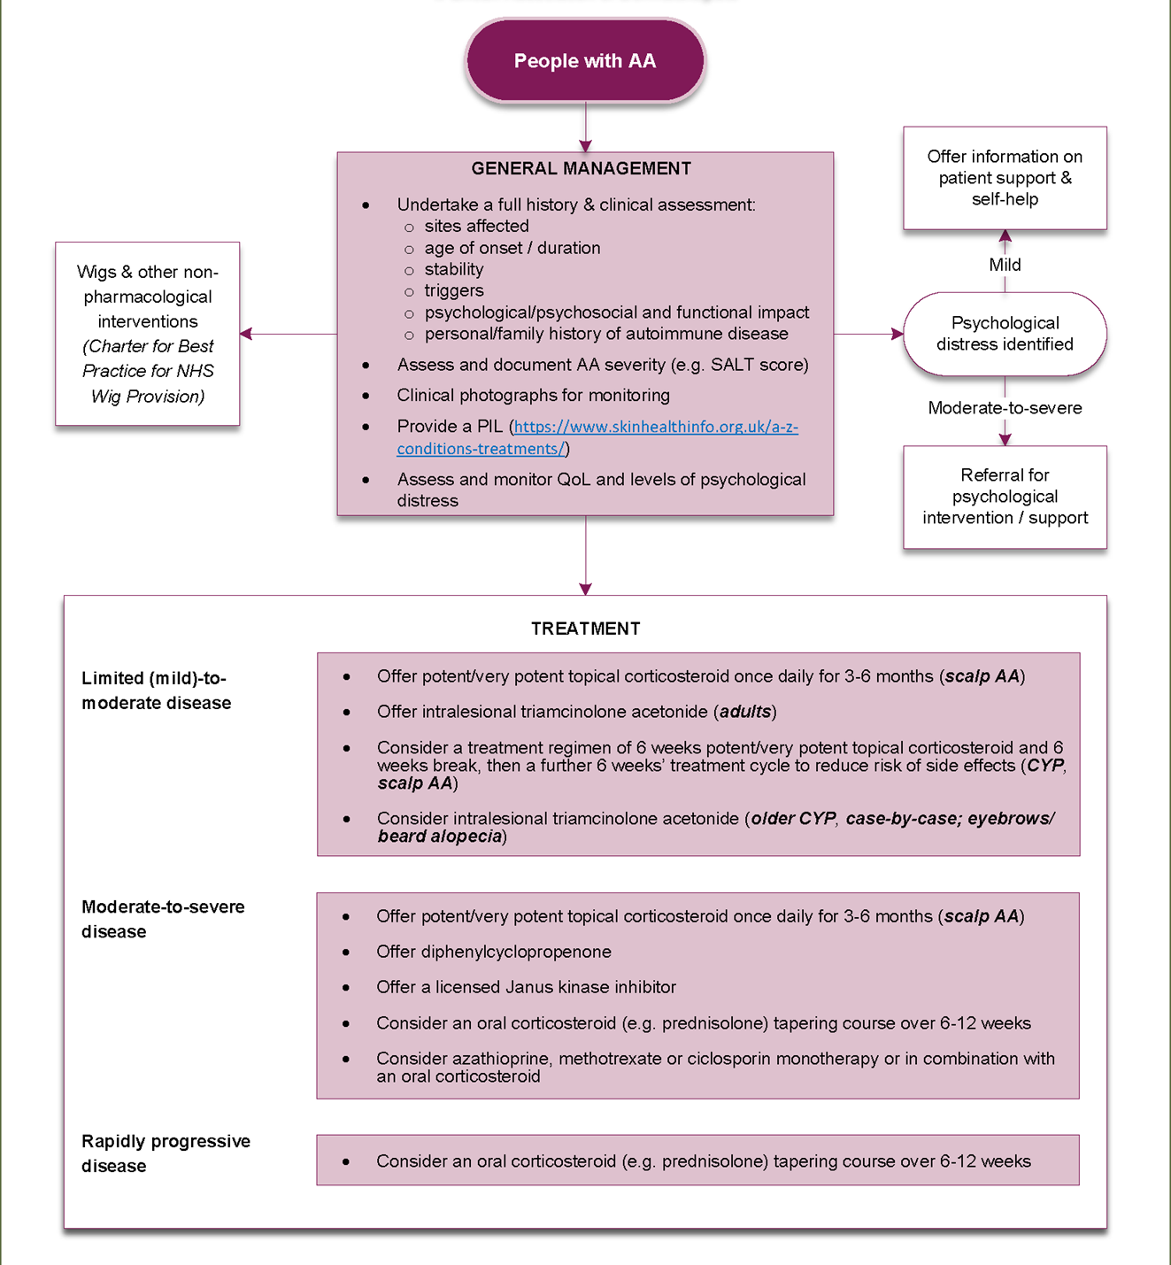
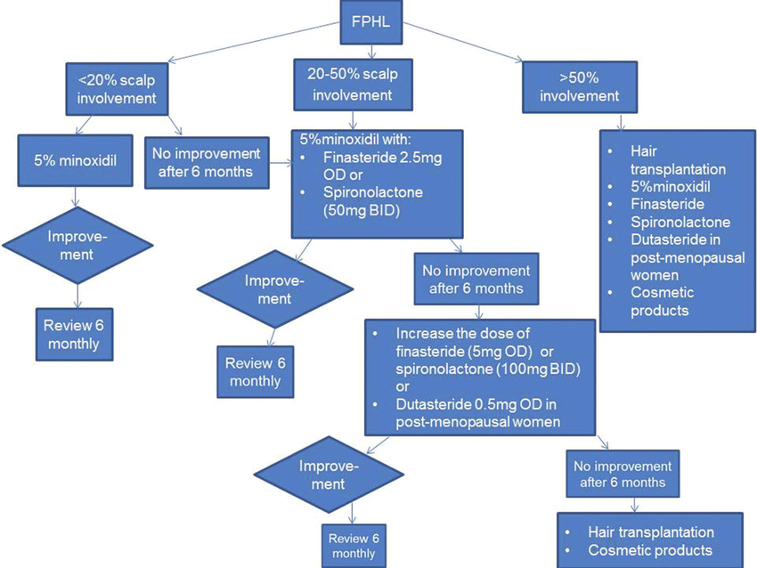
Lots of algorithms available
Female Pattern Hair Loss: A Retrospective Study in a Tertiary Referral Center
Siah et al
April 2016
International Journal of Trichology8(2):57
DOI:10.4103/0974-7753.188033
British Association of Dermatologists living guideline for managing people with alopecia areata 2024
Matthew J Harries, Anna Ascott, Leila Asfour, Paul Farrant, Gordon Hale, Susan Holmes, Amy Johnson, Victoria M L Jolliffe, Ahmed Kazmi, Abby E Macbeth ... Show more
British Journal of Dermatology, ljae385, https://doi.org/10.1093/bjd/ljae385
Published:
21 October 2024

Slide 33
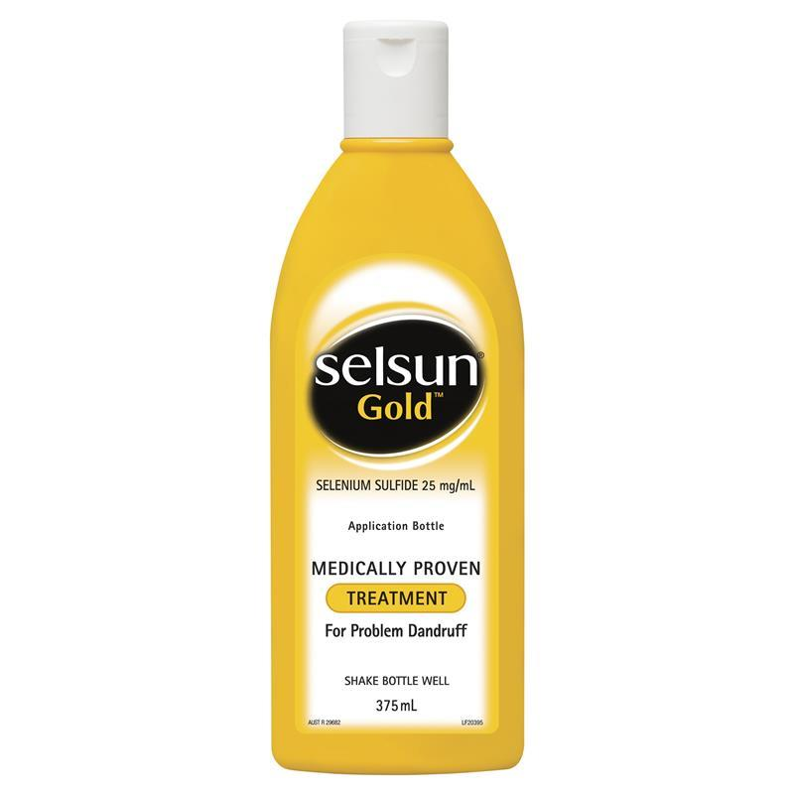
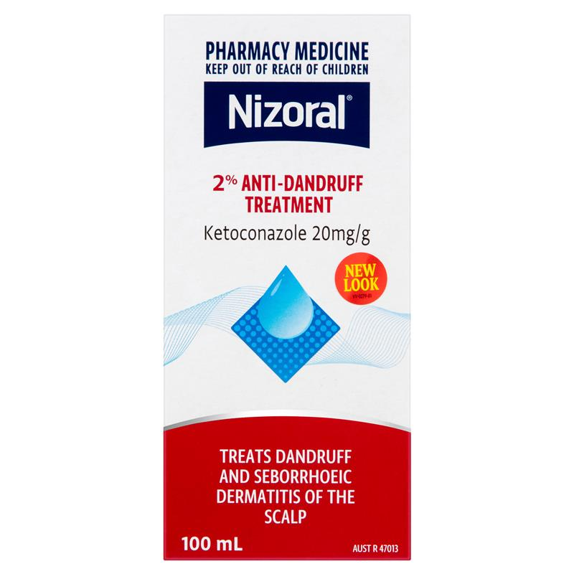

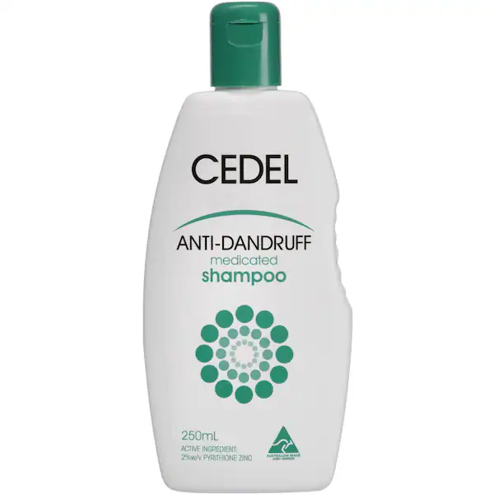
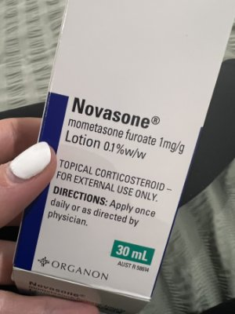
Always treat concomitant seb derm

Slide 34
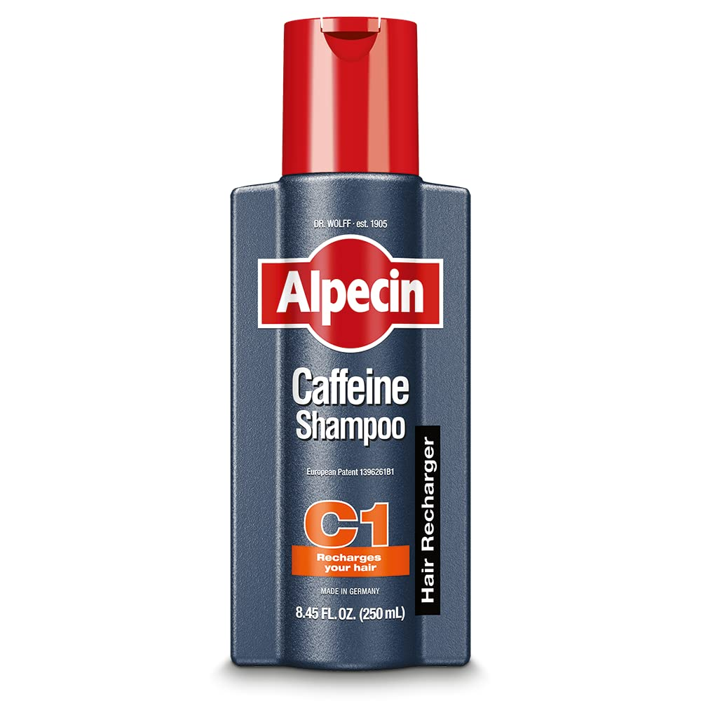
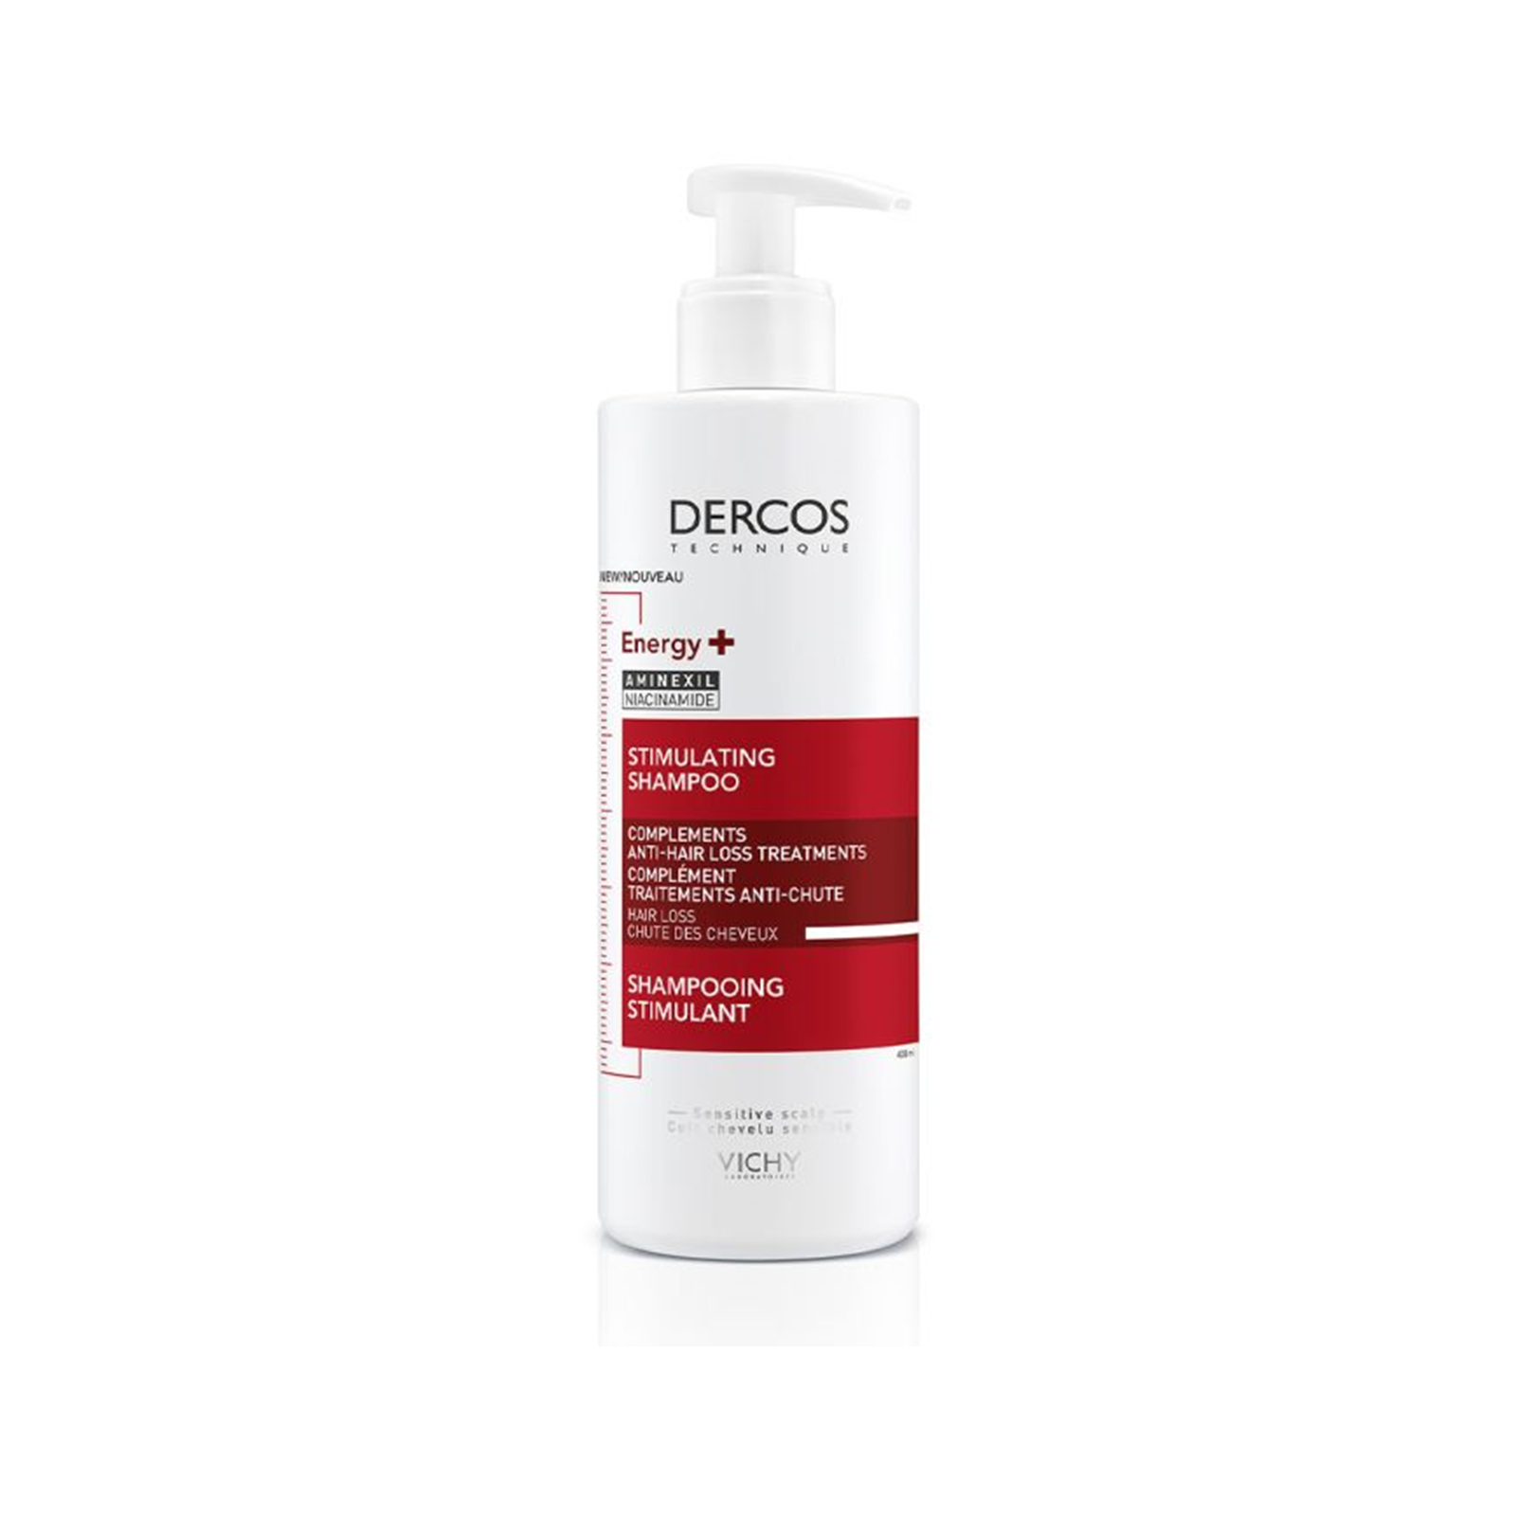
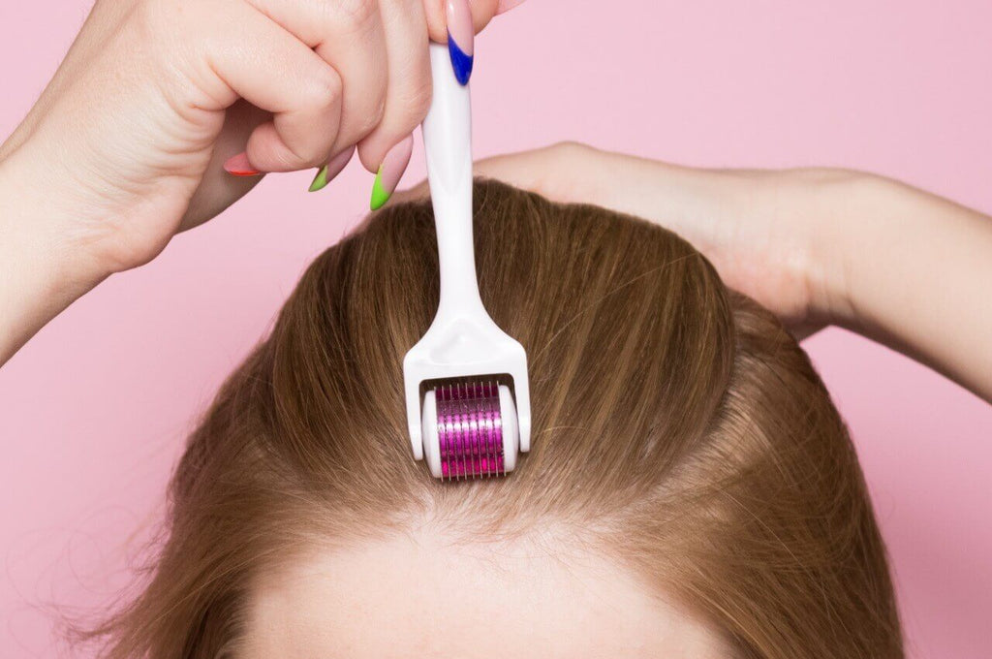




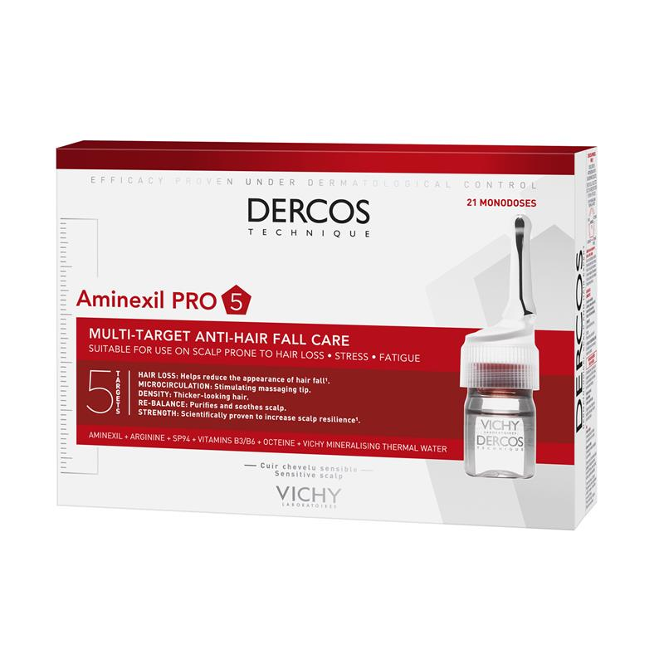
‘Home’ treatments for hair loss

Slide 35
Pattern loss: Being Holistic
Consider screening for depression and anxiety
Consider screening for cardiovascular disease
Education and support
Avoid damaging hair treatments and products
Adequate diet
Review drug chart (retinoids, cytotoxics, anticoagulants, b-blockers, captopril, statins, colchicine, lithium, valproate)
Consider blood tests: iron, vit d, zinc, TFT (hormone studies if clinically relevant),
Treat coexisting scalp conditions: e.g. seb derm, psoriasis
Risk factors for psychiatric burden of MPHL:
Extensive involvement
Younger age of onset
Early onset
Self described as ‘progressive’
Single relationship status

Slide 36
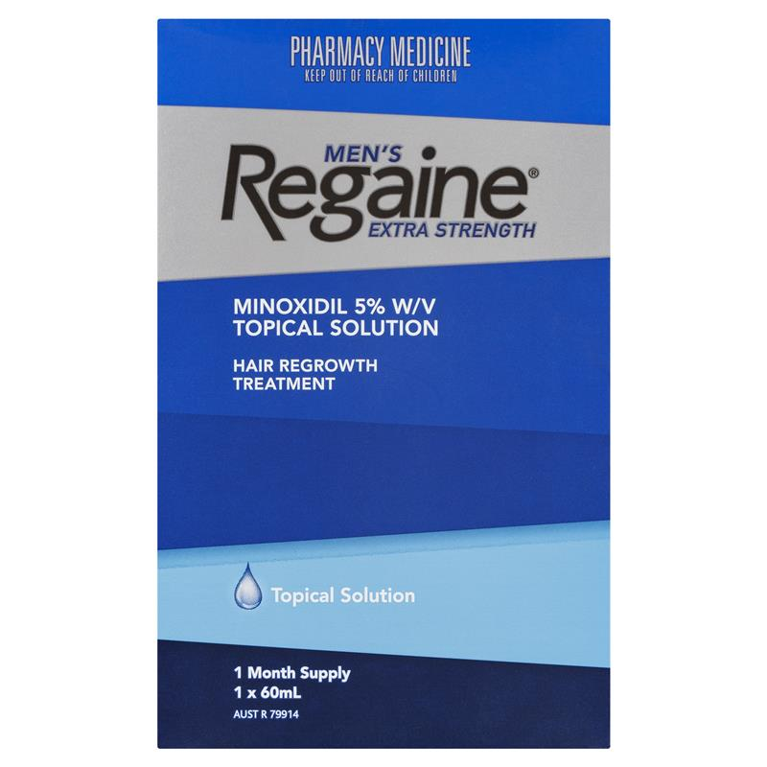
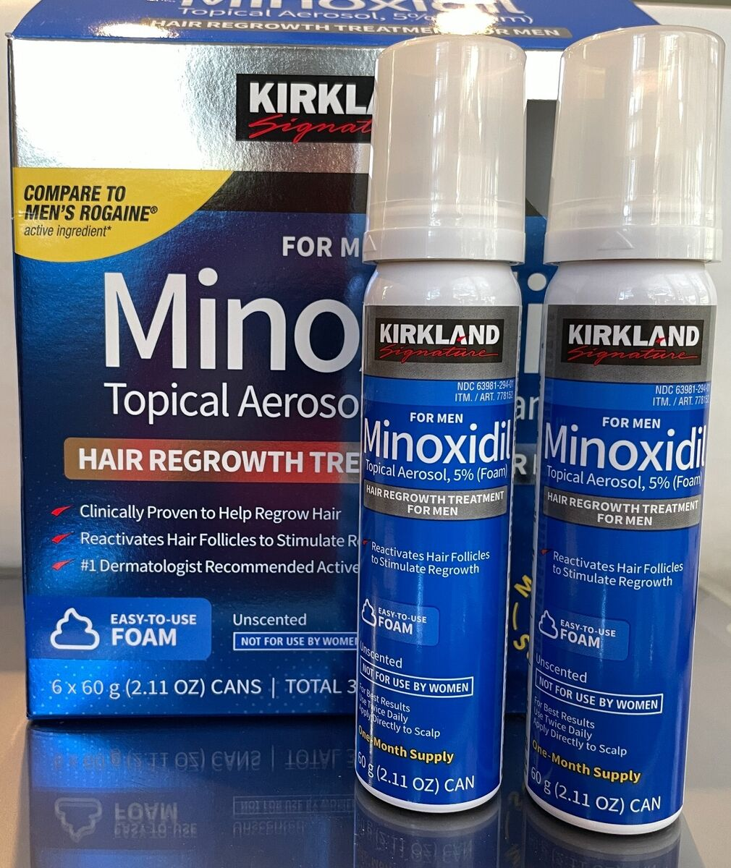
Topical Minoxidil tips
5% not lower
Liquid absorbs better but stings more
Foam stings less
Ideally twice a day
Explain how to apply
Consent:
  Irritation
  Slow
  Initial shed
  Systemic side effects
  No legacy affect
Can be compounded with extras/less
Oral always an option

Slide 37
5 Step Approach to Pattern Hair Loss
Validate
Validate the patient’s experience (avoid gas lighting)
Confirm
Confirm the diagnosis & Explain it
Explain
Explain the options/treatments/signpost
Be
Be holistic
Offer
Offer follow up and/or referral

Slide 38
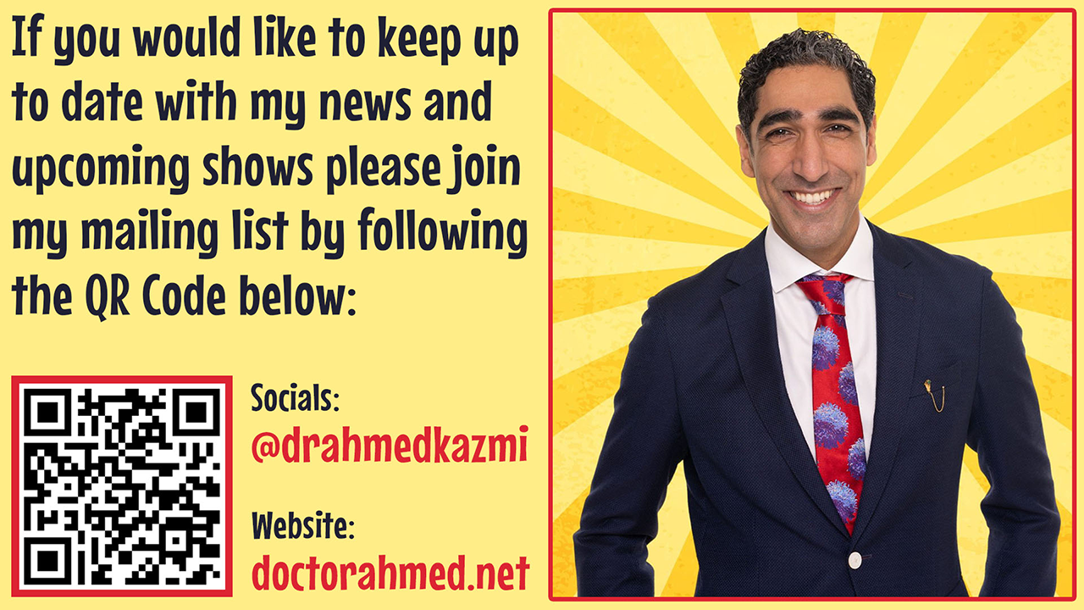
Few things to think about
Interested in a hair loss course with HealthCert?
*Let us know if so
*Let us know what sort if topics you want/skills you want to learn
*What sort of teaching style you want
*Who you want to do the teaching
Any other dermatology topics you would like HealthCert to cover?
*Genital dermatoses
*AD and Allergies
*Transgender medicine
*Mastering topicals
Would you like to collaborate with me?
*research
*Work
*Come see a show or lecture
Keep in touch: @drahmedkazmi
office@fairfielddermatology.com

Slide 39
What I can do in 60 minutes…
Feel you have a methodical approach to approaching a hair loss consult
Feel you can better diagnose the common causes of hair loss
Feel you are better able to manage some of the common causes for hair loss
Notes:
Mention picture of woman again

Slide 40
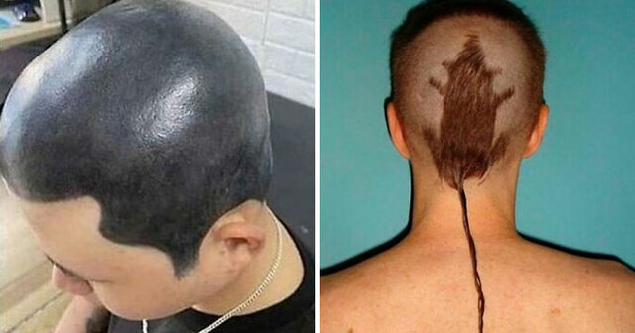
The end

