Slide 1

Clinical Guideline Update
Management of Type 2 Diabetes Mellitus
February 2025
Dr Simone Gonzo

Slide 2

Welcome to Country

Slide 3

Disclosures
Dr Simone Gonzo is in private practice at Caboolture, Queensland
Is a GP Supervisor for RACGP
Teaches medical students from The University of Queensland
Completing a Masters of Healthcare Leadership

Slide 4
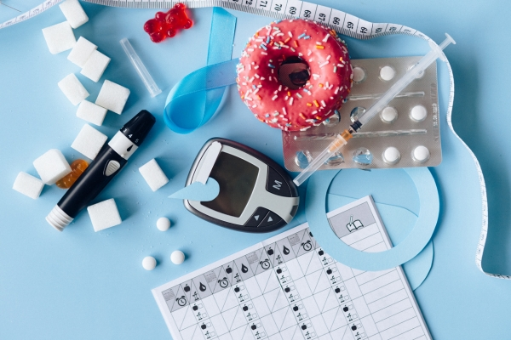
Learning outcomes
Determine the content of the updated clinical guideline
Apply the new clinical guideline content to patient cases

Slide 5
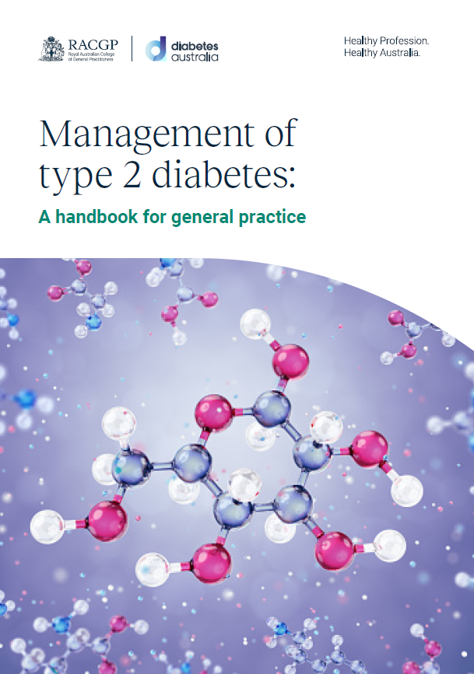
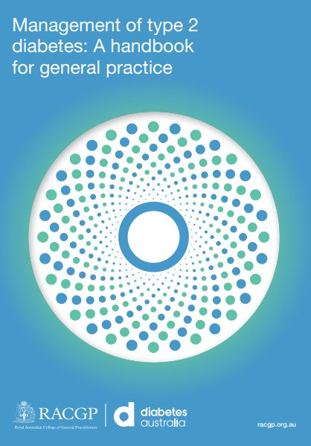
2024 – 326 pages
2020 – 198 pages

Slide 6
New topics
Remission of Type 2 Diabetes
Weight management interventions
Sleep and diabetes
Disability, dementia, cognitive decline and hearing impairment

Slide 7
Significant updates to existing sections
Early-onset Type 2 Diabetes (T2DM)
Medical management of glycaemia
Use of technology in T2DM management
Complications:-
  T2DM and cardiovascular risk
  Diabetes-related eye disease
  Updates on the management of CKD in people with diabetes
T2DM and mental health
Managing risks and other impacts of T2DM
  Vaccination advice updates, including RSV
  Preoperative medication advice, including SGLT2i (dapagliflozin & empagliflozin) and GLP-1RAs (semaglutide & dulaglutide)

Slide 8
Clinical Guideline Update
Unit 1 – New topics

Slide 9
Remission of T2DM
Lifestyle changes, including weight loss, may achieve diabetes remission.
  Defined as HbA1c below 6.5% for at least three months in the absence of glucose-lowering medications
Bariatric surgery should be recommended to non-pregnant adults with T2DM and a BMI ≥35 kg/m2 as an option to potentially induce T2DM remission.
Remission does not mean that T2DM is cured or reversed.

Slide 10
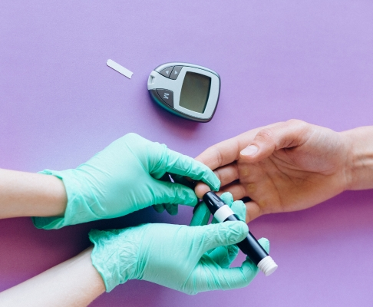
Remission of T2DM
If T2DM remission criteria are met, HbA1c (or, if HbA1c unreliable, fasting plasma glucose or an OGTT) should be performed at a minimum interval of every six months to assess persistence of diabetes remission or relapse of diabetes.

Slide 11
Weight management interventions for T2DM
In overweight or obese diabetics, a nutritionally balanced, calorie reduced diet should be followed.
Exercise programs should be initiated.
Obesity pharmacotherapy should be considered for people with diabetes and overweight or obesity along with lifestyle changes.

Slide 12
Weight management interventions for T2DM
People who achieve weight loss goals should be offered long-term (≥1 year) weight maintenance support which should, at minimum include:
  monthly contact
  ongoing monitoring and self-monitoring of weight and
  regular physical activity (200–300 min/ week)

Slide 13
Weight management interventions for T2DM
Consider metabolic surgery as a weight and glycaemic management approach in people with T2DM with BMI ≥30.0 who are otherwise good surgical candidates.
Consider metabolic surgery for people with T2DM and BMI 30.0–34.9 if hyperglycaemia is inadequately managed despite optimal treatment with either oral or injectable medications.

Slide 14
Weight management interventions for T2DM
Medications associated with weight gain:
  insulin, sulfonylureas, thiazolidinediones,
  second-generation antipsychotics (esp. olanzapine and clozapine), beta-blockers (esp. propranolol),
  tricyclic antidepressants,
  lithium,
  pizotifen,
  sodium valproate and
  glucocorticosteroids.

Slide 15
Sleep and diabetes
Consider screening for sleep health in people with diabetes, including
  symptoms of sleep disorders,
  disruptions to sleep due to diabetes symptoms or management needs and
  worries about sleep.
Refer to sleep medicine specialists and/or qualified behavioural health professionals as indicated.

Slide 16
Disability, dementia, cognitive decline & hearing impairment
Screening for early detection of mild cognitive impairment or dementia should be performed for adults >65yo at the initial visit, annually, and as appropriate.
In the presence of cognitive impairment, diabetes treatment plans should be simplified as much as possible and tailored to minimise the risk of hypoglycaemia.

Slide 17
New Clinical Guideline
End Unit 1 – New topics

Slide 18
Clinical Guideline Update
Unit 2 – Significant updates

Slide 19
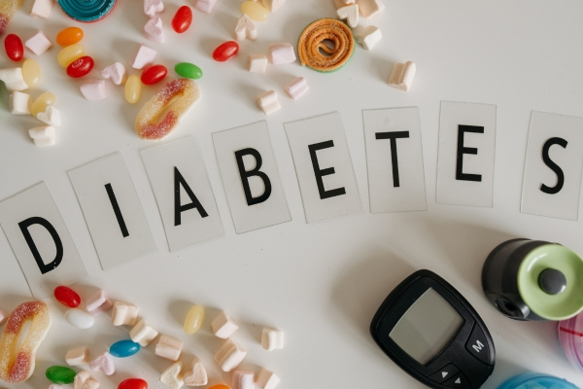
Early-onset type 2 diabetes
For people aged 18–30 years with early onset T2DM, due to the complexity of management and higher risk of complications, consider referral to an endocrinologist.

Slide 20
Glucose-lowering medication in newly diagnosed T2DM
A person-centred approach should be used to guide the choice of glucose-lowering medication.
Considerations include:
  comorbidities (atherosclerotic CV disease, heart failure, CKD)
  hypoglycaemia risk
  impact on weight
  cost
  risk for side effects and
  individual preferences

Slide 21
Medical management of glycaemia
Healthy behaviour interventions should be initiated at diagnosis.
If glycaemic targets are not achieved within three months using healthy behaviour interventions alone, anti-hyperglycaemic therapy should be added to reduce the risk of microvascular complications.

Slide 22
Medical management of glycaemia
Metformin should usually be selected before other agents due to:
  low risk of hypoglycaemia and weight gain
  long-term experience with this agent.
Individuals with metabolic decompensation e.g.
  marked hyperglycaemia,
  ketosis or
  unintentional weight loss
consider insulin with or without metformin to correct the relative insulin deficiency.

Slide 23
Advancing treatment
Dose adjustments to, and/or addition of, glucose-lowering medications should be made in order to attain target glycated haemoglobin (HbA1c) within 3–6 months.
If glycaemic targets are not achieved, other classes of glucose-lowering agents should be added or substituted to improve glycaemic control.

Slide 24
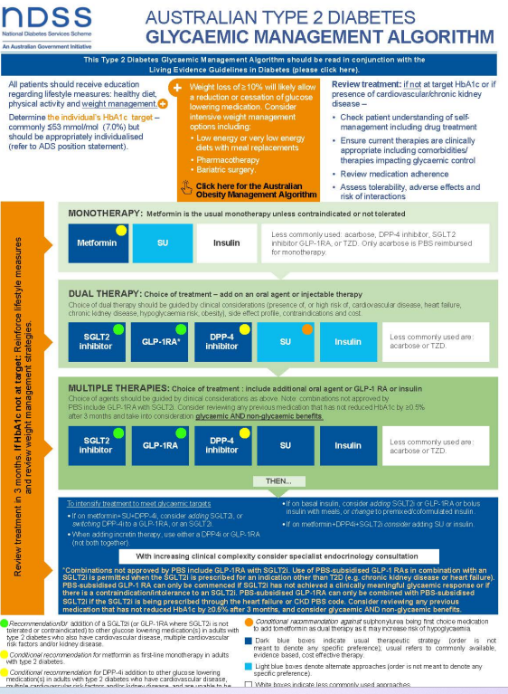
Advancing treatment

Slide 25
Use of technology in T2DM
Continuous glucose monitoring (CGM) should be considered for continual or intermittent use in all individuals with T2DM on intensive insulin therapy (multiple daily injections [MDIs] or insulin pumps), subject to individual factors and the availability of resources.

Slide 26
T2DM and cardiovascular risk
Calculate cardiovascular disease (CVD) risk level using the Australian absolute cardiovascular disease risk calculator (Aus CVD Risk Calculator) (http://www.cvdcheck.org.au/).
Age ranges for assessing CVD risk in people without known CVD:
  • All people aged 45–79 years
  • People with diabetes aged 35–79 years
  • Aboriginal and Torres Strait Islander people aged 30–79 years.
Assess individual CVD risk factors in Aboriginal and Torres Strait Islander people aged 18–29 years

Slide 27

T2DM and cardiovascular risk
https://www.cvdcheck.org.au/calculator

Slide 28
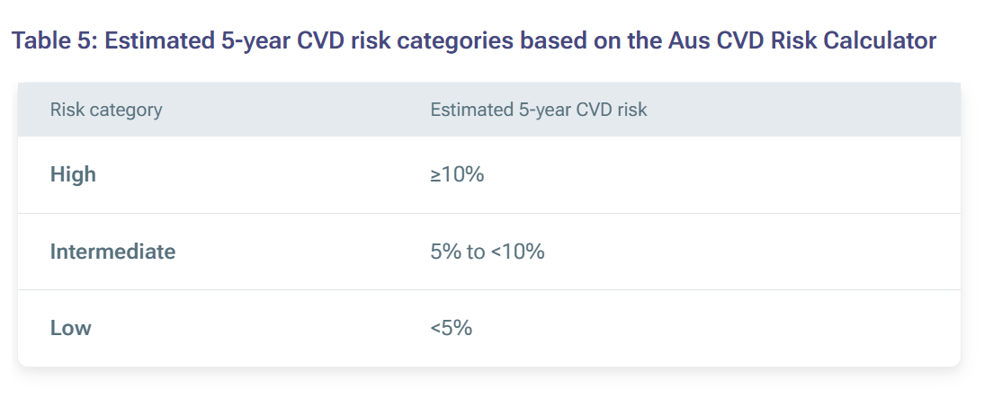
T2DM and cardiovascular risk

Slide 29
T2DM and cardiovascular risk
For ATSI people, consider reclassifying estimated CVD risk to a higher risk category after assessing the person’s
  clinical,
  psychological,
  socioeconomic circumstances and
  community CVD prevalence.

Slide 30
T2DM and cardiovascular risk
In people whose estimated CVD risk is close to the threshold for a higher risk category, consider reclassifying estimated CVD risk to the higher risk category for the following groups:
  • Māori people
  • Pacific Islander people
  • People of South Asian ethnicity (Indian, Pakistani, Bangladeshi, Sri Lankan, Nepali, Bhutanese, or Maldivian ethnicities)
People with pre-existing CVD are at high risk of another CVD event.

Slide 31
Managing CVD risk
For people at high risk of CVD (≥10%), prescribe:
  lipid-modifying medicines and
  blood pressure-lowering medicines
to reduce CVD risk, unless contraindicated or clinically inappropriate.
Explain the potential benefits and harms of treatment to the person and encourage shared decision-making.
Encourage, support and advise a healthy lifestyle.

Slide 32
T2DM and cardiovascular risk
In adults with T2DM who also have
  CVD,
  multiple cardiovascular risk factors and/or
  kidney disease.
recommend the addition of a
  sodium–glucose cotransporter 2 inhibitor (empagliflozin) OR
  a glucagonlike peptide-1 receptor agonist (semaglutide)
to other glucose-lowering medication/s.

Slide 33
T2DM and cardiovascular risk
Multiple CV risk factors are
  men >55 years of age or women >60 years of age with T2DM who have one or more additional traditional risk factors, including:
    hypertension,
    dyslipidaemia or
    smoking.

Slide 34
Antihypertensive medication
Antihypertensive therapy is strongly recommended in patients with diabetes and systolic blood pressure ≥140 mmHg.
BP targets should be individualised through a shared decision-making process that addresses:
  CV risk,
  potential adverse effects of antihypertensive medications and
  individual preferences.
Any of the first-line antihypertensive drugs that effectively lower blood pressure are recommended.

Slide 35
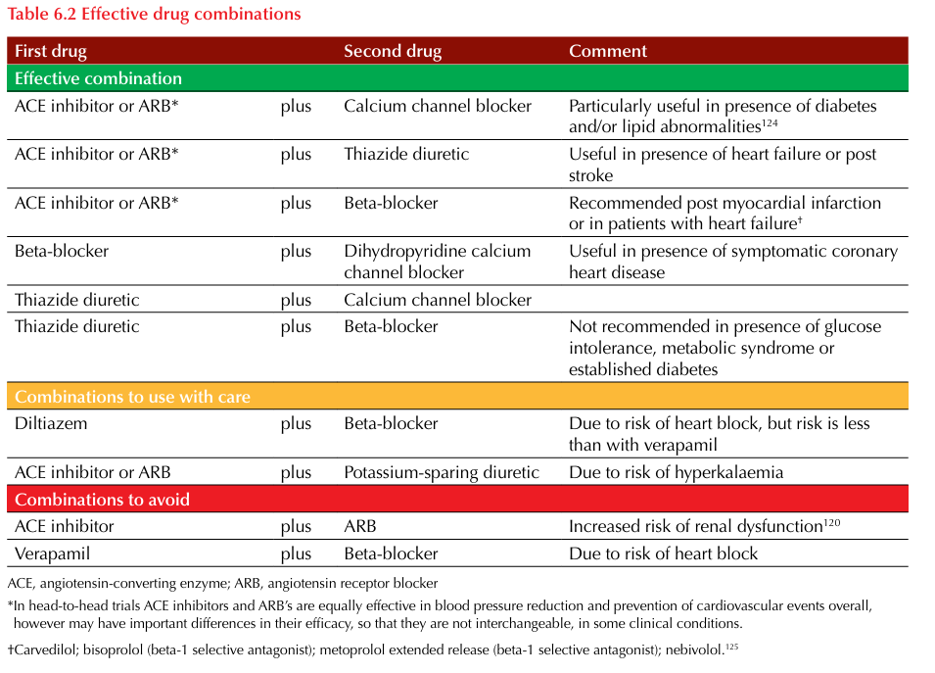
Antihypertensive medication

Slide 36
Antihypertensive medication
In patients with
  diabetes and hypertension,
  chronic kidney disease or
  comorbidities of heart disease,
a blood pressure target of <140/90 mmHg is recommended.
In patients with
  hypertension and
  a history of transient ischemic attack (TIA) or stroke,
a blood pressure target of <140/90 mmHg is recommended.

Slide 37
Lipid-lowering medications
All adults with T2DM and known prior CVD
  should receive the maximum tolerated dose of a statin, irrespective of their lipid levels (except haemorrhagic stroke).
  fibrates should be commenced in addition to a statin or on their own (for those intolerant to statin) when fasting triglycerides are >2.3 mmol/L, or high-density lipoprotein (HDL) cholesterol is low.

Slide 38
Lipid-lowering medications
In individuals with atherosclerotic CVD (ASCVD) or other CV risk factors on a statin with controlled low-density lipoprotein (LDL) cholesterol but elevated triglycerides (1.5–5.6 mmol/L), the addition of icosapent ethyl (Vazkepa)can be considered to reduce CV risk.
For people with diabetes and ASCVD, treatment with high-intensity statin therapy is recommended to target an LDL cholesterol reduction of ≥50% from baseline and an LDL cholesterol goal of <1.4 mmol/ L.
Addition of ezetimibe or a proprotein convertase subtilisin/kexin type 9 (PCSK9) inhibitor/PCSK9 targeted therapies (Praluent/Repatha) is recommended if this goal is not achieved on maximum tolerated statin therapy.

Slide 39
Antithrombotic medication
Adults with T2DM and known prior CVD should receive long-term antiplatelet therapy unless there is a clear contraindication.
Aspirin therapy (75–162 mg/day) as a secondary prevention strategy in those with diabetes and a history of ASCVD. *Based on a clinical history of atherosclerotic disease not imaging retinopathy risk reduction.
For individuals with ASCVD and documented aspirin allergy, clopidogrel (75 mg/day) should be used.

Slide 40
Diabetes-related eye disease
Individuals with T2DM should be screened and evaluated for retinopathy by an optometrist or ophthalmologist at the time of diagnosis.
Follow-up screening interval for people with retinopathy should be tailored to the severity of retinopathy.
The recommended interval for those with no or minimal retinopathy is 1 – 2 years.
Examine higher-risk patients who do not have diabetic retinopathy (DR) at least annually.
High risk defined as:
  longer duration of diabetes;
  suboptimal glycaemic management, BP or lipid control;
  people from cross-cultural and linguistically diverse backgrounds.

Slide 41
Diabetes-related eye disease
Conduct annual DR screening for ATSI people with T2DM.
To delay onset and progression of DR, people with T2DM should be offered pharmacologic and non-pharmacological management options to achieve optimal control of:
  • blood glucose
  • blood pressure
  • lipid levels.
Fenofibrate, in addition to statin therapy, may be used in people with T2DM to slow the progression of established retinopathy.

Slide 42
Diabetes-related eye disease
Refer individuals with
  any level of diabetic macular oedema,
  moderate or worse non-proliferative DR (a precursor of proliferative DR [PDR]),
  or any PDR
  to an ophthalmologist.
Rapid and marked reductions in HbA1c as a result of
  improved glycaemic management initiated during pregnancy,
  bariatric surgery or
  intensified insulin treatment
  have previously been associated with transitory worsening of DR and should be avoided.

Slide 43
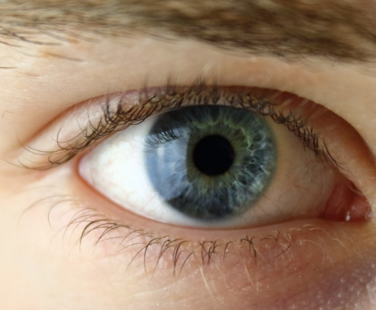
Diabetes-related eye disease
Semaglutide (Ozempic) has been associated with an increased risk of non-arteritic anterior ischemic optic neuropathy in an observational study.
This condition can occur independently of diabetes. Urgent contact with an ophthalmologist would be indicated.

Slide 44
Management of CKD in T2DM
Annually assess urine albumin to creatinine ratio (uACR) and estimated glomerular filtration rate (eGFR) in all patients with T2DM, regardless of treatment.
Treatment for hypertension should include drug classes demonstrated to reduce CV events in people with T2DM.
Angiotensin-converting enzyme inhibitors (ACEi) or (ARBs) angiotensin receptor blockers (ARBs) are recommended first-line therapy for hypertension in people with T2DM and coronary artery disease.

Slide 45
Management of CKD in people with T2DM
Multiple-drug therapy is generally required to achieve BP targets.
Combinations of ACEi and ARBs and combinations of ACEi or ARBs with direct renin inhibitors should not be used.
An ACEi or an ARB should be initiated in patients with T2DM, hypertension and albuminuria, and these medications be titrated to the highest dose that is tolerated.

Slide 46
Management of CKD in people with T2DM
Recommend the addition of a SGLT2i (dapagliflozin) to other glucose-lowering medications in adults with T2DM & CKD.
Recommend a GLP-1 RA (semaglutide) if the patient is unable to be prescribed an SGLT2i due to either intolerance or contraindication.
The evidence base for this recommendation includes studies on people with kidney disease who had an eGFR of >30 mL/min/1.73 m2

Slide 47
Management of CKD in people with T2DM
For people with T2DM and CKD with albuminuria treated with maximum tolerated doses of ACEi or ARB, addition of finerenone is recommended to improve CV outcomes and reduce the risk of CKD progression.
For people with T2DM and CKD, use of an SGLT2i (dapagliflozin) is recommended to reduce CKD progression and CV events in patients individuals with eGFR ≥20 and urinary albumin ≥200 mg/g creatinine.
For CV risk reduction in people with T2DM and diabetic CKD, consider use of an SGLT2i (if eGFR is ≥20), a GLP-1 agonist (semaglutide) or a non-steroidal mineralocorticoid receptor antagonist (finerenone) if eGFR is ≥25.

Slide 48
Management of diabetes and mental health
Routinely monitor people with diabetes for diabetes distress.
Diabetes distress is a clinically recognised emotional response to living with diabetes and the medical, financial and social impacts of diabetes.
Consider assessment for symptoms of
  diabetes distress,
  depression,
  anxiety,
  disordered eating, and
  cognitive capacities using patient-appropriate standardised and validated tools when there is a change in disease, treatment, or life circumstance;
  including caregivers and family members in this assessment is recommended.

Slide 49
Diabetes distress
Diabetes distress is a condition distinct from other psychological disorders and is estimated to affect 18–45% of people with T2DM.
Severe diabetes distress is experienced by 20% of people with insulin-treated T2DM and by 11% of those with non-insulin-treated T2DM.
Although symptoms often overlap with depressive symptoms, diabetes distress is a separate psychological condition that should be assessed for separately. It is associated with suboptimal diabetes self-care and glycaemic outcomes.

Slide 50
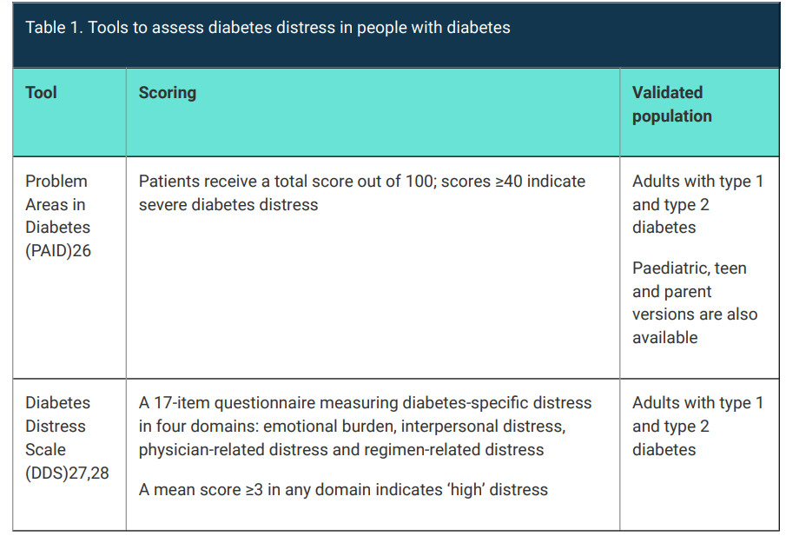
Diabetes distress

Slide 51
Diabetes and mental health
People with T2DM with any of the following should be referred to a mental health professional (GPMHCP):
  • significant distress related to diabetes management
  • persistent fear of hypoglycaemia
  • psychological insulin resistance
  • psychiatric disorders (ie depression, anxiety, eating disorders).

Slide 52
Diabetes and mental health
The 7 As model is a practical way to structure mental health care for people with diabetes.
The 7 As model encourages healthcare professionals to:
  • be aware that people with diabetes might have emotional or mental health problems
  • ask about these problems, using open-ended questions
  • assess for emotional or mental health problems using a validated tool
  • advise people about identified problems
  • assist them with developing an achievable action plan
  • assign care, where appropriate, to another healthcare professional (eg psychologist, diabetes specialist or credentialled diabetes educator)
  • arrange follow-up care

Slide 53
Vaccination advice updates
Influenza – annual vaccination
Diphtheria, tetanus, pertussis – for all adults aged ≥65 years if they have not had one in the previous 10 years
Hepatitis B – consider for travellers to hepatitis B-endemic areas
Herpes zoster – consider for ATSI people aged >50 years, and for the general population aged 65 years and over (available for free in this age group under the National Immunisation Program)

Slide 54
Vaccination advice updates
COVID 19 – assess as per current ATAGI advice
Pneumococcus – DM is considered a ‘Category B’ condition for increased risk of invasive pneumococcal disease. It is recommended that all adults with T2DM receive:
  one dose of a pneumococcal conjugate vaccine (13vPCV, 15vPCV or 20vPCV) at diagnosis (at least two months after any previous doses of a pneumococcal conjugate vaccine) and
  one dose of 23vPPV 12 months after a pneumococcal conjugate vaccine (13vPCV, 15vPCV or 20vPCV; 2–12 months later is acceptable) and a second dose of 23vPPV at least five years after the first dose of 23vPPV.
  For people who have previously received doses of 23vPPV, it is recommended they receive an age-appropriate pneumococcal conjugate vaccine 12 months after their last 23vPPV dose. If they have already received at least two doses of 23vPPV, no further 23vPPV doses are recommended.
Respiratory syncytial virus (RSV) vaccine – adults aged >60 years

Slide 55
Preoperative medication advice, including SGLT2i and GLP-1RAs
When commencing a person with diabetes on SGLT2i, inform patients about the risk of DKA associated with clinical procedures, ideally with written information and management plans.
Preop care is the same for minor and major surgery.
Insulin may be required postoperatively for some people with T2DM.

Slide 56
Preoperative medication advice, including SGLT2i and GLP-1RAs
Patients should be seen several weeks before surgery for assessment of glycaemic management and anaesthetic suitability, including their CV risks, and any treatment modifications instituted and stabilised from the time of referral before proceeding to surgery.
Aiming for HbA1c - 7% in the preoperative period has been shown to result in fewer complications and shorter hospital stays after surgery.
HbA1c ≥9% may need to have their surgery delayed until glycaemic management is optimised.

Slide 57
Preoperative medication advice, including SGLT2i and GLP-1RAs
Specifically, with SGLT2i use, the Australian Diabetes Society has guidelines for temporary cessation prior to procedures as follows:
  • For surgery and procedures requiring one or more days in hospital, omit SGLT2i for at least three days (ie two days before the procedure and on the day of procedure).
This may require increasing other glucose-lowering drugs during that time.
If the SGLT2i is part of a fixed dose combination, this will lead to withdrawal of two glucose-lowering drugs unless the second drug is prescribed separately.

Slide 58
Clinical Guideline Update
End Unit 2 – Significant updates

Slide 59
New Clinical Guideline
Case Study - Stuart

Slide 60

Case study: Stuart
43 yo male new patient to the practice.
Married, 2 children, works in corporate sales and enjoyed sports when younger – rugby union.
Wife sent him in for check up after seeing something on TV about heart health.

Slide 61
Case study: Stuart
Non-smoker
Drinks regularly with clients, footy mates and with family social circle.
185cm & 130 kg
BMI = 37.98, which falls in the obese category.
Family history:
  Mum – DM, breast ca
  Dad – MI, non-melanoma skin malignancies

Slide 62
Case study: Stuart
O/e:
  Obese, BP – 140/65, P – 85 reg, HSDNM, chest clear
Agree to fasting pathology:
  FBC, ELFTS, Fasting lipids
Advise on lifestyle interventions & goals:
  Obesity – will work on long-term weight loss approach with pt
  Alcohol – will work on long-term reduction of intake

Slide 63
Case study: Stuart
2 weeks later Stuart returns for results:
  FBC – WNL
  ELFTS – Fasting glucose - 9.5mmol/L
  Lipids – Fasting chol 5.3
  Trigs - 1.7
  HDL - 1.19
  LDL (Calc) - 3.34
  Non hdl Chol - 4.11
  Total HDL ratio - 4.5

Slide 64
Case study: Stuart
Repeat bloods, including HBA1c & OGTT
HBA1c – 8.8%
OGTT – confirms T2DM

Slide 65
Case study: Stuart
Repeat bloods, including HBA1c & OGTT
HBA1c – 8.8%
OGTT – confirms T2DM
What do we do now?

Slide 66
Case study: Stuart
Repeat bloods, including HBA1c & OGTT
HBA1c – 8.8%
OGTT – confirms T2DM
What do we do now?
Address glucose control.

Slide 67
Case study: Stuart
Repeat bloods, including HBA1c & OGTT
HBA1c – 8.8%
OGTT – confirms T2DM
What do we do now?
Address glucose control.
Address BP control

Slide 68
Case study: Stuart
Repeat bloods, including HBA1c & OGTT
HBA1c – 8.8%
OGTT – confirms T2DM
Address glucose control.
Address BP control
Manage lipids.

Slide 69
Case study: Stuart
Glucose control
  Metformin (500mg mane) - no set dose, however, start low & go slow.
BP
  Repeat BP readings in clinic = 140/85
  Commence ACE Ramipril (5mg mane)
Lipids
  Commence statin Crestor (5mg nocte)

Slide 70
Case study: Stuart
Education:
  NDSS application
  Refer to diabetic educator (GPMP)
  Refer to Diabetes Australia website

Slide 71
Case study: Stuart
Education:
  NDSS application
  Refer to diabetic educator (GPMP)
  Refer to Diabetes Australia website
Follow-up:
  Bloods in 3/12, path form given
  Review earlier if having SEs with medications.

Slide 72
Case study: Stuart – 3/12 later
 | At Diagnosis | 3/12
FBC | WNL | WNL
Fasting glucose | 9.5 | 9.0
HBA1c % | 8.8 | 7.5
Fasting chol | 5.3 | 5.0
Trigs | 1.7 | 1.7
HDL | 1.19 | 1.19
LDL | 3.34 | 3.25
Non HDL Chol | 4.11 | 4.05
Total HDL ratio | 4.5 | 4.0
BP | 140/65 | 135/80
Weight | 130kg | 128kg

Slide 73
Case study: Stuart – 3/12 later
 | At Diagnosis | 3/12
FBC | WNL | WNL
Fasting glucose | 9.5 | 9.0
HBA1c % | 8.8 | 7.5
Fasting chol | 5.3 | 5.0
Trigs | 1.7 | 1.7
HDL | 1.19 | 1.19
LDL | 3.34 | 3.25
Non HDL Chol | 4.11 | 4.05
Total HDL ratio | 4.5 | 4.0
BP | 140/65 | 135/80
Weight | 130kg | 128kg
What do we think of these results?

Slide 74
Case study: Stuart – 3/12 later
 | At Diagnosis | 3/12
FBC | WNL | WNL
Fasting glucose | 9.5 | 9.0
HBA1c % | 8.8 | 7.5
Fasting chol | 5.3 | 5.0
Trigs | 1.7 | 1.7
HDL | 1.19 | 1.19
LDL | 3.34 | 3.25
Non HDL Chol | 4.11 | 4.05
Total HDL ratio | 4.5 | 4.0
BP | 140/65 | 135/80
Weight | 130kg | 128kg
What do we think of these results?
What changes will we make?
Stuart has not had any SEs to medications.

Slide 75
Case study: Stuart
Medications at diagnosis
Metformin 500mg mane
Rampril 5mg mane
Crestor 5mg nocte

Slide 76
Case study: Stuart
Medications at diagnosis | 3/12
Metformin 500mg mane | Metformin 500mg bd
Ramipril 5mg mane | Ramipril 10mg mane
Crestor 5mg nocte | Crestor 10mg nocte
Continue with lifestyle interventions/ support:
  Encourage exercise – exercise physio / sport
  Reduce alcohol intake – triggers
  Meal changes – fizzy drink / snacks
Follow up in 3/12

Slide 77
Case study: Stuart – 6/12 later
 | At Diagnosis | 3/12 | 6/12
FBC | WNL | WNL | WNL
Fasting glucose | 9.5 | 9.0 | 7.5
HBA1c % | 8.8 | 7.5 | 7.5
Fasting chol | 5.3 | 5.0 | 4.5
Trigs | 1.7 | 1.7 | 1.6
HDL | 1.19 | 1.19 | 1.2
LDL | 3.34 | 3.25 | 3.0
Non HDL Chol | 4.11 | 4.05 | 4.08
Total HDL ratio | 4.5 | 4.0 | 3.2
BP | 140/65 | 135/80 | 126/60
Weight | 130kg | 128kg | 126kg

Slide 78
Case study: Stuart – 6/12 later
 | At Diagnosis | 3/12 | 6/12
FBC | WNL | WNL | WNL
Fasting glucose | 9.5 | 9.0 | 7.5
HBA1c % | 8.8 | 7.5 | 7.5
Fasting chol | 5.3 | 5.0 | 4.5
Trigs | 1.7 | 1.7 | 1.6
HDL | 1.19 | 1.19 | 1.2
LDL | 3.34 | 3.25 | 3.0
Non HDL Chol | 4.11 | 4.05 | 4.08
Total HDL ratio | 4.5 | 4.0 | 3.2
BP | 140/65 | 135/80 | 126/60
Weight | 130kg | 128kg | 126kg
What do we think of these results?

Slide 79
Case study: Stuart – 6/12 later
 | At Diagnosis | 3/12 | 6/12
FBC | WNL | WNL | WNL
Fasting glucose | 9.5 | 9.0 | 7.5
HBA1c % | 8.8 | 7.5 | 7.5
Fasting chol | 5.3 | 5.0 | 4.5
Trigs | 1.7 | 1.7 | 1.6
HDL | 1.19 | 1.19 | 1.2
LDL | 3.34 | 3.25 | 3.0
Non HDL Chol | 4.11 | 4.05 | 4.08
Total HDL ratio | 4.5 | 4.0 | 3.2
BP | 140/65 | 135/80 | 126/60
Weight | 130kg | 128kg | 126kg
What do we think of these results?
Stuart is motivated but unable to control meals & weight.
He has reduced alcohol.
Treatment options?

Slide 80
Case study: Stuart – 6/12 post diagnosis
Medications at diagnosis | 3/12
Metformin 500mg mane | Metformin 500mg bd
Ramipril 5mg mane | Ramipril 10mg mane
Crestor 5mg nocte | Crestor 10mg nocte

Slide 81
Case study: Stuart – 6/12 post diagnosis
Medications at diagnosis | 3/12
Metformin 500mg mane | Metformin 500mg bd
Ramipril 5mg mane | Ramipril 10mg mane
Crestor 5mg nocte | Crestor 10mg nocte
Able to access semaglutide on PBS.
Stuart happy to add this in.

Slide 82
Case study: Stuart – 6/12 post diagnosis
Medications at diagnosis | 3/12 | 6/12
Metformin 500mg mane | Metformin 500mg bd | Metformin 500mg bd
Ramipril 5mg mane | Ramipril 10mg mane | Ramipril 10mg mane
Crestor 5mg nocte | Crestor 10mg nocte | Crestor 10mg mane
 |  | Semaglutide 0.25mg/week
Continue with weight loss management – dietitian, diabetic educator
Continue with exercise
Follow up in 3 months for review, path form given

Slide 83
Case study: Stuart – 12/12 post diagnosis
 | Diagnosis | 3/12 | 6/12 | 12/12
FBC | WNL | WNL | WNL | WNL
Fasting glucose | 9.5 | 9.0 | 7.5 | 7.0
HBA1c % | 8.8 | 7.5 | 7.5 | 6.5
Fasting chol | 5.3 | 5.0 | 4.5 | 4.0
Trigs | 1.7 | 1.7 | 1.6 | 1.5
HDL | 1.19 | 1.19 | 1.2 | 1.3
LDL | 3.34 | 3.25 | 3.0 | 3.0
Non HDL Chol | 4.11 | 4.05 | 4.08 | 4.05
Total HDL ratio | 4.5 | 4.0 | 3.2 | 3.2
BP | 140/65 | 135/80 | 126/60 | 125.60
Weight | 130kg | 128kg | 126kg | 116

Slide 84
Case study: Stuart – 12/12 post diagnosis
 | Diagnosis | 3/12 | 6/12 | 12/12
FBC | WNL | WNL | WNL | WNL
Fasting glucose | 9.5 | 9.0 | 7.5 | 7.0
HBA1c % | 8.8 | 7.5 | 7.5 | 6.5
Fasting chol | 5.3 | 5.0 | 4.5 | 4.0
Trigs | 1.7 | 1.7 | 1.6 | 1.5
HDL | 1.19 | 1.19 | 1.2 | 1.3
LDL | 3.34 | 3.25 | 3.0 | 3.0
Non HDL Chol | 4.11 | 4.05 | 4.08 | 4.05
Total HDL ratio | 4.5 | 4.0 | 3.2 | 3.2
BP | 140/65 | 135/80 | 126/60 | 125.60
Weight | 130kg | 128kg | 126kg | 116
What do we think of these results?

Slide 85
Case study: Stuart – 12/12 post diagnosis
 | Diagnosis | 3/12 | 6/12 | 12/12
FBC | WNL | WNL | WNL | WNL
Fasting glucose | 9.5 | 9.0 | 7.5 | 7.0
HBA1c % | 8.8 | 7.5 | 7.5 | 6.5
Fasting chol | 5.3 | 5.0 | 4.5 | 4.0
Trigs | 1.7 | 1.7 | 1.6 | 1.5
HDL | 1.19 | 1.19 | 1.2 | 1.3
LDL | 3.34 | 3.25 | 3.0 | 3.0
Non HDL Chol | 4.11 | 4.05 | 4.08 | 4.05
Total HDL ratio | 4.5 | 4.0 | 3.2 | 3.2
BP | 140/65 | 135/80 | 126/60 | 125.60
Weight | 130kg | 128kg | 126kg | 116
What do we think of these results?
Would we change anything?

Slide 86
Summary points
T2DM is a chronic disease
Foundation of treatment – lifestyle => diet & exercise
Don’t forget mental health
Treatment options – multiple combinations – think individually for the patient

Slide 87
References
Royal Australian College of General Practitioners. (2024). Management of type 2 diabetes: A handbook for general practice (Clinical summary). RACGP. https://www.racgp.org.au/getattachment/010e971d-81a6-435e-90d0-8bb15eff8f7e/Management-of-type-2-diabetes-A-handbook-for-general-practice-Clinical-summary.pdf.aspx
Diabetes Australia. (2020). Management of type 2 diabetes: A handbook for general practice. Diabetes Australia. https://www.diabetesaustralia.com.au/wp-content/uploads/Available-here.pdf

Slide 88
References
https://www.cvdcheck.org.au/calculator
National Heart Foundation of Australia. Guideline for the diagnosis and management of hypertension in adults – 2016. Melbourne: National Heart Foundation of Australia, 2016.

Slide 89
New Clinical Guideline
END MODULE

